Slide 1
Is AI a valuable education tool that improves student learning?
Critical Thinking: Metacognition

Slide 2


How does Kialo work?
If you’re new to Kialo, watch this video to discover how the platform works. Otherwise, let’s get started!

Slide 3

Lesson Objectives
Explore key ways AI may impact student learning.
Analyze how specific AI tools may support or conflict with their individual learning strategies using a structured comparison.
Reflect on how understanding their own learning can help them use AI more ethically and responsibly in educational contexts.

Slide 4
Lesson Vocabulary
Artificial Intelligence (AI)
metacognition
self-regulated learning
cognitive offloading
cognitive onloading
learning strategy

Slide 5

Metacognition - Understanding how we think and learn
We are going to explore how we think and learn and how it relates to AI to help us be self-regulated learners.

Slide 6

3 - 2 - 1 LEARN!
Think about a time you learned something new.
Write:
3 actions you took that day
2 ways you received support
1 feeling you had when you realized you learned something new

Slide 7


Let’s Watch
What is cognitive load?

Slide 8


Think - Pair - Share
Find examples of onloading and offloading that you do in your daily life.
Onloading
Offloading
Doing the thinking yourself
Giving the thinking to someone or something else
Example: Doing mental math
Example: Using a calculator

Slide 9
3 - 2 - 1 LEARN!
Think about a time you learned something new.
Write:
3 actions you took that day
2 ways you received support
1 feeling you had when you realized you learned something new
ADD one moment where you did most of the work (cognitive onloading)
ADD one moment where a tool did most of the work (cognitive offloading)

Slide 10
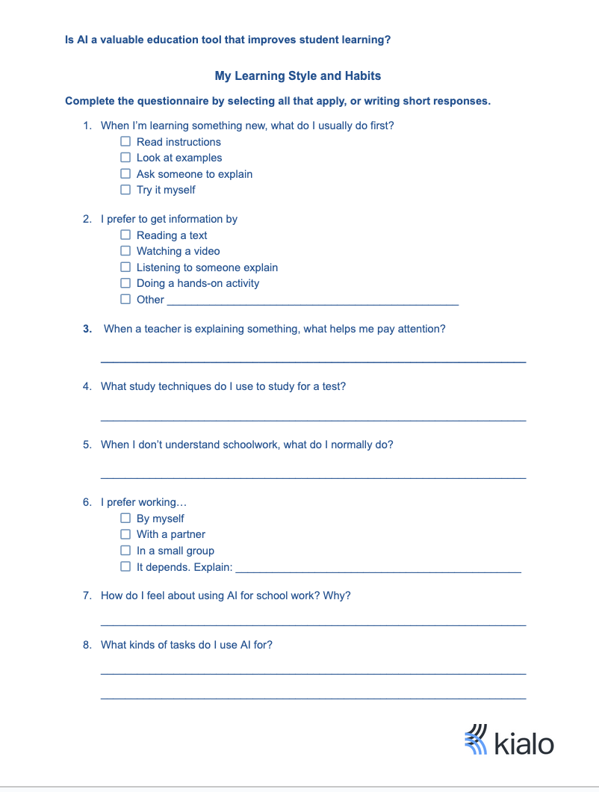
My Learning Style and Habits
Understanding our learning style and habits can help us self-regulate our own learning. Complete the questionnaire by selecting all that apply, or writing short responses.

Slide 11
AI Tools for Learning Chart
Find 5 AI tools. What do you use them for?
Helpful offloading
Using AI helps the STUDENT make more brain space to work on the learning objective.
Ex: Using Canva AI to create background design for a presentation.
Unhelpful offloading
Using AI to do the thinking that achieves the learning objective, taking the thinking opportunity away from the STUDENT.
Ex: Using Canva AI to create the content of the presentation.

Slide 12
Activity 2: Kialo Discussion
Use the information you gathered in the AI Tools chart to help you.
Class Discussion
Is AI a valuable education tool that improves student learning?

Slide 13
Activity 2: Kialo Discussion Task
Add at least four claims in total.
One claim must be in response to YOUR own idea, citing a specific AI-tool to support your original claim.
Reply to at least two additional claims written by another student, either supporting or opposing. Cite specific tools to support claims where needed.

Slide 14

Reflection:
Describe one current AI-related learning habit you have.
Is this habit mostly cognitive offloading or onloading? Why?
Does this habit help or hurt your learning?
Plan one small change to your learning habit for next week. What would you like to keep, change, or try?

Slide 15
Lesson Vocabulary: Review
Artificial Intelligence (AI)
Metacognition
self-regulated learning
cognitive offloading
cognitive onloading
learning strategy

Slide 16
Lesson Objectives: Review
Explore key ways AI may impact student learning.
Analyse how specific AI tools may support or conflict with their individual learning strategies using a structured comparison.
Reflect on how understanding their own learning can help them use AI more ethically and responsibly in educational contexts.

