Slide 1
Can Art Transform a Community?
The Arts:
The Nature of Art
Lesson 3: Listening Task

Slide 2


How does Kialo work?
If you’re new to Kialo, watch this video to discover how the platform works. Otherwise, let’s get started!

Slide 3

Lesson Objectives
Analyze how personal experience, social perception, and institutional framing shape our understanding of street art
Evaluate how public art challenges or reinforces dominant narratives around value, vandalism, and impact
Use a real-world example to deepen understanding of justification, interpretation, and perspective in the arts

Slide 4

TOK Concepts
Justification: What reasons does Gonzalez give for calling his work “art”? Are they convincing?
Interpretation: How did the meaning of his murals shift depending on who viewed them?
Perspective: How do institutions, students, and the artist himself view his work differently?
Today’s lesson links to these TOK concepts.
By completing the activities, you will build knowledge that can help with your assessments.

Slide 5
Introduction: Understanding Street Art
Today’s lesson is based around a video about the nature of graffiti.
Step 1
Share your own perspectives on what counts as valid evidence in history.
Step 2
Watch a video on the topic. Take notes on the main arguments and counterarguments, analyzing their strengths and weaknesses.
Step 3
Use your notes to add the strongest arguments and counterarguments to a Kialo discussion.

Slide 6

Introduction: Key Concepts
Justification
What counts as a valid reason for calling something art?
Interpretation
How do people interpret the same artwork differently?
Perspective
Whose view determines what art is valued or dismissed?

Slide 7

Introduction: Understanding Street Art
Class Discussion
What’s the difference between graffiti and public art?

Slide 8
Introduction: Understanding Street Art
Class Discussion
Can artwork created with spray paint carry deep meaning?

Slide 9
Introduction: Understanding Street Art
Class Discussion
How do stereotypes around “vandalism” shape how people view public artists?

Slide 10
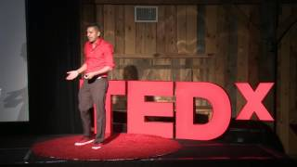
Listening Task: Graffiti: Art or Vandalism?
As you watch the video, take notes on the key arguments and counterarguments.
Analyze the strengths and weaknesses of each argument.
Find other sources to support your analysis.
You will need your notes for today’s Kialo discussion!

Slide 11
Listening Task: Understanding Street Art
As you watch the video, take notes on the key arguments and counterarguments, analyzing their strengths and weaknesses.
Key Points to Listen For:
Identify examples he uses (e.g., murals in schools, Banksy, Shepard Fairey).
What evidence does he give for how art changes communities or education?
How did people react to his art (students, teachers, the public)?
What role does perspective play in whether his work is seen as art or vandalism?
How does Gonzalez critique corporate advertising in public spaces?
Key Points to Listen For:
What role does perspective play in whether his work is seen as art or vandalism?
How does Gonzalez critique corporate advertising in public spaces?
How does he compare public art to commercial messaging?
How does Gonzalez argue that art improves education and civic engagement?
What examples does he give of street art sparking social change?

Slide 12
Listening Task: Understanding Street Art
As you watch the video, take notes on the key arguments and counterarguments, analyzing their strengths and weaknesses.
Note-Taking Framework
Main arguments: What is Gonzalez’s central claim about airbrushed and graffiti-based art?
How does he justify street art as transformative and valuable?
Examples: What school-based mural projects or public works does he reference?
What examples does he give of public responses to his murals or student-created artwork?
Main counterarguments: What negative assumptions or stereotypes does he mention about spray paint or graffiti?
How does Gonzalez respond to these critiques and reframe public art as a positive force?

Slide 13
Kialo Discussion: Can art be a form of knowledge, activism, and education even when it’s created outside official institutions?
You will now use your research in a Kialo discussion.
Your teacher will tell you whether to create your own discussion or use a ready-made version.
Step 1
If you have created your own discussion, add your theses or starter claims.
These are the main points you wish to argue for or against.
Step 2
Add the strongest arguments (pros) under each thesis, based on your notes and previous research.
Be sure to reference responsibility, evidence and certainty.
Step 3
Follow the same approach to add counterarguments (cons) to each branch.
Step 4
Include examples and evidence to support your arguments and counterarguments.

Slide 14
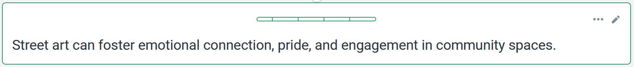


Kialo Discussion: Example Claims
For example, Gonzalez’s murals in schools made students feel happy and connected to their environment; they said walking past his work uplifted and inspired them.
While students may enjoy it, the impact on education or well-being is difficult to measure without formal evaluation.

Slide 15
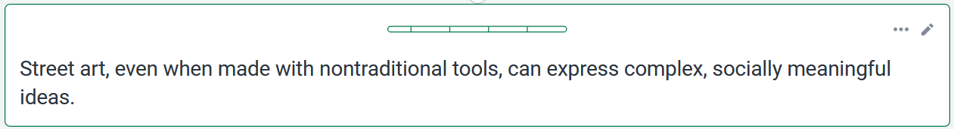
Kialo Discussion: Example Claims
For example, Gonzalez argues spray cans are just tools, like pencils or brushes, and his mural, like Banksy’s, delivers powerful, thoughtful messages using public space.
Without context or institutional framing, such messages can be misread or erased before creating impact.

Slide 16
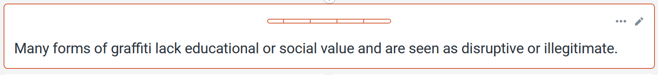
Kialo Discussion: Example Claims
For example, some view unsanctioned art as a distraction or as encouraging nonconformity.
Even unsanctioned or raw street art can reflect authentic community voice and spark dialogue.

Slide 17
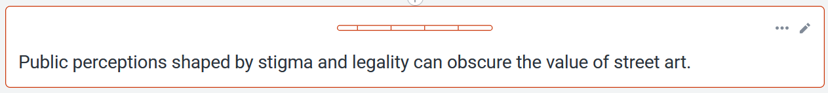
Kialo Discussion: Example Claims
For example, Gonzalez felt ashamed using spray cans due to their association with vandalism; without institutional backing, such work is often criminalized.
As more artists gain recognition and community support, these perceptions can change without formal approval.

Slide 18
Reflection Task: Understanding Street Art
Reflection Questions
What surprised you most about Diego Gonzalez’s perspective on street art and education?
What real-world examples did Gonzalez use to support his claims?
How does the dismissal of spray-can art reflect deeper social or institutional biases?
Should our definition of art expand to include non-institutional, public, or political expression?
What responsibilities do educators, cities, and cultural institutions have in supporting alternative art forms?

Slide 19
Lesson Objectives: Recap
Analyze how personal experience, social perception, and institutional framing shape our understanding of street art
Evaluate how public art challenges or reinforces dominant narratives around value, vandalism, and impact
Use a real-world example to deepen understanding of justification, interpretation, and perspective in the arts

