Slide 1
How do real-world examples of street art and graffiti reveal tensions between justification, interpretation, and perspective?
The Arts:
The Nature of Art
Lesson 2: Fact-Finding Task

Slide 2


How does Kialo work?
If you’re new to Kialo, watch this video to discover how the platform works. Otherwise, let’s get started!

Slide 3

Lesson Objectives
Investigate real-world case studies of street art and graffiti to understand how meaning and legitimacy are contested
Analyze how different interpretations and perspectives influence public response, legal status, and artistic recognition
Substantiate or challenge claims from Lesson 1 using contextual examples and TOK reasoning

Slide 4

TOK Concepts
Justification: What reasons were given to support or reject the work as art?
Interpretation: How did different groups interpret the same artwork differently?
Perspective: Whose viewpoint shaped public or legal response to the work?
Today’s lesson links to these TOK concepts.
By completing the activities, you will build knowledge that can help with your assessments.

Slide 5
Introduction: Interpretation of Art
Today’s lesson is about using case studies to expand your knowledge on the meaning and legitimacy of art.
Step 1(inc. homework)
Conduct in-depth research into a specific case, and give a short presentation to the class.
Step 2
Present your findings, and refine your arguments in your Kialo discussions.
Step 3
Reflect on different interpretations of the definition of art.

Slide 6
Case Study: Interpretation of Art
Your teacher will assign you a case study for homework.
Banksy’s “Girl with Balloon” – Shredded at Auction
Focus: How institutional framing and market value influence artistic legitimacy.
Key Question: Does commercial recognition justify calling something “art”?
5Pointz NYC Graffiti Site – Erased by Developers
Focus: The erasure of cultural landmarks and community art spaces in urban redevelopment.
Key Question: Who decides which public artworks are preserved — and why?
Shepard Fairey’s “Hope” Poster – Political Art and Mass Reproduction
Focus: The tension between political messaging, mass production, and artistic status.
Key Question: Does a work’s political impact or popularity affect how it is interpreted as art?
Local Graffiti (Student-Sourced) – Street Expression in Your City
Focus: Everyday graffiti as political commentary, protest, or art in local communities.
Key Question: Can local, unsanctioned art be more powerful or meaningful than curated gallery works?

Slide 7

Case Study: Interpretation of Art
You will need to give a short presentation to the class on your case study.
Presentation
Your presentation should focus on:
What happened in the case.
How different perspectives (artist, government, public, media) justified or criticized the work.
Which TOK concept (justification, interpretation, perspective) is most relevant.
Whether the case supports or challenges a claim from Lesson 1.

Slide 8

Introduction: Interpretation of Art
Class Discussion
Last lesson, which claims did you find most convincing or flawed?
Did any arguments rely too much on opinion without real examples?

Slide 9
Introduction: Interpretation of Art
Class Discussion
How do real-world examples of street art challenge the boundaries of artistic legitimacy and reflect different perspectives?

Slide 10
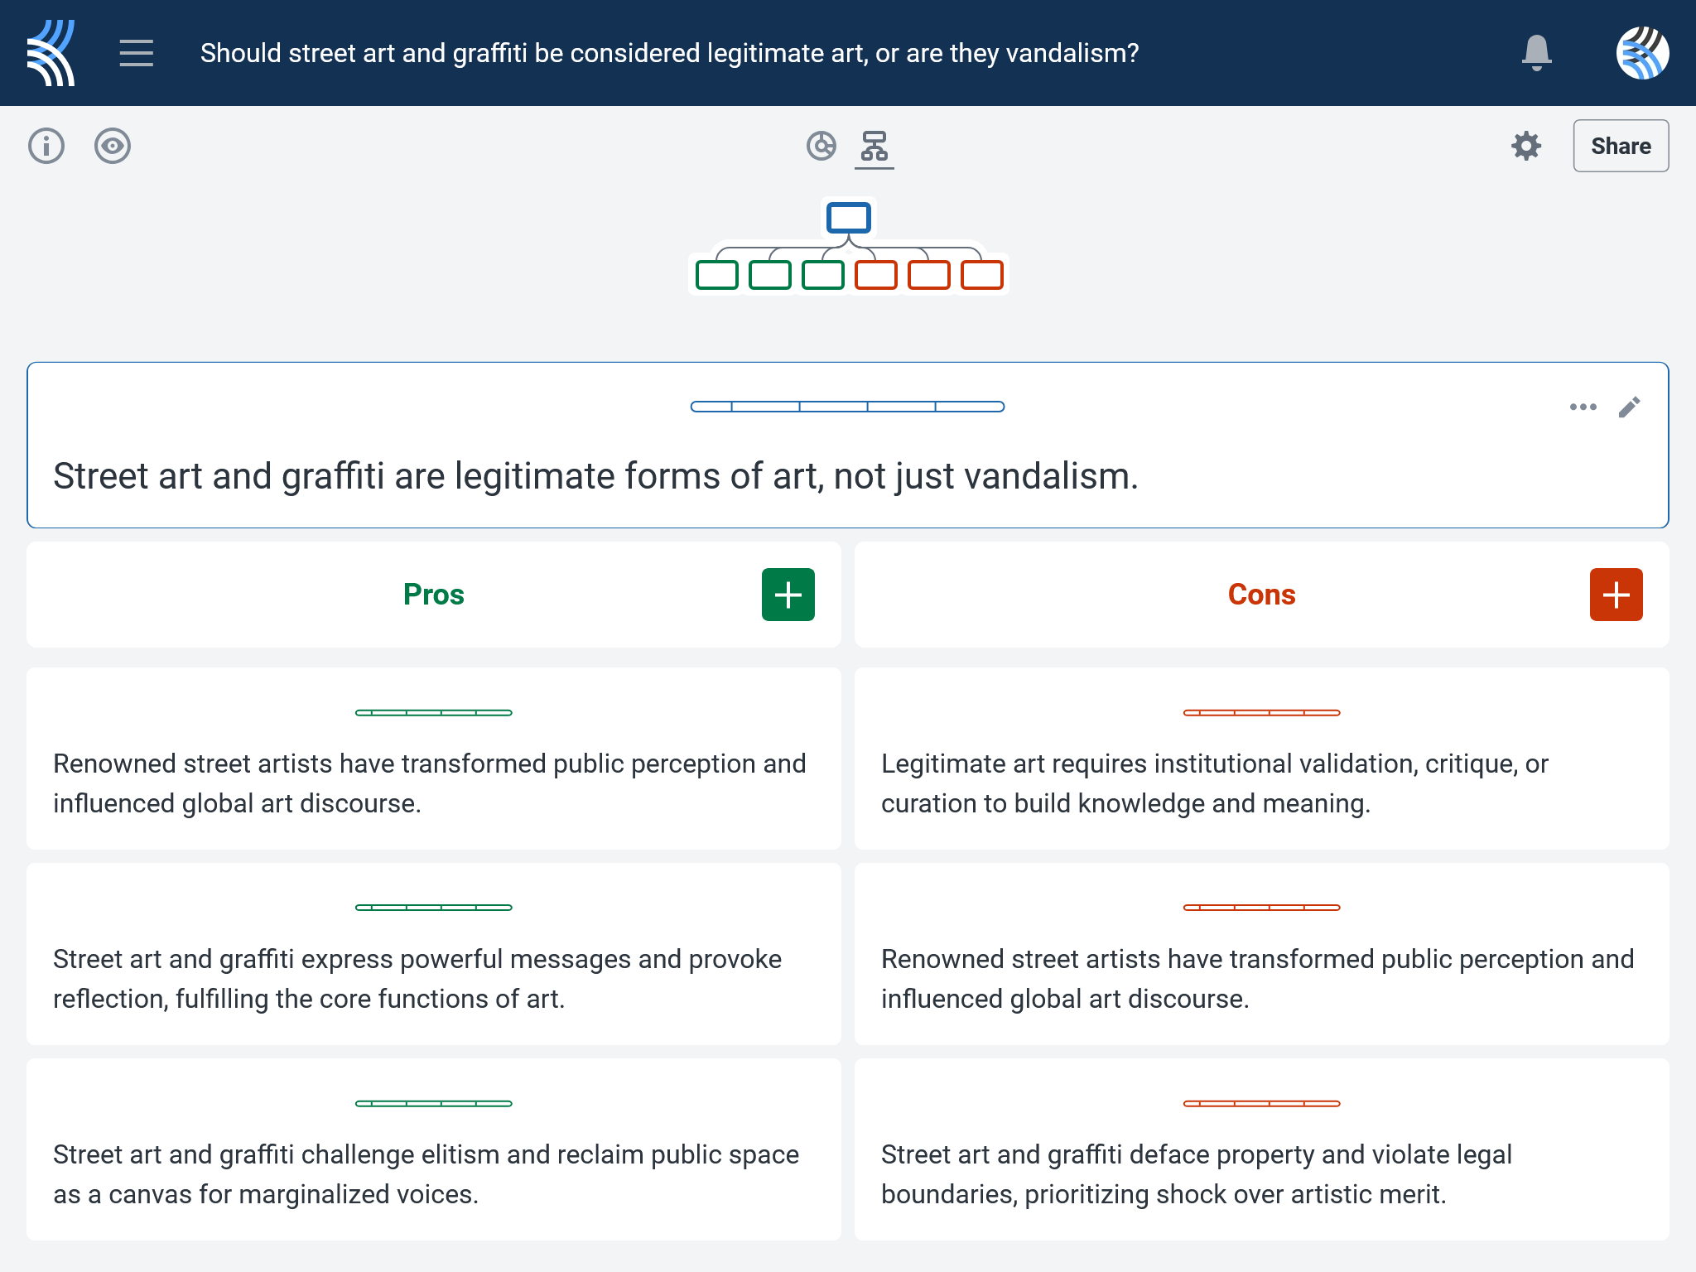
Kialo Discussion: Should street art and graffiti be considered a legitimate form of art, or are they vandalism?
Use your case study and any other research to support, challenge, or refine your initial arguments in your Kialo discussion!

Slide 11
Reflection Task: Interpretation of Art
How did your case study affect your understanding of who gets to define and preserve art in public spaces?
What made certain examples feel more like suppression or erasure — versus celebration or empowerment?
In your case, who had the most control over the artistic narrative — governments, institutions, artists, or communities?

Slide 12
Reflection Task: Interpretation of Art
Can efforts to include marginalized artistic voices ever be truly equal when power and access to platforms remain uneven?
What role should visibility, credibility, and consent play in deciding how street art is displayed, removed, or commercialized?
Should all public uses of artistic expression require consultation with the communities they represent — or are there exceptions?

Slide 13
Lesson Objectives: Recap
Investigate real-world case studies of street art and graffiti to understand how meaning and legitimacy are contested
Analyze how different interpretations and perspectives influence public response, legal status, and artistic recognition
Substantiate or challenge claims from Lesson 1 using contextual examples and TOK reasoning

