Slide 1
Are street art and graffiti legitimate forms of art?
The Arts:
The Nature of Art
Lesson 1: Opening Debate

Slide 2


How does Kialo work?
If you’re new to Kialo, watch this video to discover how the platform works. Otherwise, let’s get started!

Slide 3

Lesson Objectives
Examine how people justify whether something qualifies as art
Explore how interpretation of street art varies depending on context and viewer
Recognize the role of perspective in shaping artistic judgments and knowledge claims

Slide 4

TOK Concepts
Justification: What reasons or criteria do people use to justify whether street art is “real” art?
Interpretation: How does the meaning of a street artwork change depending on who sees it and where it appears?
Perspective: How do different roles (e.g., artist, critic, official, citizen) affect what people believe counts as art?
Today’s lesson links to these TOK concepts.
By completing the activities, you will build knowledge that can help with your assessments.

Slide 5
Introduction: The Legitimacy of Street Art and Graffiti
Today’s lesson is about sharing your existing knowledge and perspectives on whether street art and graffiti are legitimate forms of art.
Step 1
Discuss the class’s initial response to the question.
Step 2
Share your existing knowledge and perspectives and respond to those of your peers in an in-depth Kialo discussion.
Step 3
Reflect on what counts as art.

Slide 6

Introduction: Key Concepts
Justification
What counts as a valid reason for calling something art?
Interpretation
How does meaning change based on audience, culture, or setting?
Perspective
Whose view is represented in how we define and value art?

Slide 7

Introduction: The Legitimacy of Street Art and Graffiti
Class Discussion
Should street art and graffiti be considered a legitimate form of art, or are they vandalism?

Slide 8
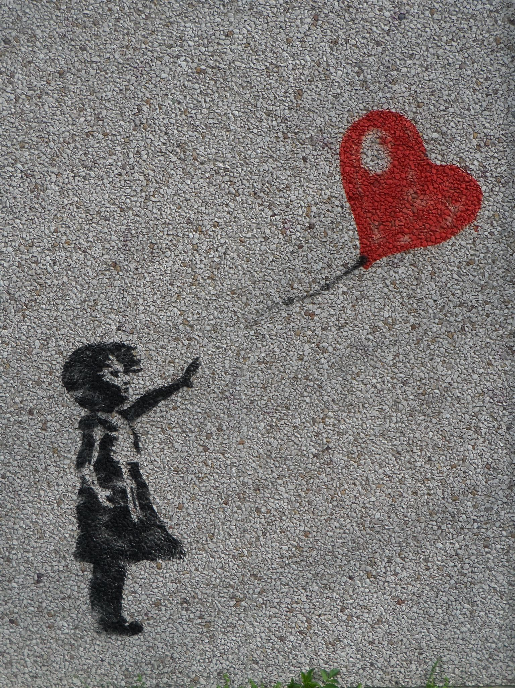

Introduction: Girl With a Balloon
Discussion Questions
Is this art?
Would your answer change if you were the property owner? A curator? A street artist?
What factors influence your view?

Slide 9
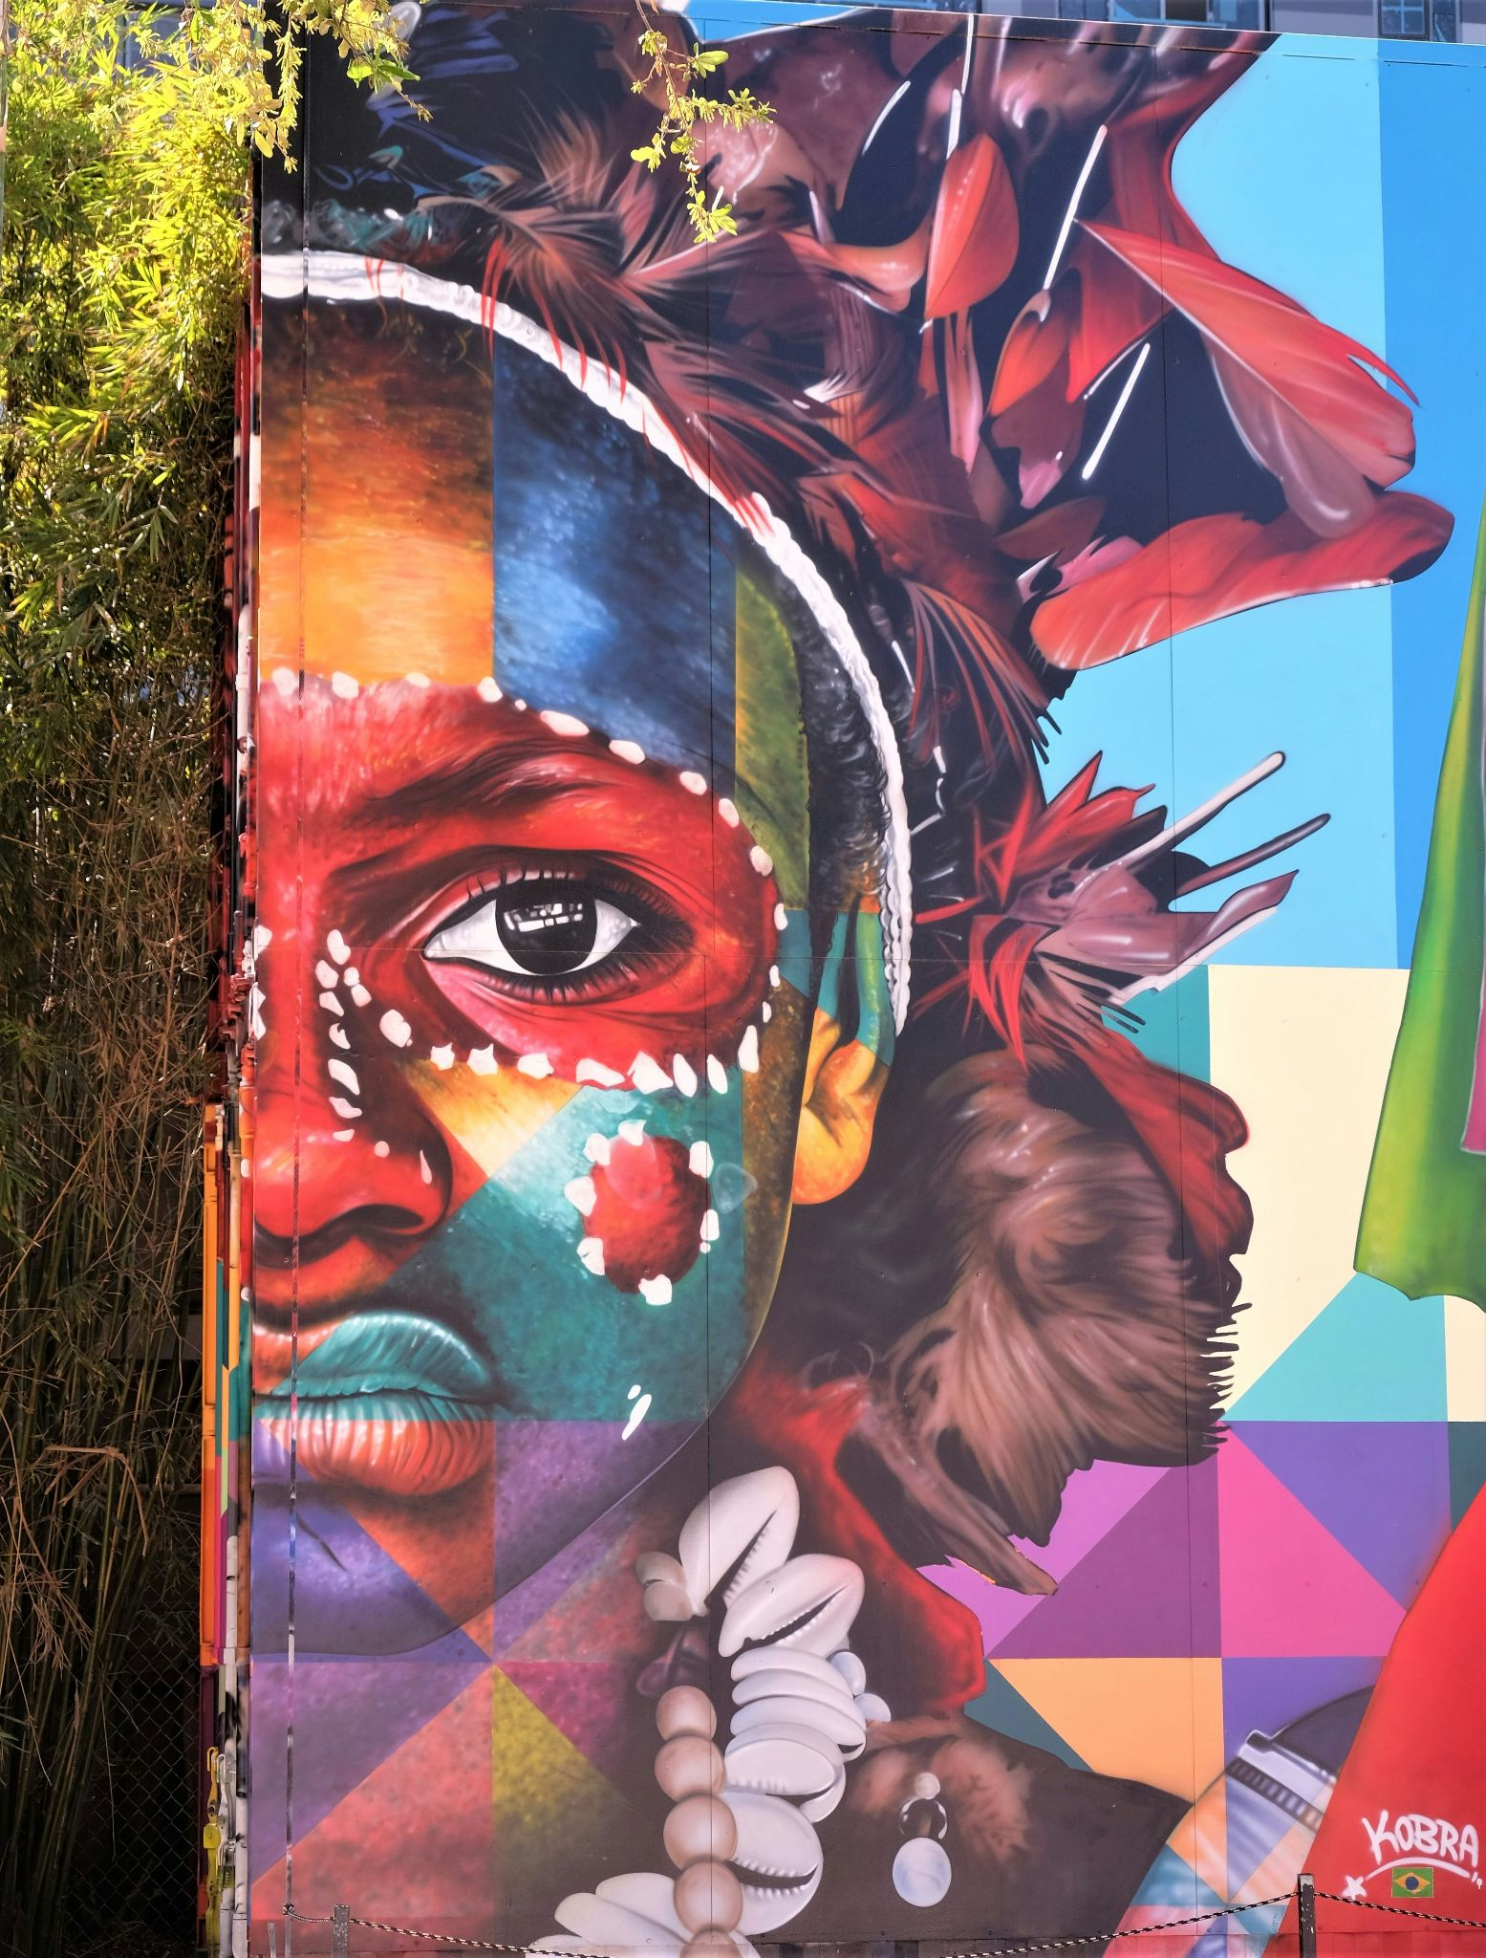
Introduction: Wynwood Walls
Discussion Questions
Is this art?
Would your answer change if you were the property owner? A curator? A street artist?
What factors influence your view?

Slide 10
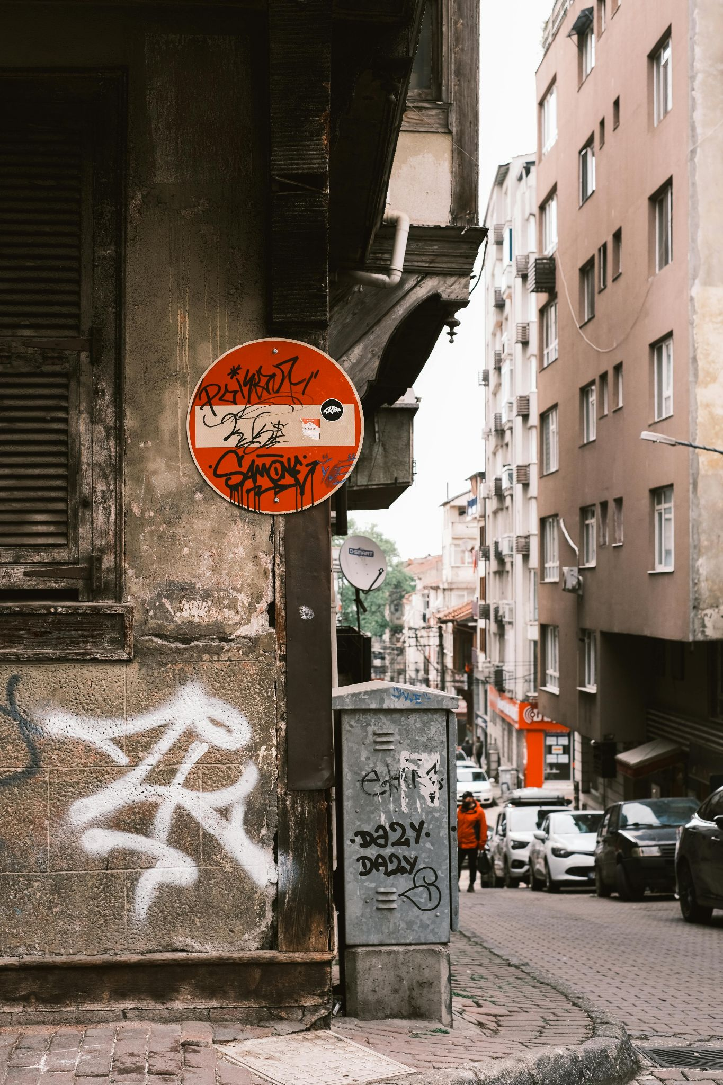
Introduction: Graffiti Tags
Discussion Questions
Is this art?
Would your answer change if you were the property owner? A curator? A street artist?
What factors influence your view?

Slide 11

Introduction: The Sistine Chapel
Discussion Questions
Is this art?
Would your answer change if you were the property owner? A curator? A street artist?
What factors influence your view?

Slide 12
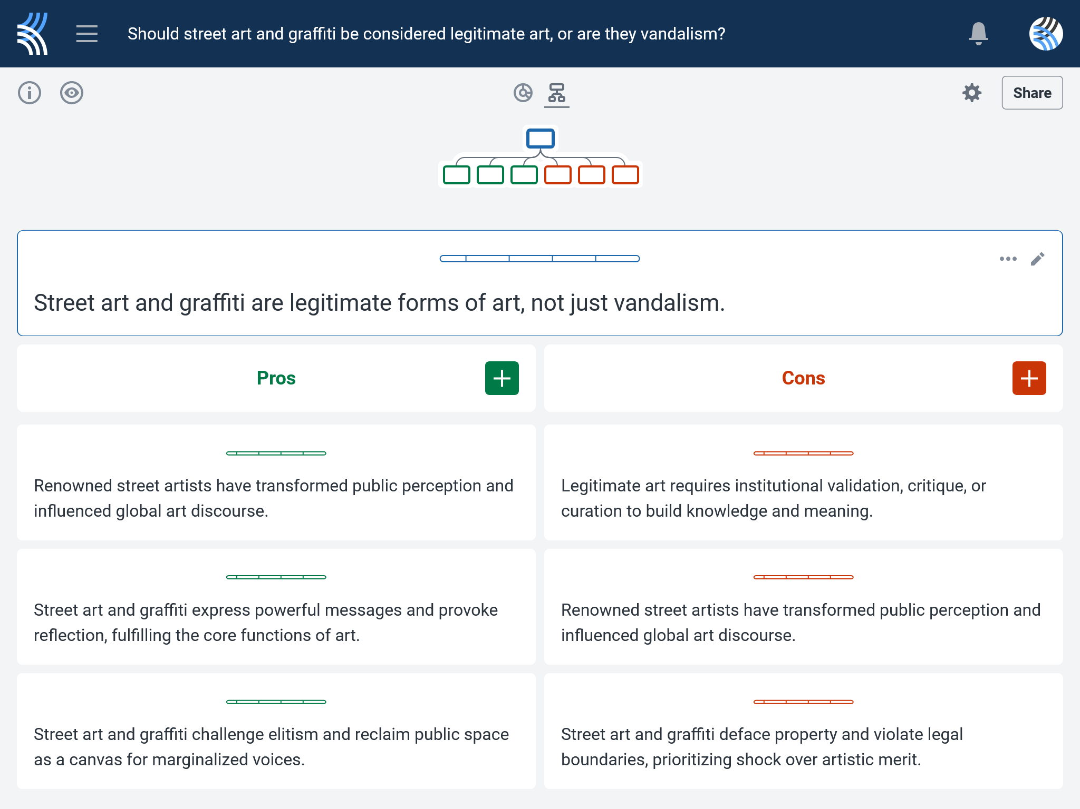
Kialo Discussion: Should street art and graffiti be considered a legitimate form of art, or are they vandalism?
Now that you’ve had chance to discuss your initial thoughts, you are going to add your ideas to a Kialo discussion.
Let’s learn more about having an in-depth discussion on Kialo.

Slide 13
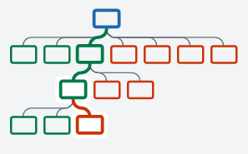

Kialo Discussion: The Argument Tree
On Kialo, the discussion is represented by an argument tree.
The pros are green and the cons are red.
Here are two Kialo argument trees.
Which one represents a more in-depth discussion?

Slide 14
Kialo Discussion: The Argument Tree
In this discussion, everyone has added their own perspective on the thesis.
Some perspectives might be repeated.
Students have not engaged with their peers’ perspectives.
This is unlikely to be an in-depth discussion!
In this discussion, students have added their perspective on the thesis, developed their arguments, and responded to other perspectives.
This results in a more in-depth discussion!

Slide 15
Kialo Discussion: Should street art and graffiti be considered a legitimate form of art, or are they vandalism?
Let’s apply this to a discussion!
Building Arguments
Step 1: Choose the starter claim you most agree with.
Step 2: Develop this claim by adding at least 2 pros.
Step 3: Add at least 2 cons to represent an alternative perspective.
Step 4: Repeat this for at least 3 other starter claims.
Step 5: Your peers will also add claims to the discussion. Try to respond to at least 3 of these.
Check the argument tree: How deep is the discussion?

Slide 16
Kialo Discussion: Should street art and graffiti be considered a legitimate form of art, or are they vandalism?
Questions to Consider
What makes something “art” rather than vandalism — intention, context, or recognition?
How do different perspectives (e.g., artist, property owner, city official, art critic) shape our interpretation of street art?
Can a work be meaningful or valuable if it was created without permission?
Should public approval or expert validation be necessary to justify artistic status?
How do the TOK concepts of justification, interpretation, and perspective help us make sense of disagreements over street art?

Slide 17
Reflection Task: The Legitimacy of Street Art and Graffiti
Did your view of what counts as art shift during today’s discussion?
What was the strongest justification you heard for or against street art?
How did someone else’s perspective or interpretation challenge your assumptions?
Which concept — justification, interpretation, or perspective — helped you most clearly understand the debate?
Optional extension: Ask students to find and photograph a piece of street art or graffiti before next class. Write a short note: What do you think it means? Do you consider it art? Why or why not?

Slide 18
Lesson Objectives: Recap
Examine how people justify whether something qualifies as art
Explore how interpretation of street art varies depending on context and viewer
Recognize the role of perspective in shaping artistic judgments and knowledge claims

