Slide 1
Do mathematical models strengthen or weaken trust in mathematics as a way of producing knowledge?
Mathematics:
Certainty in Mathematics
Lesson 3: Listening Task

Slide 2
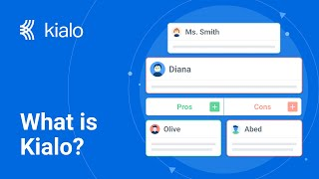

How does Kialo work?
If you’re new to Kialo, watch this video to discover how the platform works. Otherwise, let’s get started!

Slide 3

Lesson Objectives
Analyze how mathematical models can be used as tools of control rather than objective truth.
Evaluate how corporations, governments, and institutions exercise power through algorithmic decision-making.
Reflect on whether responsibility and transparency strengthen or weaken mathematics in practice.

Slide 4

TOK Concepts
Certainty: What responsibilities do mathematicians, corporations, and governments have when presenting models as objective or certain? Should efficiency and profit ever outweigh the duty to acknowledge assumptions, bias, and uncertainty?
Power: How do mathematical models shift power between individuals, corporations, and states? Who ultimately decides which models are legitimate, trustworthy, or acceptable to use in education, justice, or politics?
Perspective: How do different cultural and political contexts shape trust in mathematical models? Can mathematical applications ever be universally “fair,” or are they always influenced by context and values?
Today’s lesson links to these TOK concepts.
By completing the activities, you will build knowledge that can help with your assessments.

Slide 5
Introduction: Weapons of Math Destruction
Today’s lesson is based around a video about the effect of algorithms on democracy.
Step 1
Share your own perspectives on the role of mathematical models.
Step 2
Watch a video on the topic. Take notes on the main arguments and counterarguments, analyzing their strengths and weaknesses.
Step 3
Use your notes to add the strongest arguments and counterarguments to a Kialo discussion.

Slide 6
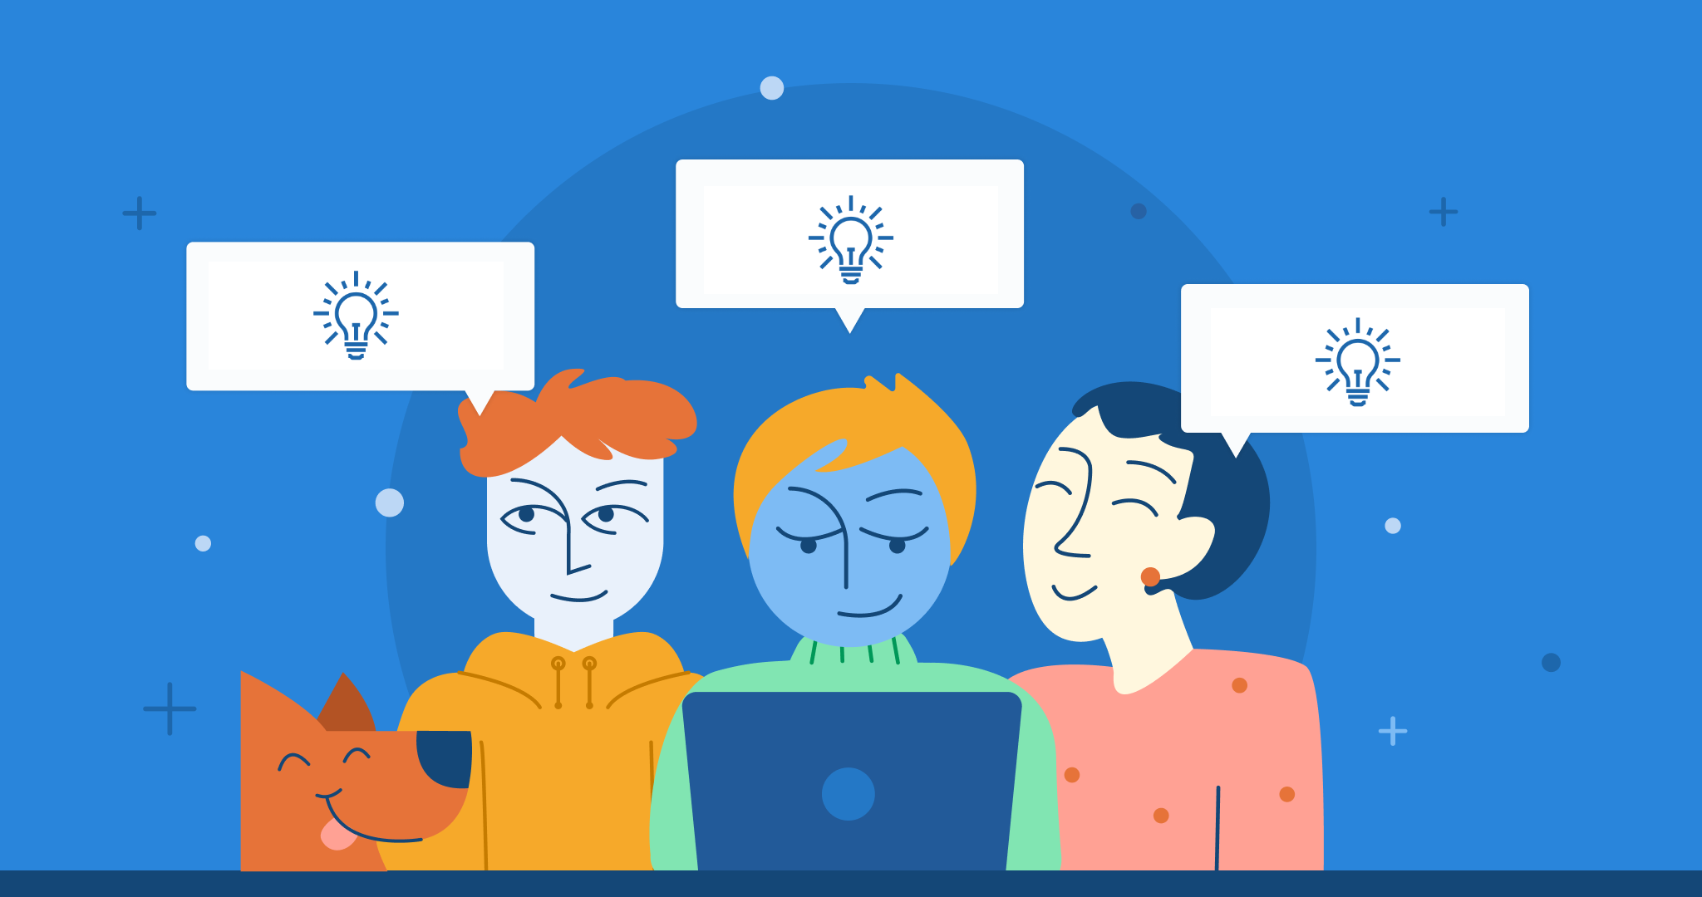
Introduction: Weapons of Math Destruction
Class Discussion
Are mathematical models designed to reveal truth or to control outcomes?

Slide 7
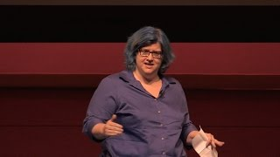
Listening Task: Weapons of Math Destruction
As you watch the video, take notes on the key arguments and counterarguments.
Analyze the strengths and weaknesses of each argument.
Find other sources to support your analysis.
You will need your notes for today’s Kialo discussion!

Slide 8
Listening Task: Weapons of Math Destruction
As you watch the video, take notes on the key arguments and counterarguments, analyzing their strengths and weaknesses.
Key Points to Listen For:
Why do people view mathematical models as authoritative and objective?
What are the five features of “Weapons of Math Destruction”?
How do algorithms in education, justice, and politics function as mathematical “truths” but in fact reinforce inequality?
Key Points to Listen For:
Who benefits from these models, and who is harmed?
Why are mathematical models described as “embedded opinions”?
What solutions or responsibilities does O’Neil propose?

Slide 9
Listening Task: Weapons of Math Destruction
As you watch the video, take notes on the key arguments and counterarguments, analyzing their strengths and weaknesses.
Note-Taking Framework
Main Arguments
Algorithms often claim objectivity but embed bias and reinforce inequality.
Models are social constructs, not neutral truths.
Without transparency, mathematical systems undermine democracy and fairness.
Supporting Examples
Teacher value-added model in education.
Predictive policing and sentencing models.
Political micro-targeting.

Slide 10
Listening Task: Weapons of Math Destruction
As you watch the video, take notes on the key arguments and counterarguments, analyzing their strengths and weaknesses.
Note-Taking Framework
Counterarguments and Questions
Are models the problem, or the way humans use them?
Can regulation (like FOIA or GDPR) truly restrain misuse of models?
Are algorithms always harmful, or can they sometimes improve fairness (e.g., replacing blatantly biased human decisions)?
Who holds ultimate responsibility — the mathematicians building models, the institutions deploying them, or the public interpreting them?

Slide 11
Kialo Discussion: Do requirements for transparency and accountability in mathematical models strengthen trust in mathematics?
You will now use your research in a Kialo discussion.
Your teacher will tell you whether to create your own discussion or use a ready-made version.
Step 1
If you have created your own discussion, add your theses or starter claims.
These are the main points you wish to argue for or against.
Step 2
Add the strongest arguments (pros) under each thesis, based on your notes and previous research.
Be sure to reference certainty, power and perspective.
Step 3
Follow the same approach to add counterarguments (cons) to each branch.
Step 4
Include examples and evidence to support your arguments and counterarguments.

Slide 12
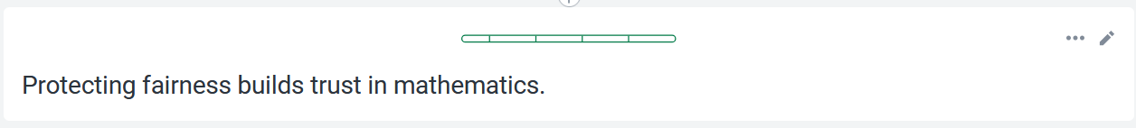
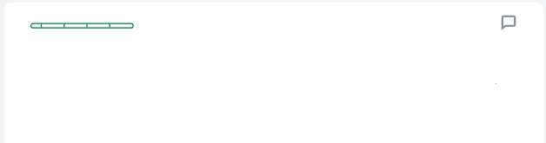
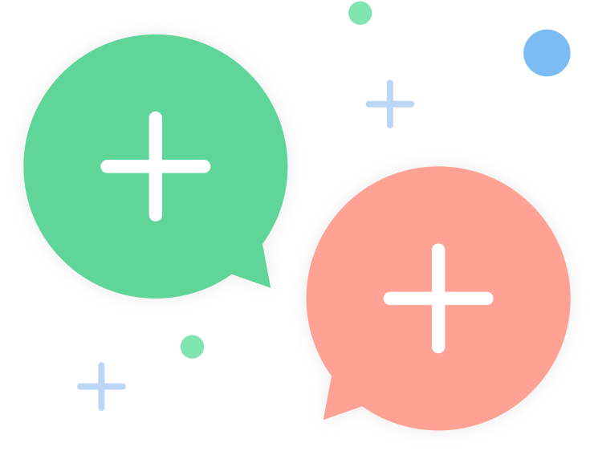
Kialo Discussion: Example Claims
O’Neil shows how opaque teacher evaluation algorithms eroded trust because teachers could not understand or challenge their scores.
Transparent models would restore legitimacy.

Slide 13
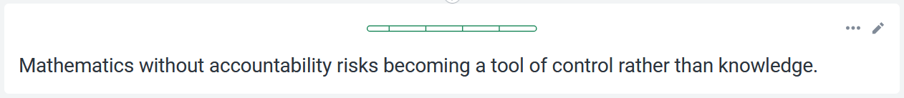
Kialo Discussion: Example Claims
For example, predictive policing models embed biased data.
This leads to unfair sentencing and reinforces inequality.

Slide 14
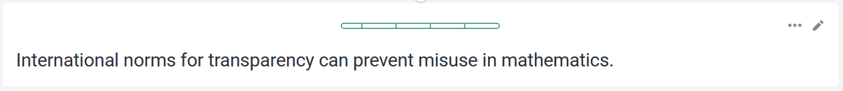
Kialo Discussion: Example Claims
For example, political micro-targeting models manipulate voters.
Stronger responsibility mechanisms could have limited their harmful impact.

Slide 15
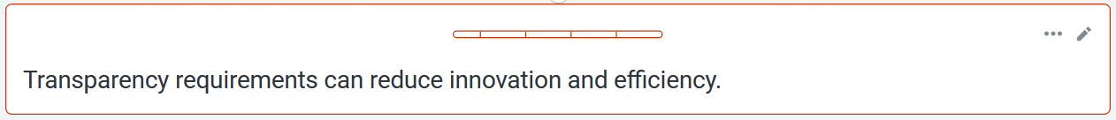
Kialo Discussion: Example Claims
For example, companies argue that keeping algorithms proprietary enables breakthroughs in efficiency and targeted services.
This might be slowed by strict oversight.

Slide 16
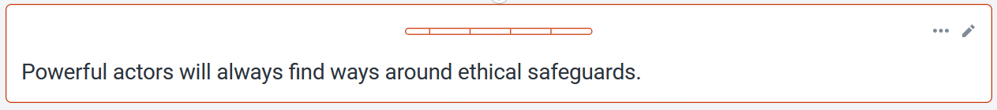
Kialo Discussion: Example Claims
For example, even with regulations, many algorithms remain opaque because corporations claim intellectual property protection.
This makes oversight ineffective.

Slide 17
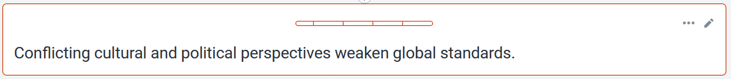
Kialo Discussion: Example Claims
Predictive policing is defended in some contexts as promoting “safety,” while critics see it as reinforcing systemic racism.
It’s difficult to say whose definition of fairness should dominate.

Slide 18
Reflection Task: Weapons of Math Destruction
Reflection Questions
What surprised you most about how mathematical models and algorithms are applied in real life?
Does this change your trust in mathematics as a way of producing knowledge?
What role should institutions play in ensuring mathematical models are transparent and accountable?
Can we expect fairness when the same corporations or governments profit from the models they design and enforce?
How should educators, policymakers, or citizens prepare people to navigate conflicting or manipulative uses of mathematical models?
Is it more dangerous to overtrust mathematical models when misused, or to distrust mathematics completely?

Slide 19
Lesson Objectives: Recap
Analyze how mathematical models can be used as tools of control rather than objective truth.
Evaluate how corporations, governments, and institutions exercise power through algorithmic decision-making.
Reflect on whether responsibility and transparency strengthen or weaken mathematics in practice.

