Slide 1
How do real-world controversies in mathematics reveal tensions between certainty, truth, and perspective?
Mathematics:
Certainty in Mathematics
Lesson 2: Fact-Finding Task

Slide 2


How does Kialo work?
If you’re new to Kialo, watch this video to discover how the platform works. Otherwise, let’s get started!

Slide 3

Lesson Objectives
Analyze case studies where the reliability of mathematical proofs or models was contested, limited, or debated.
Understand how different perspectives (mathematicians, scientists, policymakers, corporations, the public) influence what counts as “true” or “reliable” mathematical knowledge.
Apply TOK concepts (certainty, truth, perspective) to evaluate how mathematical knowledge is constructed, legitimized, or undermined.
Substantiate or challenge claims from Lesson 1 with real-world evidence and reasoning drawn from mathematical controversies.

Slide 4

TOK Concepts
Certainty: Who is responsible for ensuring that mathematical structures (proofs or models) are presented as certain or reliable? Should mathematicians, scientists, or policymakers carry ultimate accountability when assumptions or limitations are hidden?
Power: How do power structures shape which mathematical knowledge is accepted, silenced, or elevated as “truth”?
Perspective: How do cultural, social, and historical viewpoints influence what counts as reliable mathematics? Are mathematical truths universal, or do their applications and interpretations shift depending on context?
Today’s lesson links to these TOK concepts.
By completing the activities, you will build knowledge that can help with your assessments.

Slide 5
Introduction: Mathematical Controversies
Today’s lesson is about using case studies to expand your knowledge on real-world mathematical controversies.
Step 1(inc. homework)
Conduct in-depth research into a specific case, and give a short presentation to the class.
Step 2
Present your findings, and refine your arguments in your Kialo discussions.
Step 3
Reflect on who gets to define and legitimize “truth” in mathematics.

Slide 6
Case Study: Mathematical Controversies
Your teacher will assign you a case study for homework.
Gödel’s Incompleteness Theorems (1931)
Focus: Proved that some mathematical truths cannot be established within a system.
Key Question: Can mathematics ever be a complete and certain system of knowledge?
Four Color Theorem (1976)
Focus: First major computer-assisted proof; relied on machine calculations beyond human checking.
Key Question: Should we trust a proof if humans cannot verify every step?
Banach–Tarski Paradox
Focus: A mathematically valid theorem showing a ball can be split and reassembled into two identical copies.
Key Question: What happens when mathematical truth contradicts physical intuition and reality?
2008 Financial Crisis (Gaussian Copula Model)
Focus: Risk models gave a false sense of certainty, contributing to global collapse.
Key Question: What are the dangers of overreliance on mathematical models in real-world decision-making?

Slide 7

Case Study: Mathematical Controversies
You will need to give a short presentation to the class on your case study.
Presentation
Your presentation should focus on:
What happened in the case.
Who had the power to decide or act (mathematicians, computers, scientists, policymakers, the public).
Which perspectives were marginalized or excluded.
Which TOK concept (certainty, truth, perspective) is most relevant.
Whether the case supports or challenges a claim from Lesson 1.

Slide 8

Introduction: Mathematical Controversies
Class Discussion
Last lesson, which claims did you find most convincing or flawed?
Did any arguments rely too much on assumptions without real-world support?

Slide 9
Introduction: Mathematical Controversies
Class Discussion
How do real-world mathematical controversies reveal tensions between certainty, truth, and perspective?

Slide 10
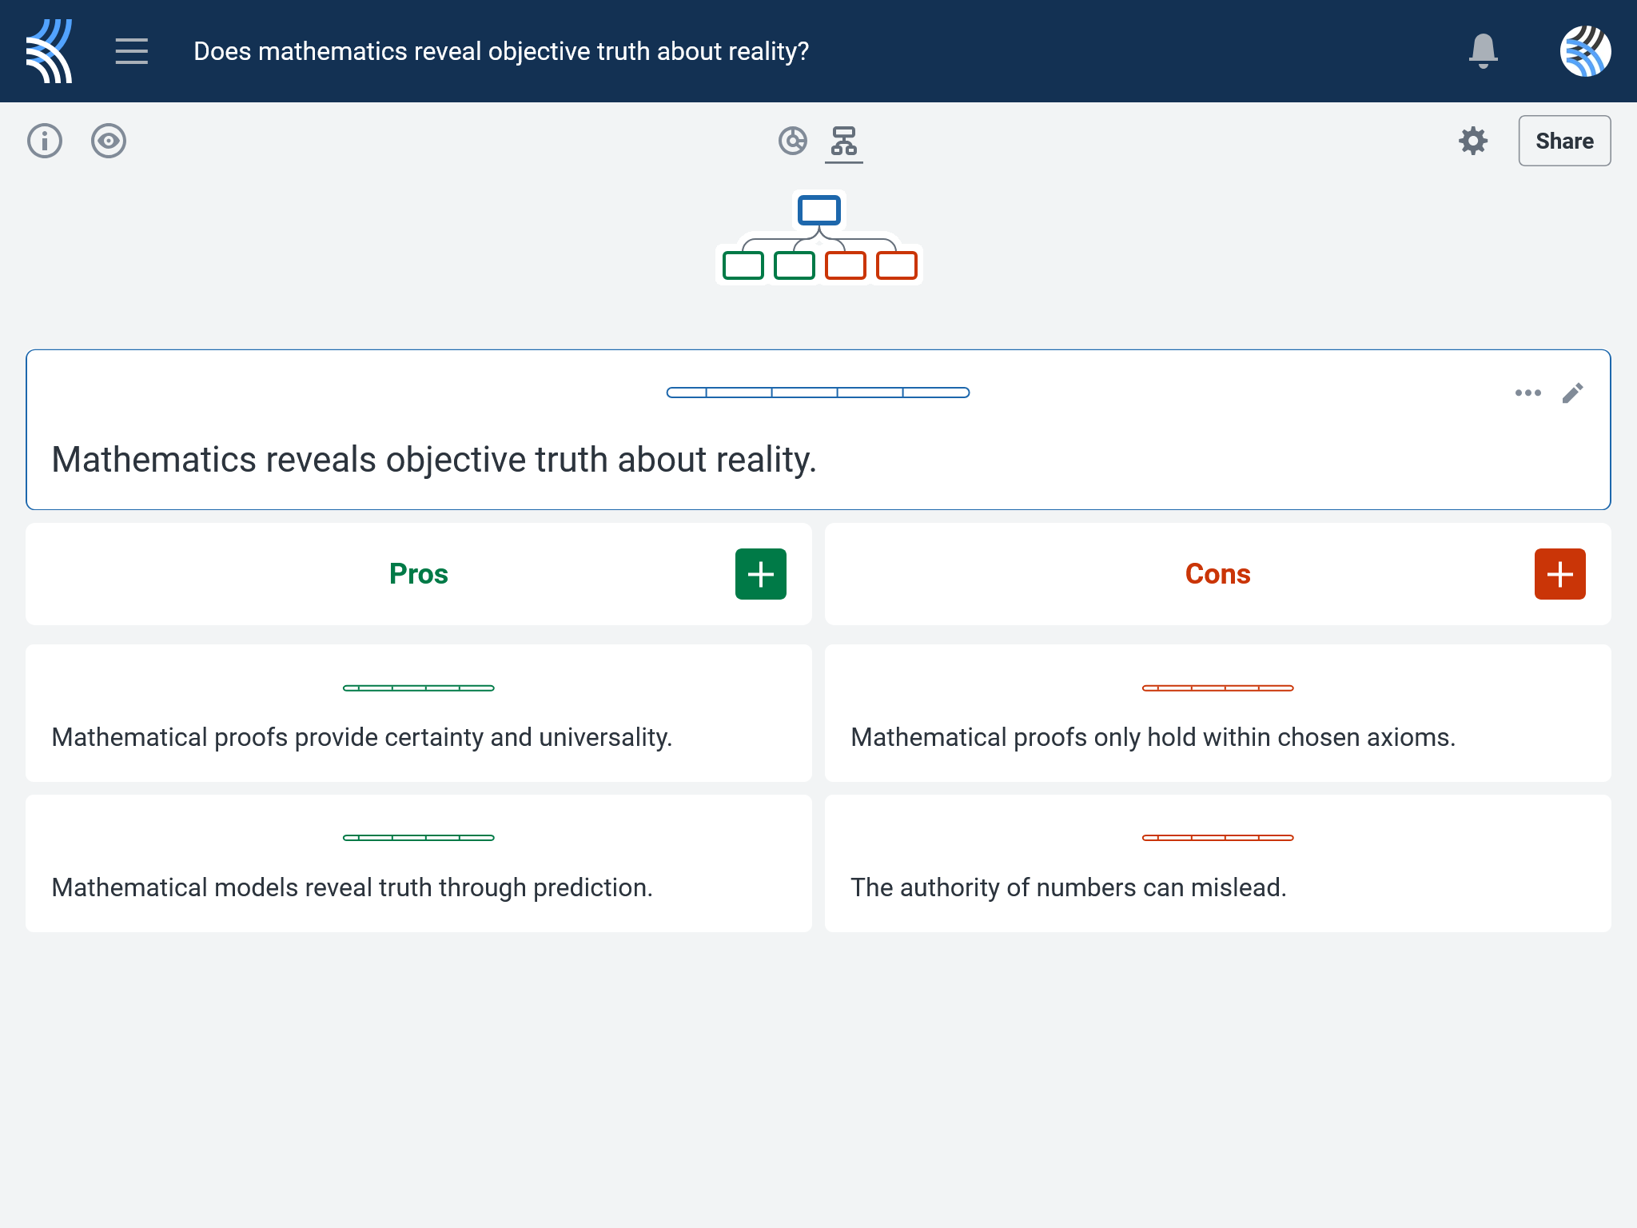
Kialo Discussion: Does mathematics reveal objective truth about reality?
Use your case study and any other research to support, challenge, or refine your initial arguments in your Kialo discussion!

Slide 11
Kialo Discussion: Does mathematics reveal objective truth about reality?
Focus Areas
Mathematical Gatekeeping: Who decides which proofs or models are accepted as legitimate knowledge, and who gets excluded?
Institutional Authority: How do journals, universities, corporations, or governments influence the perceived legitimacy of mathematical structures?
Trust and Reliability: How do controversial proofs or failed models (e.g., financial risk formulas) affect public trust in mathematics?
Knowledge Inequality: Are all mathematical voices — especially alternative systems, critical perspectives, or less powerful institutions — treated equally when defining “truth”?

Slide 12
Reflection Task: Mathematical Controversies
How did your case study affect your understanding of who gets to define and legitimize “truth” in mathematics?
What made certain examples feel more like illusions of certainty or institutional overreach, versus genuine reliability?
In your case, who had the most control over the mathematical narrative: mathematicians, computers, policymakers, corporations, or the public?

Slide 13
Reflection Task: Mathematical Controversies
Can efforts to make mathematics more rigorous (e.g., formal verification, better data in models) ever be truly equal when access to resources, funding, and authority remains uneven?
What role should credibility, transparency, and perspective play in deciding whether mathematical structures are accepted as truth?
Should all mathematical models that affect public wellbeing (e.g., finance, health, climate) require broader social consultation, or are there exceptions?

Slide 14
Lesson Objectives: Recap
Analyze case studies where the reliability of mathematical proofs or models was contested, limited, or debated.
Understand how different perspectives (mathematicians, scientists, policymakers, corporations, the public) influence what counts as “true” or “reliable” mathematical knowledge.
Apply TOK concepts (certainty, truth, perspective) to evaluate how mathematical knowledge is constructed, legitimized, or undermined.
Substantiate or challenge claims from Lesson 1 with real-world evidence and reasoning drawn from mathematical controversies.

