Slide 1
Do mathematical structures reveal truth or just create illusions of certainty?
Mathematics:
Certainty in Mathematics
Lesson 1: Opening Debate

Slide 2


How does Kialo work?
If you’re new to Kialo, watch this video to discover how the platform works. Otherwise, let’s get started!

Slide 3

Lesson Objectives
Explore how proofs and models function as structures of certainty in mathematics
Debate whether mathematics provides truth or only useful approximations/assumptions
Apply TOK concepts of certainty, truth, and perspective to mathematics

Slide 4

TOK Concepts
Certainty: What duties do mathematicians and model-builders have in presenting their work as certain or reliable? Should the pursuit of mathematical elegance or predictive success ever outweigh clarity about assumptions and limitations?
Power: Who holds the authority to decide what counts as legitimate mathematical knowledge — pure mathematicians, applied scientists, governments, or corporations? How do power dynamics influence which proofs are recognized and which models are trusted or implemented?
Perspective: How do cultural, historical, and societal contexts shape what is considered “true” in mathematics? Should mathematical truth be seen as universal, or does its meaning shift when applied in different cultural or practical contexts?
Today’s lesson links to these TOK concepts.
By completing the activities, you will build knowledge that can help with your assessments.

Slide 5
Introduction: The Certainty of Mathematics
Today’s lesson is about sharing your existing knowledge and perspectives on the certainty of mathematics.
Step 1
Discuss the class’s initial response to the question.
Step 2
Share your existing knowledge and perspectives and respond to those of your peers in an in-depth Kialo discussion.
Step 3
Reflect on what is seen as mathematically “true”.

Slide 6

Introduction: The Certainty of Mathematics
Class Discussion
Do mathematical structures reveal truth, or just create illusions of certainty?

Slide 7

Introduction: Key Concepts
Certainty
Are mathematical truths absolute or conditional on axioms and assumptions?
Truth
Do models and proofs describe reality or only provide persuasive structures?
Perspective
How do mathematicians, scientists, and the public differently interpret the authority of mathematics?

Slide 8
Introduction: The Certainty of Mathematics
Look at the examples of landmarks in logic, proof, and prediction on the next six slides.
Discussion Questions
Which of these examples do you find most convincing, and why?
Can something be mathematically valid but still misleading?
Does mathematical certainty depend on proofs, models, or social trust?

Slide 9
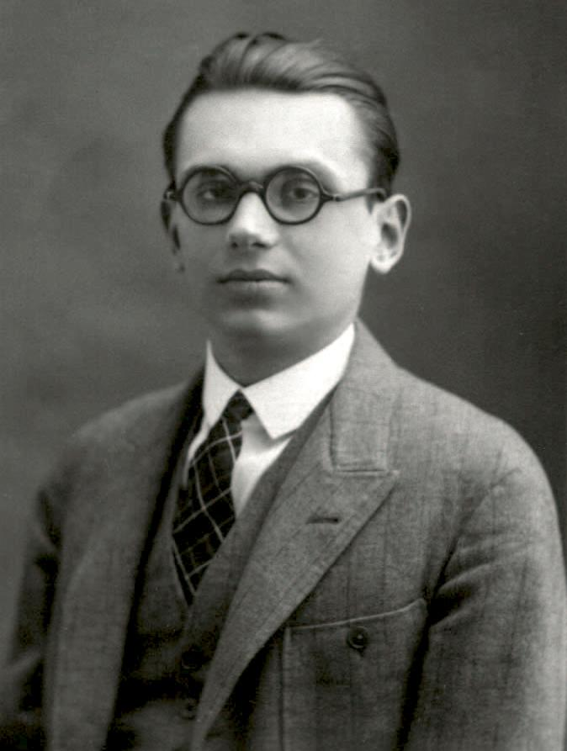
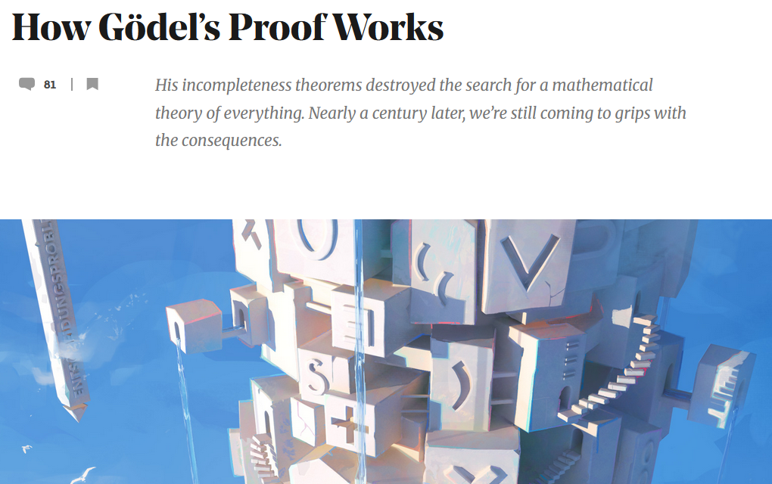


Gödel’s Incompleteness Theorems (1931)

Slide 10
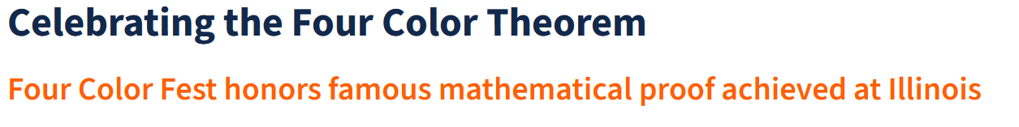
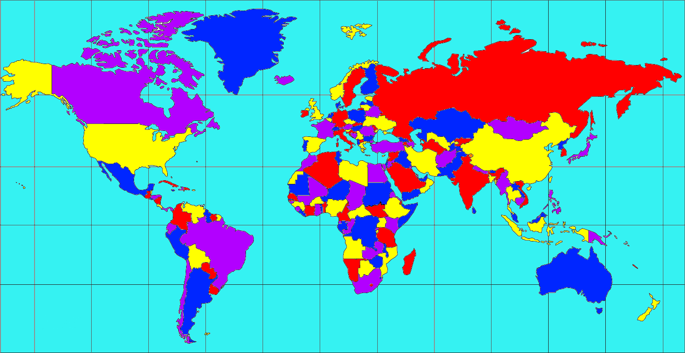
Four Color Theorem (1976)

Slide 11
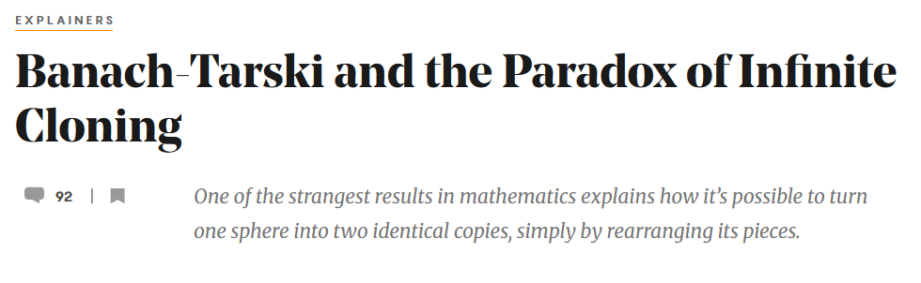
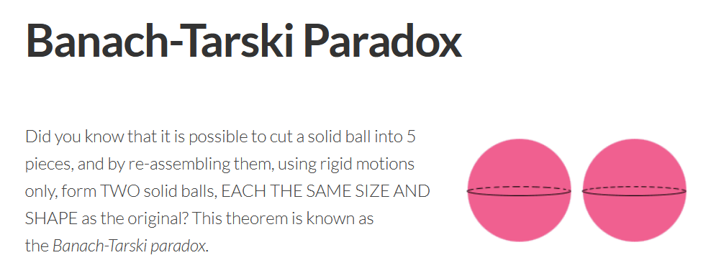

Banach–Tarski Paradox

Slide 12
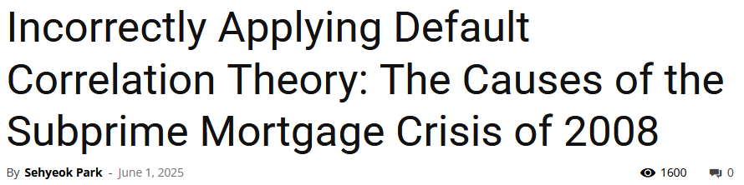

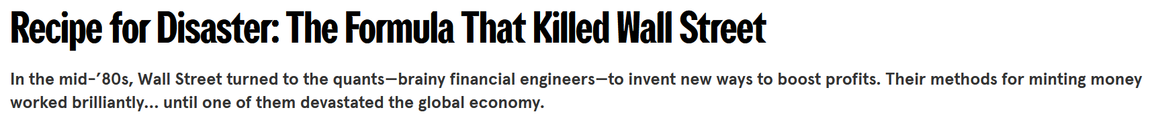
2008 Financial Crisis: Gaussian copulas

Slide 13
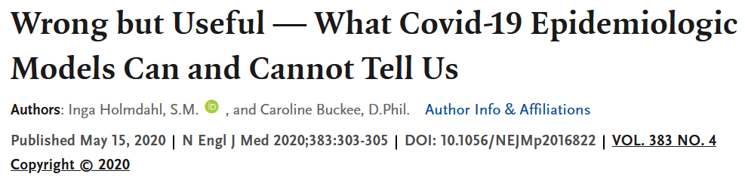
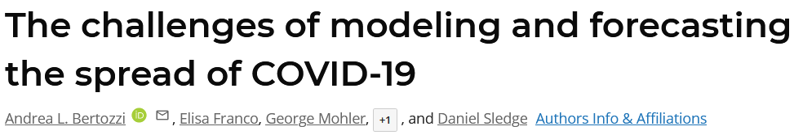
COVID-19 Epidemiological Models

Slide 14
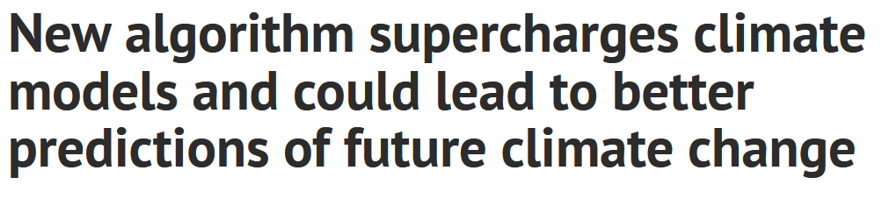
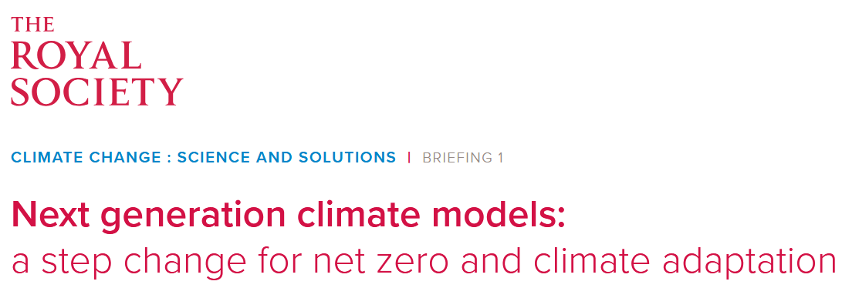
Climate Change Models

Slide 15
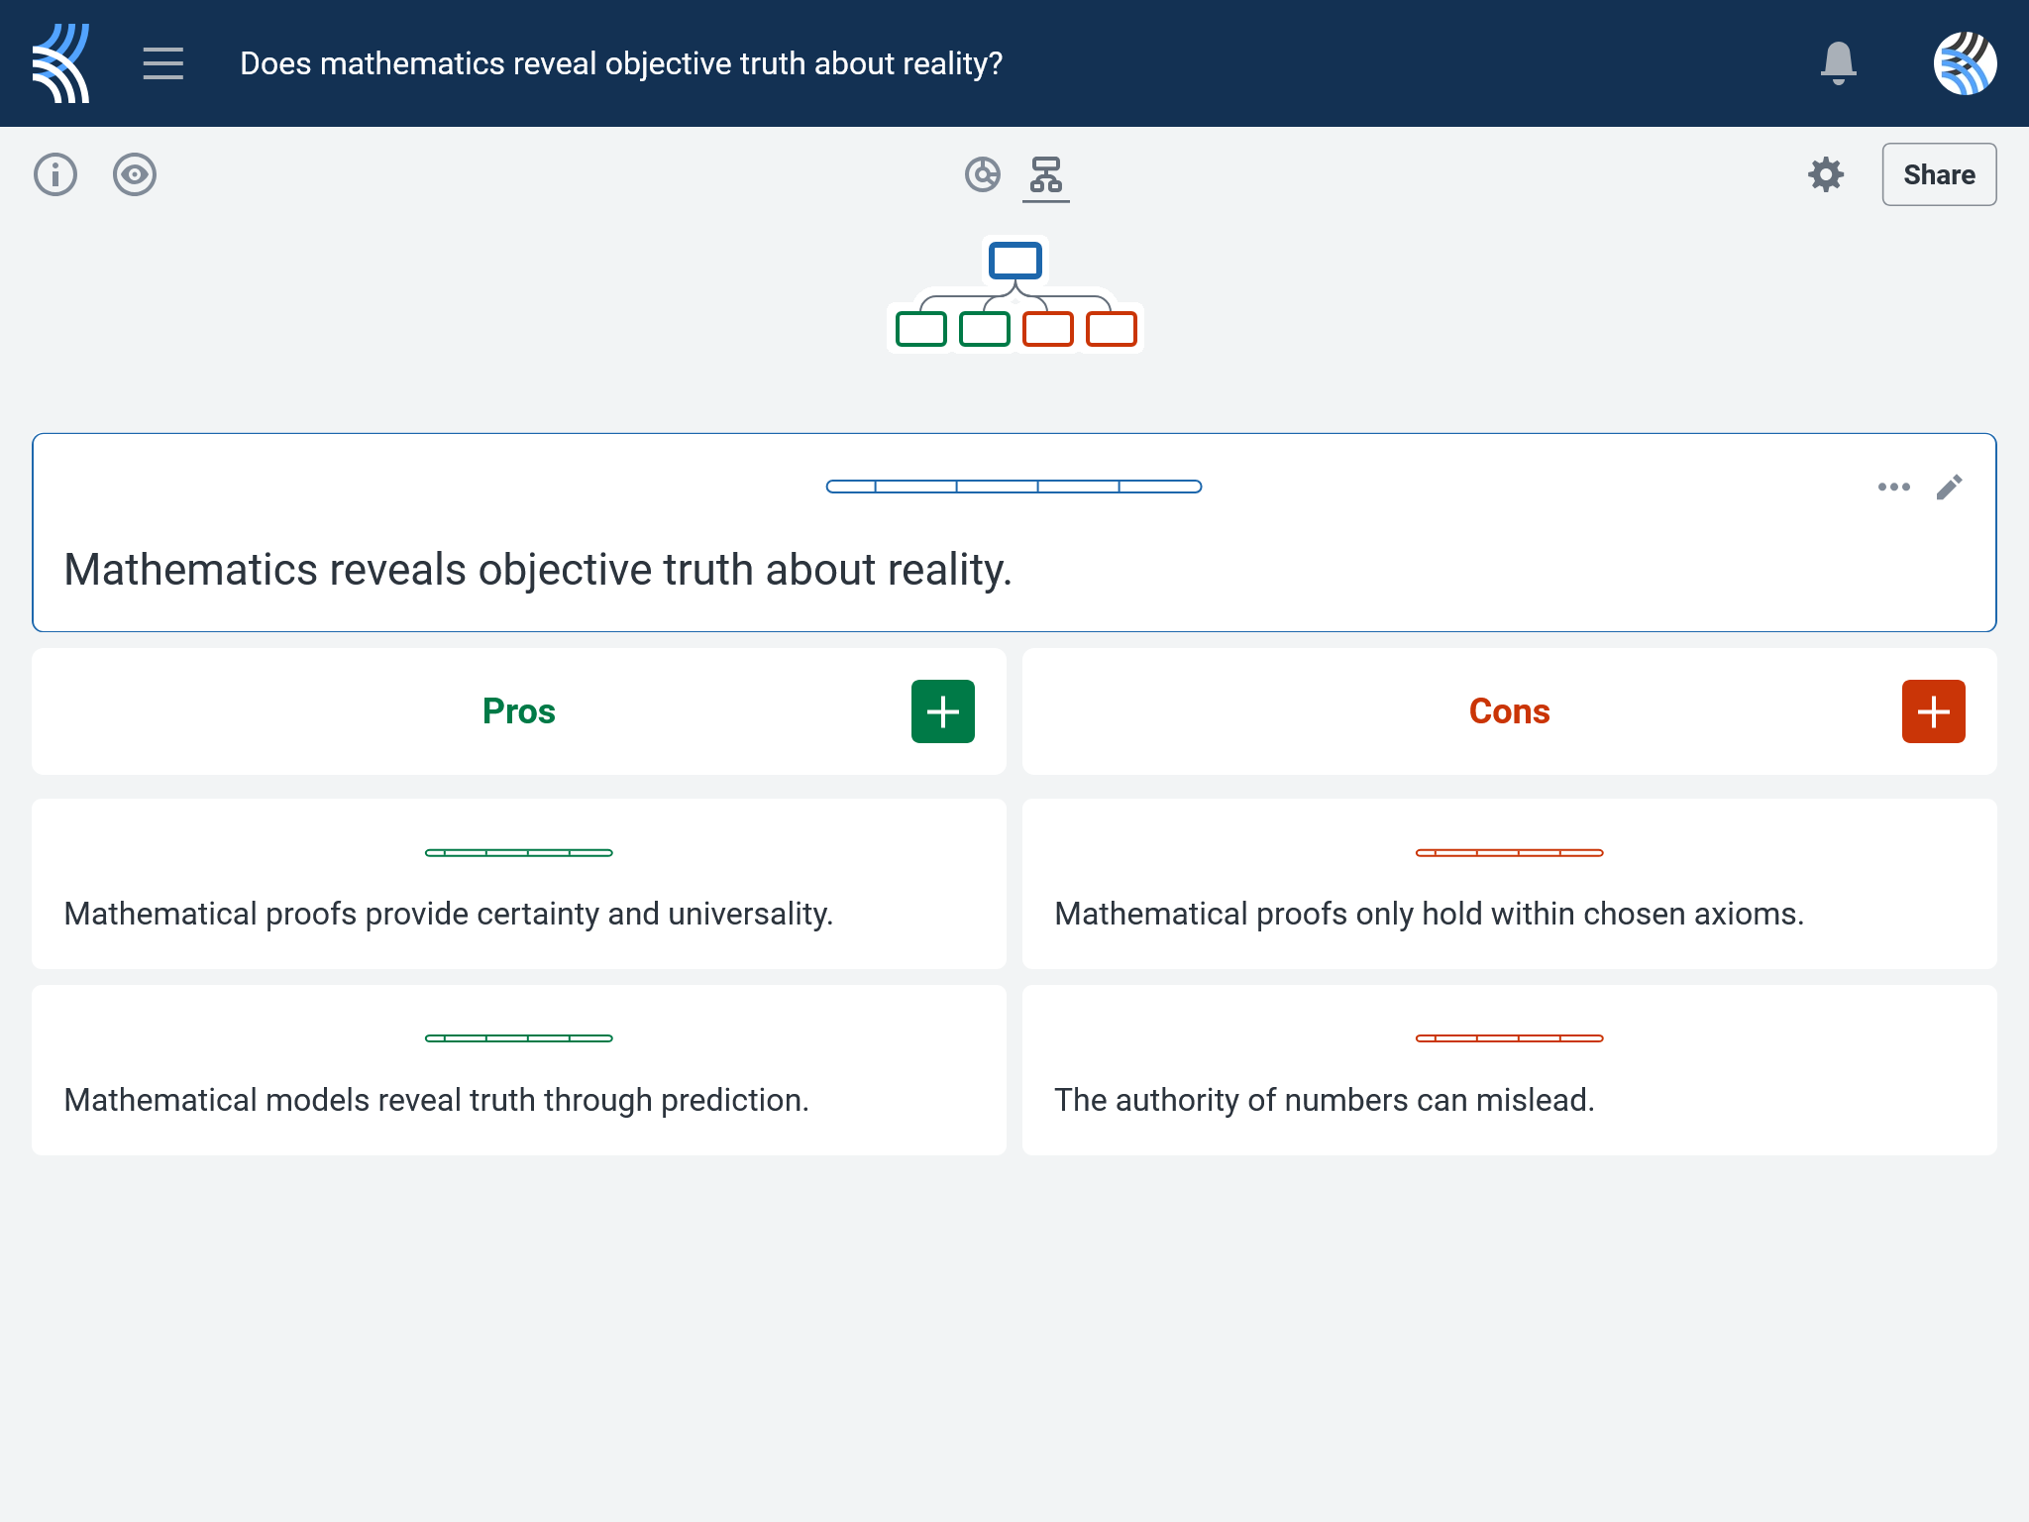
Kialo Discussion: Does mathematics reveal objective truth about reality?
Now that you’ve had chance to discuss your initial thoughts, you are going to add your ideas to a Kialo discussion.
Let’s learn more about having an in-depth discussion on Kialo.

Slide 16
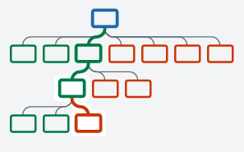

Kialo Discussion: The Argument Tree
On Kialo, the discussion is represented by an argument tree.
The pros are green and the cons are red.
Here are two Kialo argument trees.
Which one represents a more in-depth discussion?

Slide 17
Kialo Discussion: The Argument Tree
In this discussion, everyone has added their own perspective on the thesis.
Some perspectives might be repeated.
Students have not engaged with their peers’ perspectives.
This is unlikely to be an in-depth discussion!
In this discussion, students have added their perspective on the thesis, developed their arguments, and responded to other perspectives.
This results in a more in-depth discussion!

Slide 18
Kialo Discussion: Does mathematics reveal objective truth about reality?
Let’s apply this to a discussion!
Building Arguments
Step 1: Choose the starter claim you most agree with.
Step 2: Develop this claim by adding at least 2 pros.
Step 3: Add at least 2 cons to represent an alternative perspective.
Step 4: Repeat this for at least 3 other starter claims.
Step 5: Your peers will also add claims to the discussion. Try to respond to at least 3 of these.
Check the argument tree: How deep is the discussion?

Slide 19
Kialo Discussion: Does mathematics reveal objective truth about reality?
Questions to Consider
Does a proof guarantee truth, or just truth within a system?
Should we trust computer-assisted proofs the same way we trust traditional proofs?
Is predictive success enough to justify calling a model “true”?
Who should decide when a mathematical model is reliable — mathematicians, scientists, or society?
How do the TOK concepts of certainty, truth, and perspective help us evaluate these dilemmas?

Slide 20
Reflection Task: The Certainty of Mathematics
Discussion Questions
Did mathematics in these cases strengthen or weaken the reliability of knowledge?
Can flawed or misleading mathematical structures (proofs or models) ever be justified by their usefulness?
Who should bear responsibility for ensuring mathematical models and proofs are applied responsibly — mathematicians, scientists, or policymakers?
How does perspective (pure vs. applied math, scientific vs. societal, cultural vs. universal) change what is seen as mathematically “true”?
How do power structures (governments, corporations, academic institutions) influence which mathematical questions are pursued, funded, or trusted?

Slide 21
Lesson Objectives: Recap
Explore how proofs and models function as structures of certainty in mathematics
Debate whether mathematics provides truth or only useful approximations/assumptions
Apply TOK concepts of certainty, truth, and perspective to mathematics

