Slide 1
Can science be trusted without question?
Science:
Science as a Knowledge Source
Lesson 3: Listening Task

Slide 2
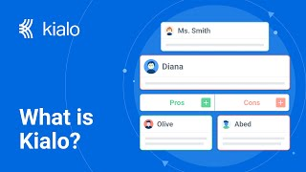

How does Kialo work?
If you’re new to Kialo, watch this video to discover how the platform works. Otherwise, let’s get started!

Slide 3

Lesson Objectives
Explore how bias, institutional power, and public interpretation influence the credibility of scientific claims
Deepen understanding of justification, perspective, and objectivity in the natural sciences
Evaluate real-world consequences when science is distorted, misrepresented, or hidden from public view

Slide 4

TOK Concepts
Justification: What reasons were given for accepting flawed evidence as valid?
Perspective: How do industry vs. public vs. scientific perspectives conflict in interpreting data?
Objectivity: What limits objectivity in real-world scientific practice?
Today’s lesson links to these TOK concepts.
By completing the activities, you will build knowledge that can help with your assessments.

Slide 5
Introduction: Battling Bad Science
Today’s lesson is based around a video about the way evidence can be distorted.
Step 1
Share your own perspectives on trust in science.
Step 2
Watch a video on the topic. Take notes on the main arguments and counterarguments, analyzing their strengths and weaknesses.
Step 3
Use your notes to add the strongest arguments and counterarguments to a Kialo discussion.

Slide 6

Introduction: Key Concepts
Justification
What makes scientific reasoning convincing?
Perspective
How do industry, media, and the public view scientific findings?
Objectivity
Is it possible to eliminate bias in scientific work?

Slide 7

Introduction: Battling Bad Science
Class Discussion
What do you think makes a scientific claim trustworthy?
Who do you trust more: scientists, journalists, or institutions like governments or pharma companies?
Can science ever be neutral?

Slide 8
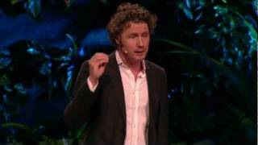
Listening Task: Battling Bad Science
As you watch the video, take notes on the key arguments and counterarguments.
Analyze the strengths and weaknesses of each argument.
Find other sources to support your analysis.
You will need your notes for today’s Kialo discussion!

Slide 9
Listening Task: Battling Bad Science
As you watch the video, take notes on the key arguments and counterarguments, analyzing their strengths and weaknesses.
Key Points to Listen For:
What examples does Goldacre give of science being misrepresented?
How do media and authority figures distort evidence?
How do flawed methodologies (e.g., lack of control groups, placebo misuse) weaken scientific justification?
Key Points to Listen For:
What role does publication bias play in shaping our understanding of drug efficacy?
Who benefits from this manipulation of evidence?
How does Goldacre suggest science can regain credibility?

Slide 10
Listening Task: Battling Bad Science
As you watch the video, take notes on the key arguments and counterarguments, analyzing their strengths and weaknesses.
Note-Taking Framework
Main arguments: Why authority is not enough in science.
Why poorly designed studies mislead public understanding.
Why missing data (e.g. withheld trial results) is the greatest threat to scientific objectivity.
Examples: Coffee and cancer contradictions in the media.
Fake credentials and bogus claims in nutrition science.
Reboxetine and Tamiflu as case studies in pharmaceutical industry misconduct.
Main counterarguments: Is science the problem, or the way it’s communicated and funded?
Can the peer-review process fix these issues?
Do individual scientists have enough power to change flawed systems?

Slide 11
Kialo Discussion: Is science still the most reliable way to produce knowledge when it can be manipulated and misrepresented?
You will now use your research in a Kialo discussion.
Your teacher will tell you whether to create your own discussion or use a ready-made version.
Step 1
If you have created your own discussion, add your theses or starter claims.
These are the main points you wish to argue for or against.
Step 2
Add the strongest arguments (pros) under each thesis, based on your notes and previous research.
Be sure to reference responsibility, evidence and certainty.
Step 3
Follow the same approach to add counterarguments (cons) to each branch.
Step 4
Include examples and evidence to support your arguments and counterarguments.

Slide 12
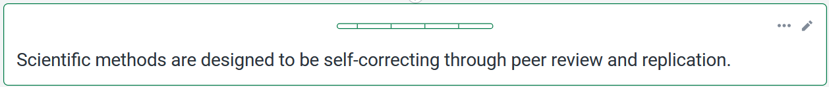
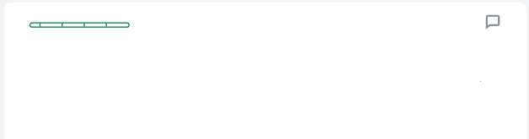
Kialo Discussion: Example Claims
For example, Goldacre explains how the academic process involves critical appraisal, where postdocs expect “bloodbath” Q&A sessions after presenting data.
This culture of intellectual challenge ensures only rigorously defended knowledge survives.

Slide 13
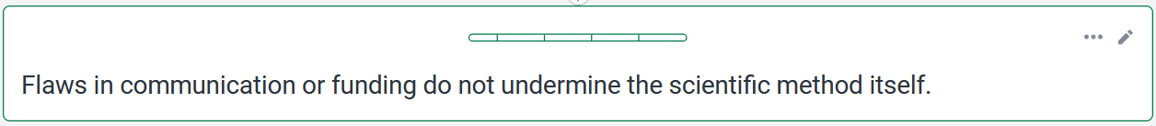
Kialo Discussion: Example Claims
Even though studies can be misrepresented in the media (e.g., red wine preventing breast cancer), Goldacre shows that the underlying study itself was sound lab research, just misinterpreted.
Even though studies can be misrepresented in the media (e.g., red wine preventing breast cancer), Goldacre shows that the underlying study itself was sound lab research, just misinterpreted.

Slide 14
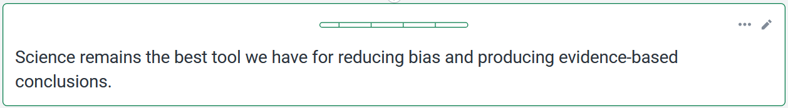
Kialo Discussion: Example Claims
The placebo effect, randomization, and control groups are discussed as essential scientific tools to isolate variables and test treatments objectively.
These techniques are unique to science and help minimize personal or systemic bias.

Slide 15
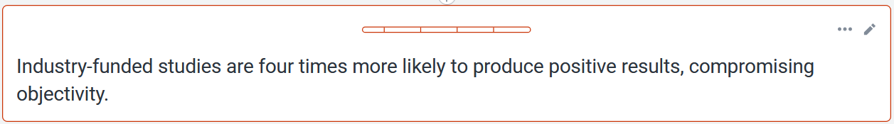
Kialo Discussion: Example Claims
For example, Goldacre cites meta-analysis findings showing that trials funded by pharmaceutical companies are four times more likely to report positive outcomes than independently funded trials, even though their methodology is often more rigorous.
This reveals the power of selective reporting or framing.

Slide 16
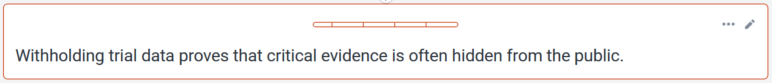
Kialo Discussion: Example Claims
For example, governments spent billions stockpiling Tamiflu for flu complications without ever getting access to full trial data.
Even Cochrane researchers were denied.

Slide 17
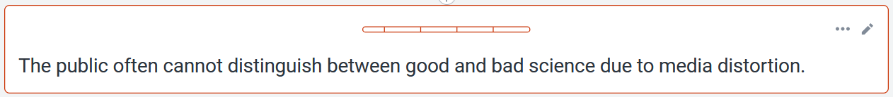
Kialo Discussion: Example Claims
Goldacre shows how the Daily Mail claims contradictory health outcomes (e.g., coffee both causes and prevents cancer).
These stories misrepresent small-scale or lab-based studies as definitive, confusing public understanding of scientific reliability.

Slide 18
Reflection Task: Battling Bad Science
Reflection Questions
What surprised you most about how science is distorted in real life?
Does this change your trust in science as a knowledge system?
What role should institutions (like governments, pharma companies, media) play in maintaining scientific integrity?
Can we expect objectivity when the same people funding research benefit from its results?
How should educators prepare students to navigate conflicting or misleading science?
Is it more dangerous to overtrust science or to distrust it completely?

Slide 19
Lesson Objectives: Recap
Explore how bias, institutional power, and public interpretation influence the credibility of scientific claims
Deepen understanding of justification, perspective, and objectivity in the natural sciences
Evaluate real-world consequences when science is distorted, misrepresented, or hidden from public view

