Slide 1
How do real-world scientific controversies reveal tensions between justification, objectivity, and perspective?
Science:
Science as a Knowledge Source
Lesson 2: Fact-Finding Task

Slide 2
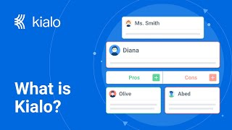

How does Kialo work?
If you’re new to Kialo, watch this video to discover how the platform works. Otherwise, let’s get started!

Slide 3

Lesson Objectives
Analyze real-world case studies where scientific knowledge was challenged, revised, or misused
Understand how different perspectives and contexts influence what is accepted as “scientific truth”
Use TOK concepts (e.g., justification, objectivity, perspective) to examine the reliability of scientific knowledge
Substantiate or challenge claims from Lesson 1 using contextual examples and TOK reasoning

Slide 4

TOK Concepts
Justification: What reasons were given to support or reject the scientific claim? Were these reasons based on evidence, authority, peer review, or institutional status?
Objectivity: To what extent were the methods, interpretations, or outcomes of the scientific case influenced by bias, funding, ideology, or social values?
Perspective: Whose viewpoint shaped the public, political, or institutional response to the scientific controversy?
Today’s lesson links to these TOK concepts.
By completing the activities, you will build knowledge that can help with your assessments.

Slide 5
Introduction: Scientific Knowledge
Today’s lesson is about using case studies to expand your knowledge on whether science is the most reliable way of producing knowledge.
Step 1(inc. homework)
Conduct in-depth research into a specific case, and give a short presentation to the class.
Step 2
Present your findings, and refine your arguments in your Kialo discussions.
Step 3
Reflect on issues of justification, objectivity, and perspective in science.

Slide 6
Case Study: Scientific Knowledge
Your teacher will assign you a case study for homework.
Replication Crisis
Focus: Widespread failure to replicate studies in psychology and biomedicine.
Key Question: If findings cannot be repeated, are they reliable?
Planet Vulcan and the Limits of Newtonian Physics
Focus: 19th-century astronomers invented a planet to protect Newton’s laws when Mercury’s orbit didn’t match.
Key Question: Why were scientists reluctant to revise their models, even with contradictory evidence?
HIV/AIDS Denialism and Public Harm
Focus: Political leaders in South Africa rejected mainstream science, leading to delayed treatment rollout and thousands of deaths.
Key Question: What happens when alternative perspectives are given equal footing despite lacking evidence?
The Human Genome Project
Focus: A global effort to map human DNA that raised debates about ownership, funding, and genetic ethics.
Key Question: Who decides what counts as valuable research, and who benefits?

Slide 7

Case Study: Scientific Knowledge
You will need to give a short presentation to the class on your case study.
Presentation
Your presentation should focus on:
What happened in the case.
How different perspectives (scientists, government, public, media) justified or criticized the work.
Which TOK concept is most relevant: justification, objectivity, or perspective.
Whether the case supports or challenges a claim from Lesson 1.

Slide 8

Introduction: Scientific Knowledge
Class Discussion
Last lesson, which claims did you find most convincing or flawed?
Did any arguments rely too much on assumptions without real verification?

Slide 9
Introduction: Scientific Knowledge
Class Discussion
How do real-world scientific controversies reveal tensions between justification, objectivity, and perspective?

Slide 10
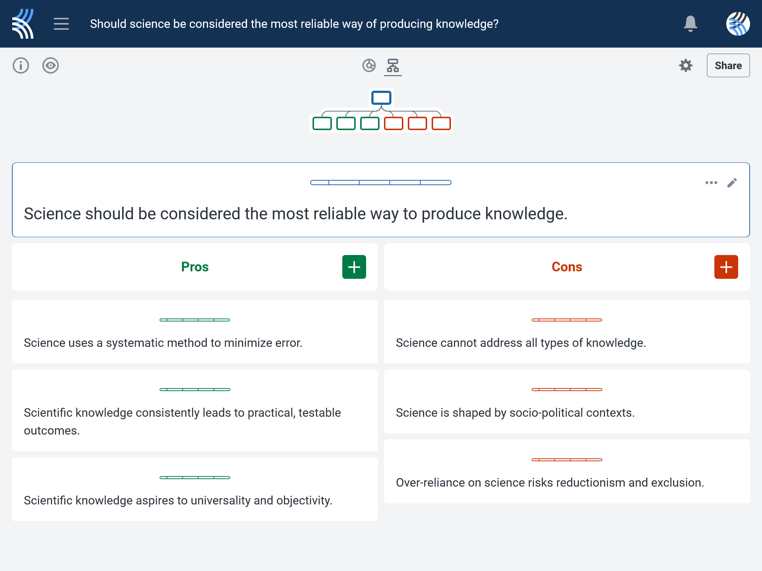
Kialo Discussion: Should science be considered the most reliable way of producing knowledge?
Use your case study and any other research to support, challenge, or refine your initial arguments in your Kialo discussion!

Slide 11
Kialo Discussion: Should science be considered the most reliable way of producing knowledge?
Focus Areas
Scientific Gatekeeping: Who decides which scientific knowledge is accepted, funded, or published and who gets excluded?
Institutional Authority: How do governments, corporations, or journals affect the perceived legitimacy of a scientific claim?
Trust and Public Reception: How does misinformation, media framing, or social bias shape what the public considers “science”?
Knowledge Inequality: Are all scientific voices treated equally within the scientific system?

Slide 12
Reflection Task: Scientific Knowledge
How did your case study affect your understanding of who gets to define and legitimize scientific knowledge?
What made certain examples feel more like political or institutional interference, versus scientific self-correction or progress?
In your case, who had the most control over the scientific narrative: researchers, governments, corporations, or the public?

Slide 13
Reflection Task: Scientific Knowledge
Can efforts to make science more inclusive ever be truly equal when access to funding, publication, and institutional support remains uneven?
What role should credibility, transparency, and ethics play in deciding whether scientific claims are accepted or contested?
Should all scientific research that affects public wellbeing require broader social consultation, or are there exceptions?

Slide 14
Lesson Objectives: Recap
Analyze real-world case studies where scientific knowledge was challenged, revised, or misused
Understand how different perspectives and contexts influence what is accepted as “scientific truth”
Use TOK concepts (e.g., justification, objectivity, perspective) to examine the reliability of scientific knowledge
Substantiate or challenge claims from Lesson 1 using contextual examples and TOK reasoning

