Slide 1
Should science be considered the most reliable way of producing knowledge?
Science:
Science as a Knowledge Source
Lesson 1: Opening Debate

Slide 2


How does Kialo work?
If you’re new to Kialo, watch this video to discover how the platform works. Otherwise, let’s get started!

Slide 3

Lesson Objectives
Examine how we justify whether something counts as scientific knowledge
Explore how interpretations of scientific evidence can vary depending on method, values, or institutional context
Recognize the role of perspective, objectivity, and justification in shaping scientific authority
Challenge assumptions about science being neutral, purely empirical, or universally accepted

Slide 4

TOK Concepts
Justification: How do empirical methods justify scientific knowledge claims?
Perspective: How do different stakeholders shape the public’s understanding of science?
Objectivity: To what extent is neutrality in science an achievable goal?
Today’s lesson links to these TOK concepts.
By completing the activities, you will build knowledge that can help with your assessments.

Slide 5
Introduction: Scientific Knowledge
Today’s lesson is about sharing your existing knowledge and perspectives on whether science is the most reliable way of producing knowledge.
Step 1
Discuss the class’s initial response to the question.
Step 2
Share your existing knowledge and perspectives and respond to those of your peers in an in-depth Kialo discussion.
Step 3
Reflect on the legitimacy and reliability of science.

Slide 6

Introduction: Key Concepts
Justification
What reasons or methods support the scientific claims we consider as “truth”?
Interpretation
Is science free from bias or influenced by values?
Perspective
Who decides what counts as reliable science?

Slide 7

Introduction: Scientific Knowledge
Class Discussion
What makes knowledge scientific — and why do we trust it?

Slide 8
Introduction: Scientific Knowledge
Look at the examples of scientific developments on the next six slides.
Discussion Questions
Which of these do you trust the most? Why?
What makes something “scientific” in your mind?
Can something look scientific and still be misleading?

Slide 9
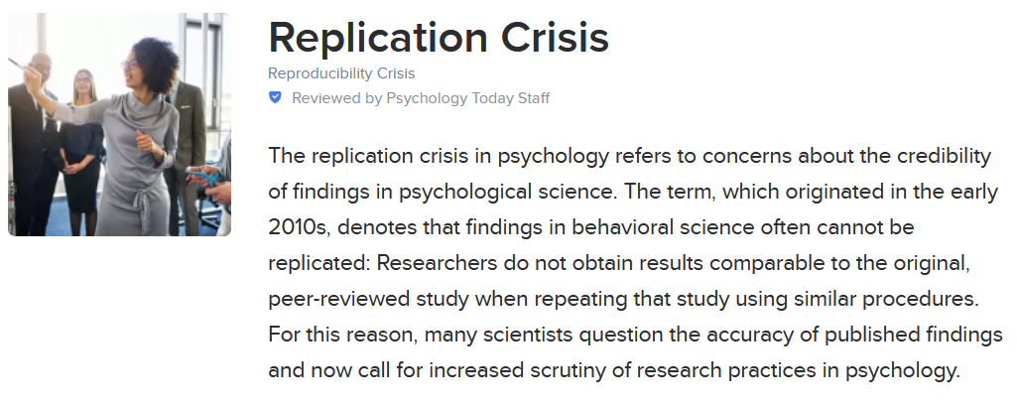


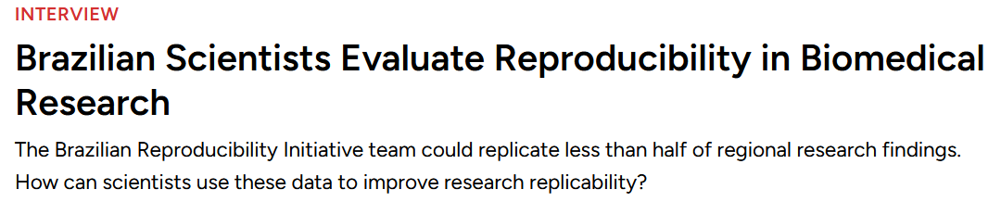
Introduction: The Replication Crisis

Slide 10

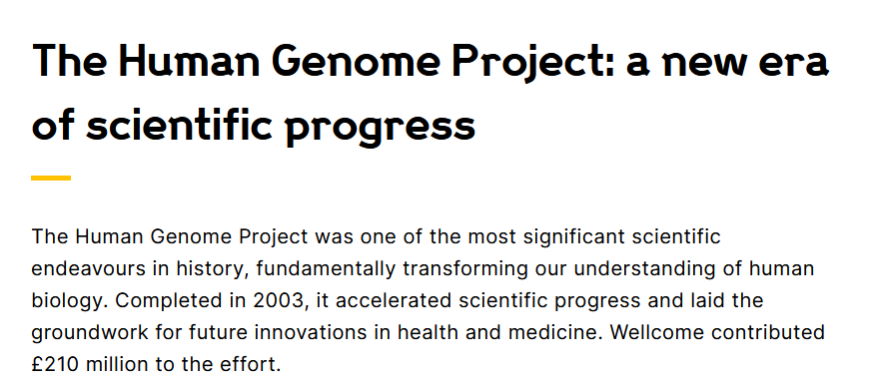
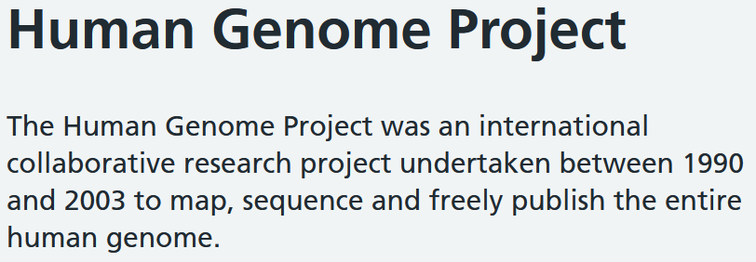
Introduction: The Human Genome Project

Slide 11
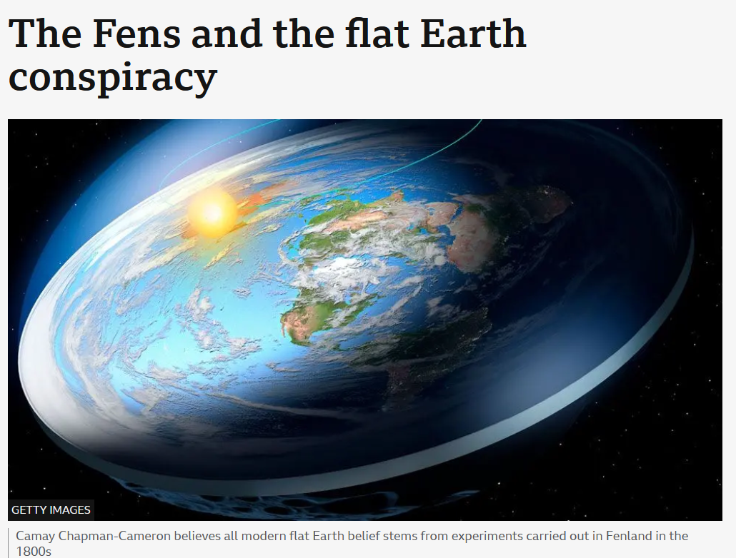
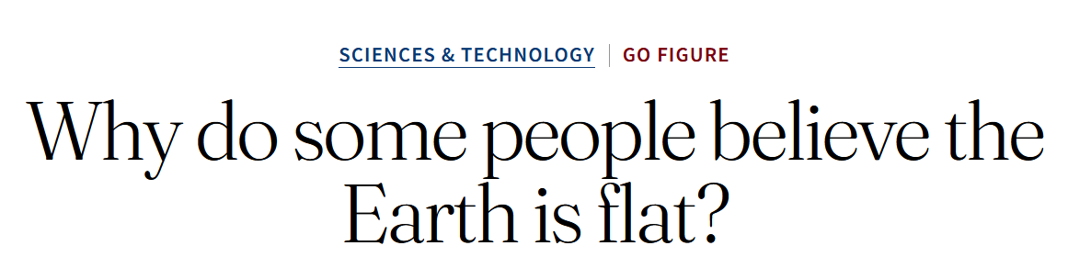
Introduction: Flat Earth Theories

Slide 12
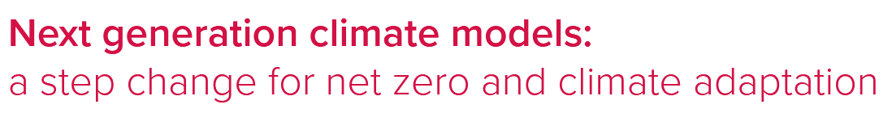
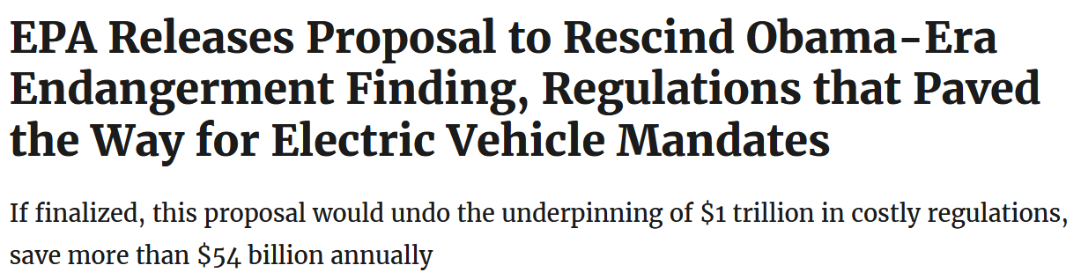
Introduction: Climate Change Denial

Slide 13
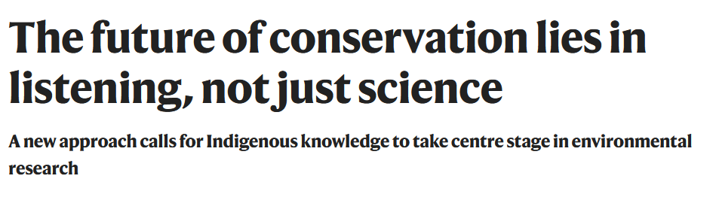
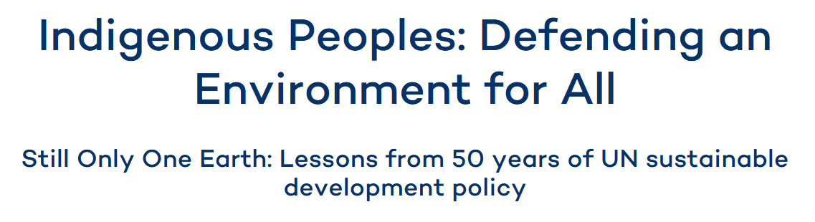
Introduction: Environmental Knowledge

Slide 14
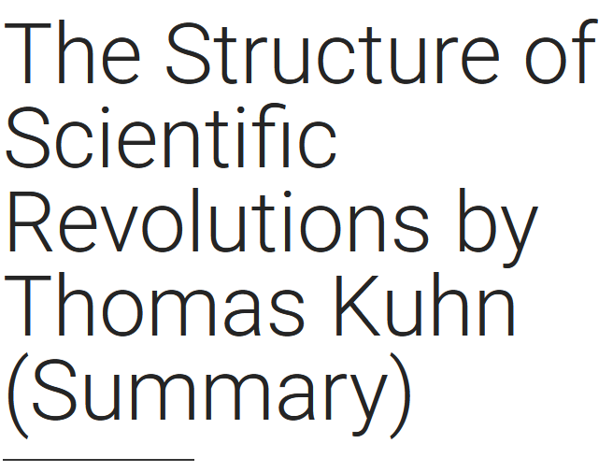
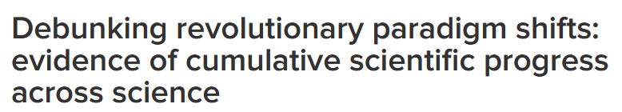
Introduction: Paradigm Shifts

Slide 15
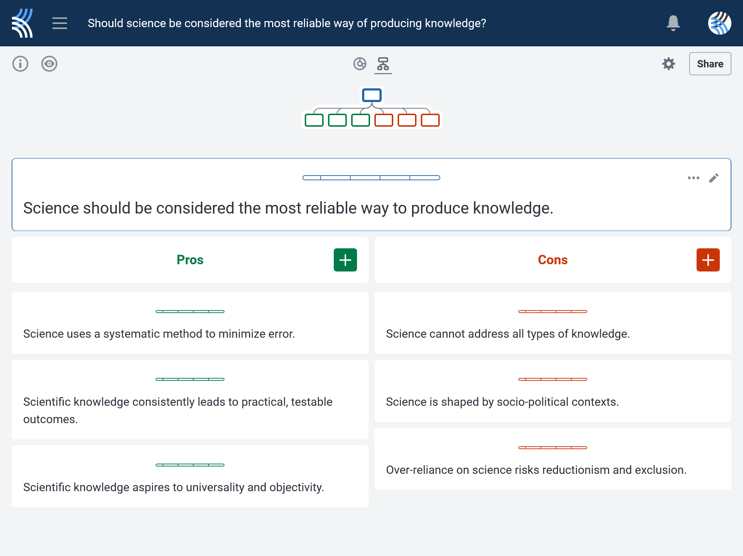
Kialo Discussion: Should science be considered the most reliable way of producing knowledge?
Now that you’ve had chance to discuss your initial thoughts, you are going to add your ideas to a Kialo discussion.
Let’s learn more about having an in-depth discussion on Kialo.

Slide 16
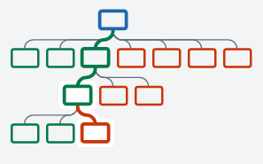

Kialo Discussion: The Argument Tree
On Kialo, the discussion is represented by an argument tree.
The pros are green and the cons are red.
Here are two Kialo argument trees.
Which one represents a more in-depth discussion?

Slide 17
Kialo Discussion: The Argument Tree
In this discussion, everyone has added their own perspective on the thesis.
Some perspectives might be repeated.
Students have not engaged with their peers’ perspectives.
This is unlikely to be an in-depth discussion!
In this discussion, students have added their perspective on the thesis, developed their arguments, and responded to other perspectives.
This results in a more in-depth discussion!

Slide 18
Kialo Discussion: Should science be considered the most reliable way of producing knowledge?
Let’s apply this to a discussion!
Building Arguments
Step 1: Choose the starter claim you most agree with.
Step 2: Develop this claim by adding at least 2 pros.
Step 3: Add at least 2 cons to represent an alternative perspective.
Step 4: Repeat this for at least 3 other starter claims.
Step 5: Your peers will also add claims to the discussion. Try to respond to at least 3 of these.
Check the argument tree: How deep is the discussion?

Slide 19
Kialo Discussion: Should science be considered the most reliable way of producing knowledge?
Questions to Consider
What makes scientific knowledge more reliable than other ways of knowing — its method, its results, or its institutional authority?
Are there forms of knowledge that science cannot reliably address?
How do different perspectives influence what is seen as “valid” science?
If scientific knowledge changes over time, can it still claim to be reliable?
How do the TOK concepts of justification, perspective, and objectivity help us understand disagreements about scientific knowledge?
Can we ever separate scientific reasoning from the values and power structures in which it is produced?

Slide 20
Reflection Task: Scientific Knowledge
Discussion Questions
What was the strongest argument you heard — for or against science’s reliability?
Did any example make you question your trust in scientific knowledge?
Which concept — justification, objectivity, or perspective — helped you analyze science most clearly?
Optional extension: Find one scientific claim online this week (news article, TikTok, infographic, podcast). Bring it to the next class. Be prepared to explain whether it seems justified and what makes it trustworthy or questionable.

Slide 21
Lesson Objectives: Recap
Examine how we justify whether something counts as scientific knowledge.
Explore how interpretations of scientific evidence can vary depending on method, values, or institutional context.
Recognize the role of perspective, objectivity, and justification in shaping scientific authority.
Challenge assumptions about science being neutral, purely empirical, or universally accepted.

