Slide 1
How to plan a TOK essay on Kialo
Prescribed Title: Do we need custodians of knowledge?

Slide 2


How does Kialo work?
If you’re new to Kialo, watch this video to discover how the platform works. Otherwise, let’s get started!

Slide 3


Lesson Objectives
Use a Kialo discussion to structure a TOK essay.
Deconstruct a TOK essay into claims, counterclaims, and examples.
Plan a clear and coherent argument on an area of knowledge, supported by examples.
Evaluate different points of view.

Slide 4
Lesson Vocabulary
structure
thesis
claim
counterclaim
counterargument
point of view
coherent

Slide 5
How can Kialo help me plan my TOK essay?
Planning your essay on Kialo helps you:
visually represent your thoughts, so you can organize complex ideas.
see how your ideas interact with each other.
build clear and coherent arguments.
support arguments with examples.
evaluate different points of view.

Slide 6
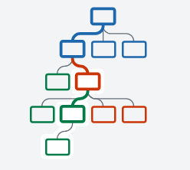
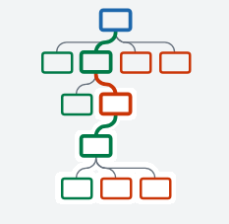

How can Kialo help me plan my TOK essay?
As you plan your essay on Kialo, your ideas are structured into an argument map.
This structure helps you build clear and coherent arguments.
Every argument map looks different depending on the number of theses, pros, and cons.
Your argument map should have a mixture of pros (green) and cons (red) to show you have evaluated different points of view.

Slide 7
How can Kialo help me plan my TOK essay?
As you develop your essay, you might find that you need to move a claim to change the order of your ideas.
This is easy on Kialo!
To move or link a claim:
Drag a claim into the clipboard in the bottom-left corner of the screen. It will appear as you drag the claim.
Navigate to the new location.
Drag and drop the claim where appropriate (if moving it onto a claim, the left-hand side will place it under the claim as a pro, the right-hand side as a con).
Select whether to Move or Link the claim in the new location.

Slide 8

TOK Essay Planning:
Step 1

Slide 9
Step 1: Deconstruct a TOK essay
You will compare the plan on Kialo with the finished essay section.
Open the Kialo discussion How to plan a TOK essay on Kialo Edu: Do we need custodians of knowledge? (Step 1).
Move through the discussion, looking at how the student has used pro claims to build a clear and coherent argument.
Then, compare this to the finished version of the essay section.
How has using Kialo helped the student structure their essay?

Slide 10

Step 1: Deconstruct a TOK essay
Discussion Questions
Where is the prescribed title displayed?
What information is presented in the thesis?
How does the claim structure support building a clear and coherent argument?
How have examples been used to support points?

Slide 11
Essay Section 1: Introduction
Prescribed Title: Do we need custodians of knowledge?
In the context of this essay, a custodian is defined as a body responsible for safeguarding and maintaining knowledge. There exists a clear societal demand and function for custodians of knowledge,
as they serve a role in sustaining the authenticity of knowledge and creating trust in the transfer of knowledge, particularly to less expert communities.
Where is the prescribed title displayed on Kialo?
What information is presented in the thesis on Kialo?

Slide 12
Essay Section 1: Introduction
Prescribed Title: Do we need custodians of knowledge?
In the context of this essay, a custodian is defined as a body responsible for safeguarding and maintaining knowledge. There exists a clear societal demand and function for custodians of knowledge,
as they serve a role in sustaining the authenticity of knowledge and creating trust in the transfer of knowledge, particularly to less expert communities.
Discussion Name
Thesis

Slide 13
Essay Section 1: Structure
In the arts, custodians of knowledge traditionally serve an important role in preserving and providing art for the masses, thereby supporting the transfer of artistic knowledge. Art associations, galleries, and museums serve as custodians for artistic knowledge by conserving and guarding physical artworks for people to experience, but also guarding the definition and value of art by making choices about the works to be included and presented. This type of custodianship can be considered necessary and useful for transferring artistic knowledge to people without expertise in arts, as the art curated by the custodians is known to have ‘artistic value.’
How does the claim structure support building a clear and coherent argument?

Slide 14
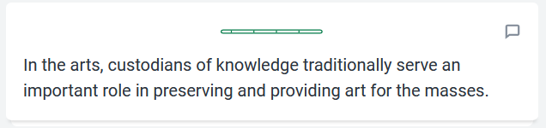
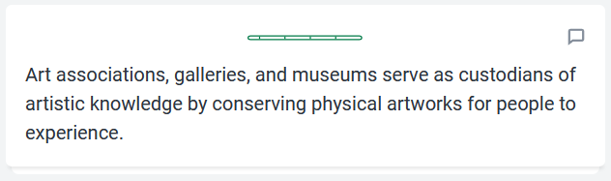
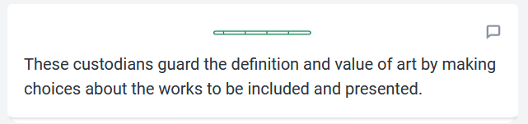
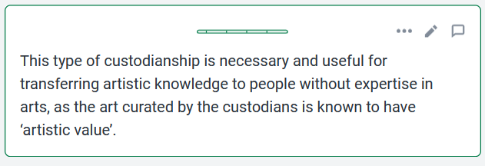
Essay Section 1: Structure
The student has used pro claims to construct a clear and coherent argument.

Slide 15
Essay Section 1: Using Examples
This demand for custodians can be seen in the public reaction to art made by artificial intelligence. When an artwork is observed to be less creative and meaningful, it causes less intrinsic emotional interpretations and reactions and therefore lacks contribution to human knowledge and understanding of the arts. For example, a psychological study with 2965 participants published in Nature magazine found that humans had a negative bias toward art labeled as AI-made compared to art labeled as human-made, even if the art was practically indistinguishable or kept constant. When art is thought to be created by AI, it is automatically perceived as less creative which gives it less value among the observers.
How have examples been used to support points?

Slide 16
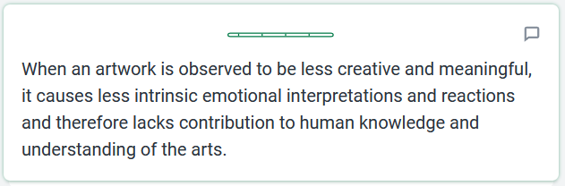
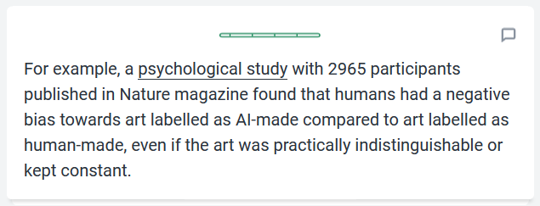
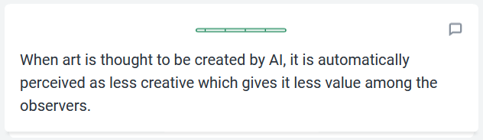
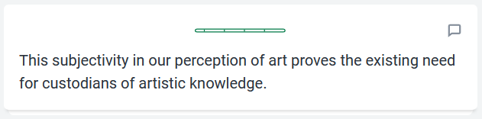
Essay Section 1: Using examples
On Kialo, you can link to sources to support your examples.
This example gives the argument a real-life context.

Slide 17
TOK Essay Planning:
Step 2

Slide 18
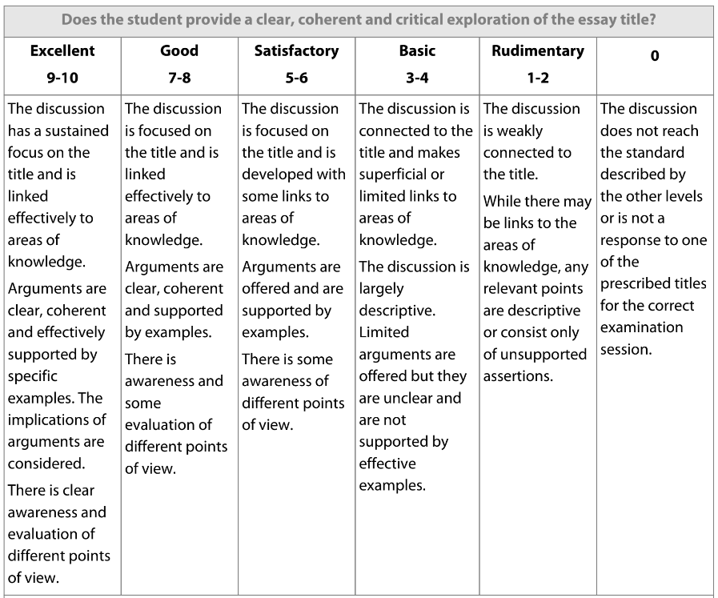

Step 2: TOK Essay Assessment Instrument
What do we need to add to the essay to achieve a 9–10 grade?

Slide 19
Step 2: Guided Practice
Read the section 2 of the sample essay on the Vienna Secession.
This section evaluates a different point of view.
Who is the custodian in this example?
How did they aim to protect and monitor Viennese artistic knowledge at the time?
How did notable artists react?
How does this demonstrate the potential negative impact of custodians of art?
What were the actual consequences of the Kunstlerhaus’s actions?

Slide 20


Step 2: Guided Practice
Section 2 of the essay provides a counterargument to this claim:
What is the counterargument?

Slide 21
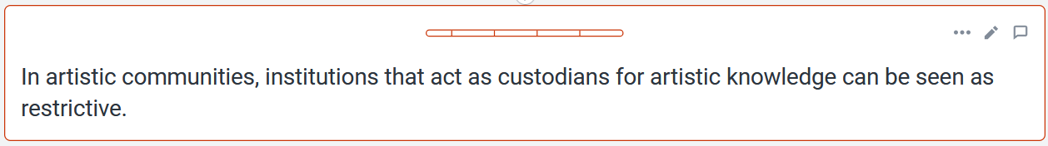
Step 2: Guided Practice
Now, your teacher will guide you through building this counterargument on Kialo.

Slide 22
Step 2: Guided Practice
Click here for an example of the completed counterargument plan.

Slide 23
TOK Essay Planning:
Step 3

Slide 24
Step 3: TOK Essay Assessment Instrument
What do we need to add to the essay to achieve a 9–10 grade?

Slide 25
Step 3: Independent Practice
We now need to develop arguments that refer to a different Area of Knowledge.
This will focus on the natural sciences.
Work in groups to conduct research into custodians of knowledge in the natural sciences.
Use Kialo to construct an argument in favor of custodians of knowledge in the natural sciences.
Use Kialo to construct an argument that evaluates a different viewpoint on the role of custodians of knowledge in the natural sciences.
Step 1
Step 2
Step 3

Slide 26
Reflection: Writing a Conclusion
We now need to write a conclusion.
This should tie all the arguments together and provide a definitive response to the prescribed title: Do we need custodians of knowledge?
Conclusion Success Criteria
Demonstrate critical thinking in explaining what you’ve learnt.
Evaluate the main arguments in response to the prescribed title.
Explain the implications of your response.
Refer to any unresolved questions or limitations.

Slide 27
Lesson Objectives: Recap
Use a Kialo discussion to structure a TOK essay.
Deconstruct a TOK essay into claims, counterclaims, and examples.
Plan a clear and coherent argument on an area of knowledge, supported by examples.
Evaluate different points of view.

Slide 28
Lesson Vocabulary: Recap
structure
thesis
claim
counterclaim
counterargument
point of view
coherent

