Slide 1
How do real-world controversies in the human sciences reveal tensions between responsibility, power, and perspective?
Science:
Ethical Restrictions in Human Sciences
Lesson 2: Fact-Finding Task

Slide 2
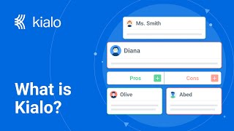
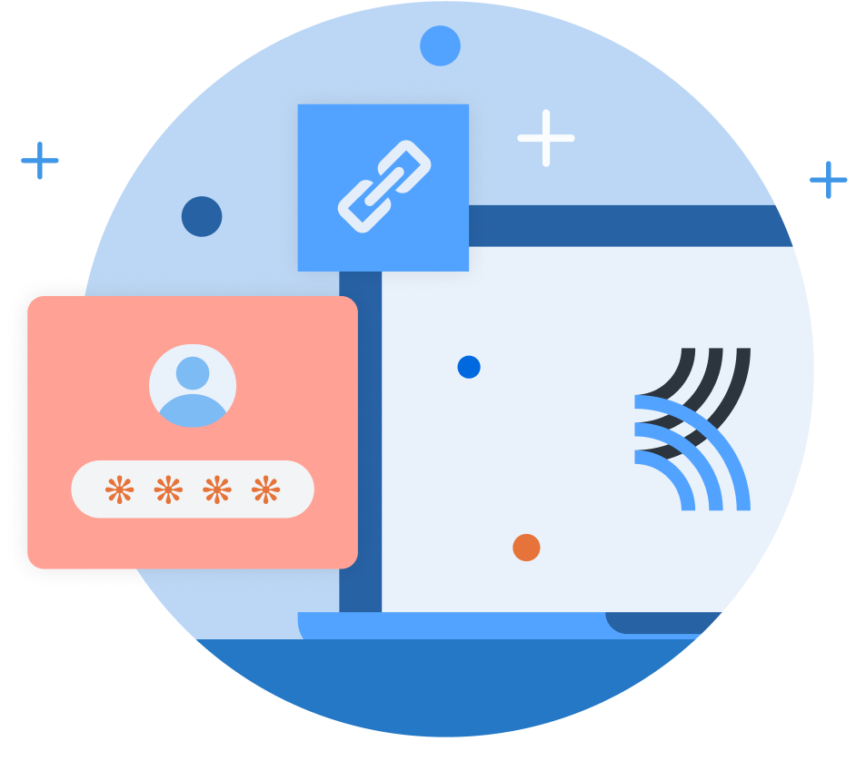
How does Kialo work?
If you’re new to Kialo, watch this video to discover how the platform works. Otherwise, let’s get started!

Slide 3

Lesson Objectives
Analyze case studies where ethical standards in human sciences were contested, violated, or debated.
Understand how different perspectives (researchers, governments, corporations, communities) influence what counts as “responsible” knowledge.
Apply TOK concepts (responsibility, power, perspective) to evaluate how ethical knowledge is constructed or undermined.
Substantiate or challenge claims from Lesson 1 with real-world evidence and ethical reasoning.

Slide 4

TOK Concepts
Responsibility: Who is responsible for protecting participants in human sciences research? Should researchers, institutions, or governments carry the ultimate accountability when ethical failures occur?
Power: How do power structures (e.g., governments funding research, corporations controlling data, universities setting ethical boards) shape which studies are conducted, silenced, or publicized?
Perspective: How do cultural, social, and historical viewpoints influence what counts as ethical or unethical research? Are ethical standards universal, or do they shift depending on context?
Today’s lesson links to these TOK concepts.
By completing the activities, you will build knowledge that can help with your assessments.

Slide 5
Introduction: Ethical Restrictions in Human Sciences
Today’s lesson is about using case studies to expand your knowledge on ethical restrictions in human sciences.
Step 1(inc. homework)
Conduct in-depth research into a specific case, and give a short presentation to the class.
Step 2
Present your findings, and refine your arguments in your Kialo discussions.
Step 3
Reflect on who gets to define and legitimize ethical research in human sciences.

Slide 6
Case Study: Ethical Restrictions in Human Sciences
Your teacher will assign you a case study for homework.
Tuskegee Syphilis Study (1932–72, USA)
Focus: African American men denied treatment in order to “study” disease progression.
Key Question: Can knowledge produced through exploitation ever be legitimate?
Stanford Prison Experiment (1971)
Focus: Simulated prison spiraled into psychological abuse of participants.
Key Question: Did Zimbardo uncover truths about power or simply create unethical suffering?
Cambridge Analytica & Facebook Data Harvesting (2016)
Focus: Psychological profiling and big data used to sway elections.
Key Question: Where is the line between behavioral science and manipulation?

Slide 7

Case Study: Ethical Restrictions in Human Sciences
You will need to give a short presentation to the class on your case study.
Presentation
Your presentation should focus on:
What happened in the case.
Who had power to decide or act (researchers, governments, corporations, participants).
Which perspectives were marginalized or excluded.
Which TOK concept (responsibility, power, perspective) is most relevant.
Whether the case supports or challenges a claim from Lesson 1.

Slide 8

Introduction: Ethical Restrictions in Human Sciences
Class Discussion
Last lesson, which claims did you find most convincing or flawed?
Did any arguments rely too much on assumptions without real-world support?

Slide 9
Introduction: Ethical Restrictions in Human Sciences
Class Discussion
How do real-world controversies in human sciences reveal tensions between responsibility, power, and perspective?

Slide 10
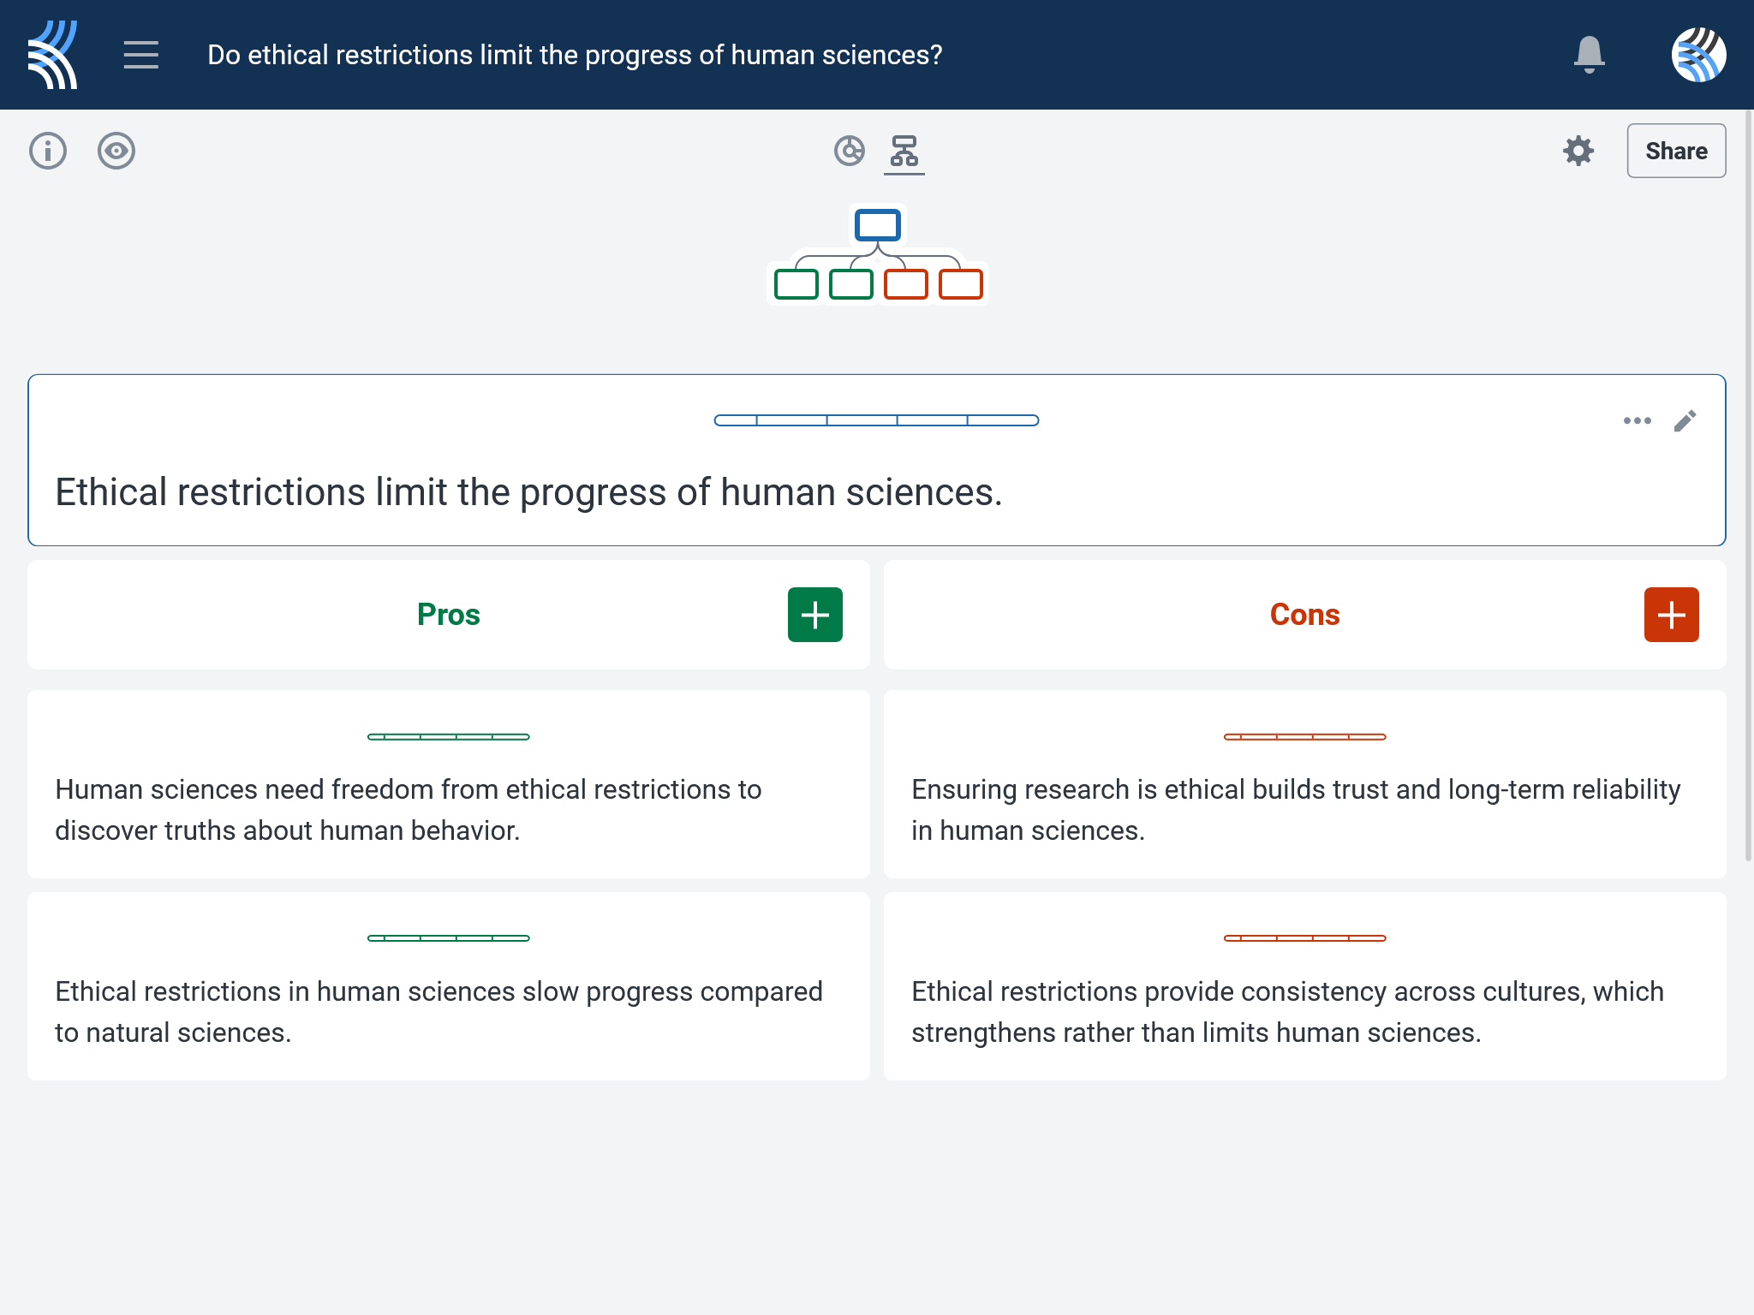
Kialo Discussion: Do ethical restrictions limit the progress of human sciences?
Use your case study and any other research to support, challenge, or refine your initial arguments in your Kialo discussion!

Slide 11
Kialo Discussion: Do ethical restrictions limit the progress of human sciences?
Focus Areas
Ethical Gatekeeping: Who decides which human sciences research is permitted, funded, or published and who gets excluded?
Institutional Authority: How do governments, universities, or corporations influence the perceived legitimacy of human sciences research?
Trust and Responsibility: How do ethical breaches (Tuskegee, Facebook) impact public trust in research?
Knowledge Inequality: Are all voices — especially marginalized communities, participants, or whistleblowers — treated equally in setting ethical boundaries?

Slide 12
Reflection Task: Scientific Knowledge
How did your case study affect your understanding of who gets to define and legitimize “ethical” research in human sciences?
What made certain examples feel more like abuse of power or institutional interference versus genuine ethical responsibility or protection?
In your case, who had the most control over the ethical narrative: researchers, governments, corporations, or participants?

Slide 13
Reflection Task: Scientific Knowledge
Can efforts to make human sciences research more inclusive ever be truly equal when access to funding, authority, and publication remains uneven?
What role should credibility, transparency, and responsibility play in deciding whether human sciences knowledge is accepted or contested?
Should all human sciences research that affects public wellbeing (e.g., health, behavior, elections, surveillance) require broader social consultation or are there exceptions?

Slide 14
Lesson Objectives: Recap
Analyze case studies where ethical standards in human sciences were contested, violated, or debated.
Understand how different perspectives (researchers, governments, corporations, communities) influence what counts as “responsible” knowledge.
Apply TOK concepts (responsibility, power, perspective) to evaluate how ethical knowledge is constructed or undermined.
Substantiate or challenge claims from Lesson 1 with real-world evidence and ethical reasoning.

