Slide 1
Do ethical restrictions limit the progress of human sciences?
Science:
Ethical Restrictions in Human Sciences
Lesson 1: Opening Debate

Slide 2
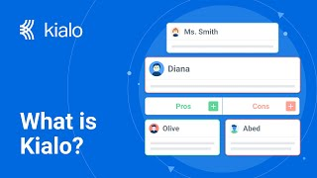
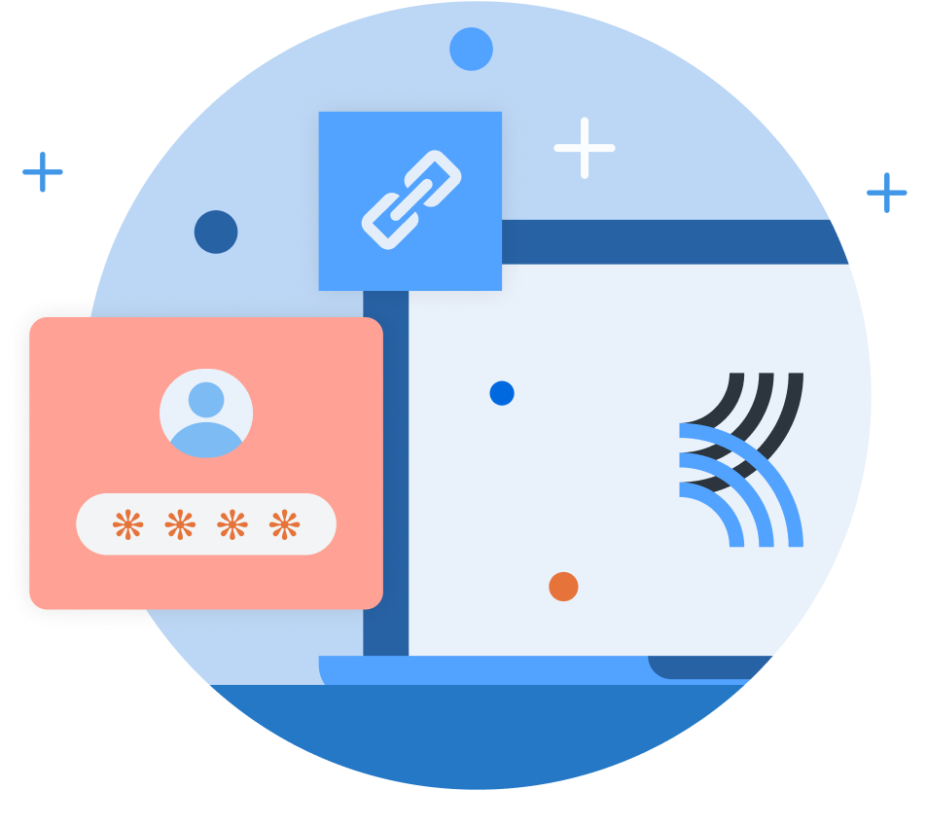
How does Kialo work?
If you’re new to Kialo, watch this video to discover how the platform works. Otherwise, let’s get started!

Slide 3

Lesson Objectives
Analyze how human sciences (psychology, data science, behavioral economics) are used to manipulate behavior
Evaluate how corporations, governments, and institutions exercise power through human sciences
Reflect on whether ethical responsibility strengthens or weakens human sciences in the digital age

Slide 4

TOK Concepts
Responsibility: What duties do human scientists have toward their participants and the societies affected by their research? Should the pursuit of knowledge ever outweigh the duty to protect human dignity and wellbeing?
Power: Who holds the authority to decide what counts as ethical in human sciences — researchers, governments, corporations, or communities? How do power dynamics influence what kinds of research are permitted or suppressed?
Perspective: How do cultural, historical, and societal viewpoints shape what is considered acceptable research? Should ethical standards be universal, or should they adapt to different cultural contexts?
Today’s lesson links to these TOK concepts.
By completing the activities, you will build knowledge that can help with your assessments.

Slide 5
Introduction: Ethical Restrictions in Human Sciences
Today’s lesson is about sharing your existing knowledge and perspectives on ethical restrictions in human sciences.
Step 1
Discuss the class’s initial response to the question.
Step 2
Share your existing knowledge and perspectives and respond to those of your peers in an in-depth Kialo discussion.
Step 3
Reflect on whether ethical restrictions limit the progress of human science.

Slide 6

Introduction: Ethical Restrictions in Human Sciences
Class Discussion
Do ethical restrictions limit the progress of human sciences?

Slide 7

Introduction: Key Concepts
Responsibility
What duties do researchers have toward participants, society, and future generations?
Power
Who has authority to decide what is ethical — researchers, governments, corporations, or communities?
Perspective
How do cultural, historical, and societal contexts shape what is considered ethical?

Slide 8
Introduction: Ethical Restrictions in Human Sciences
Look at the examples of scientific developments on the next six slides.
Discussion Questions
Which of these examples do you find most troubling, and why?
Who had the power to decide what was acceptable in each case?
Should “progress” ever come at the expense of ethics?

Slide 9

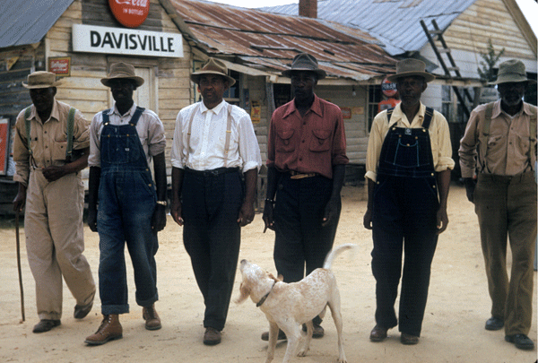

The Tuskegee Syphilis Study

Slide 10

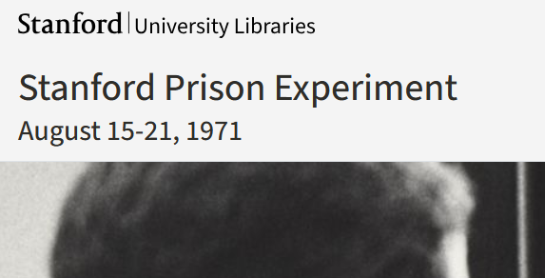
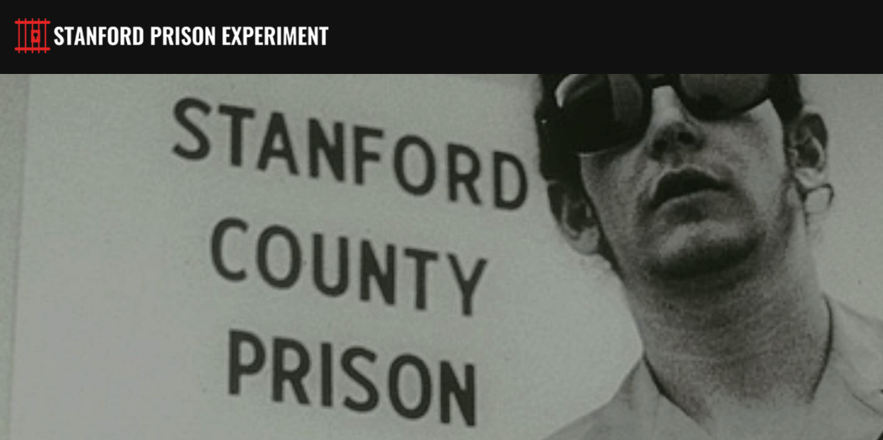
The Stanford Prison Experiment

Slide 11
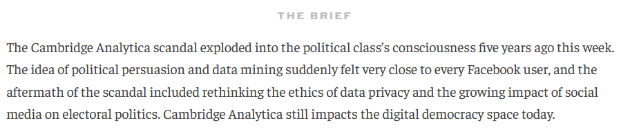
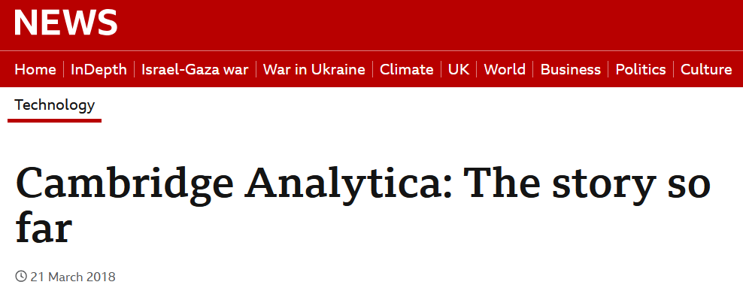
Cambridge Analytica

Slide 12
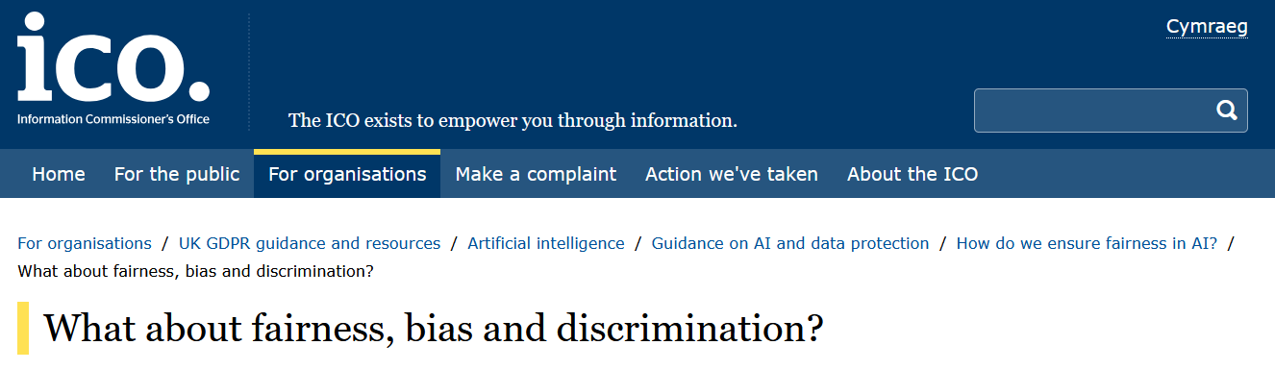
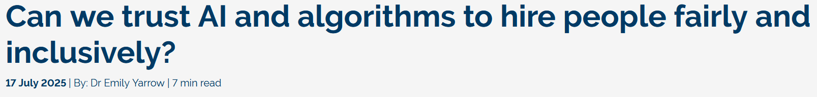
AI and Algorithmic Bias

Slide 13
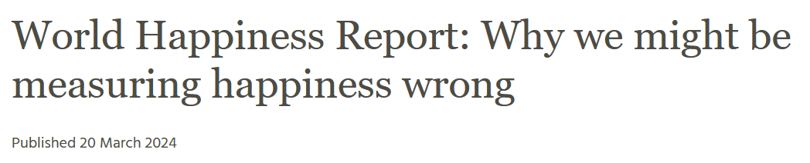
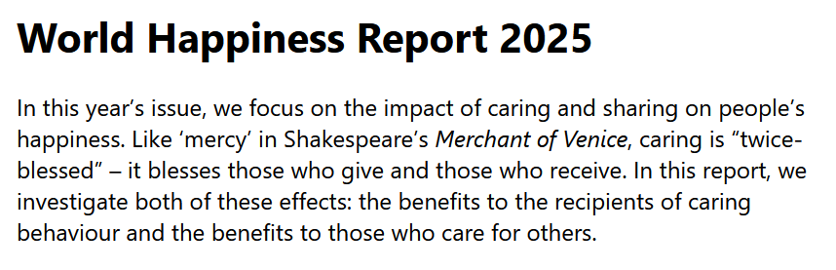
Global Happiness Indexes

Slide 14
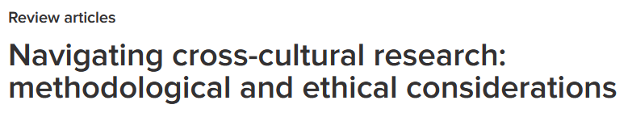
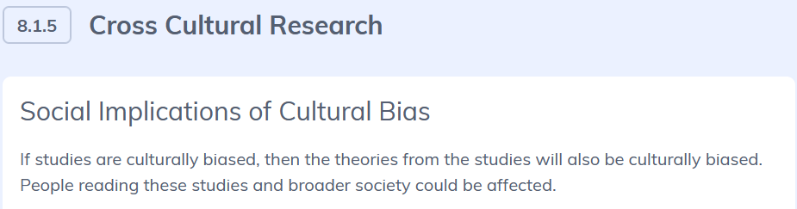
Cross-Cultural Research Ethics

Slide 15
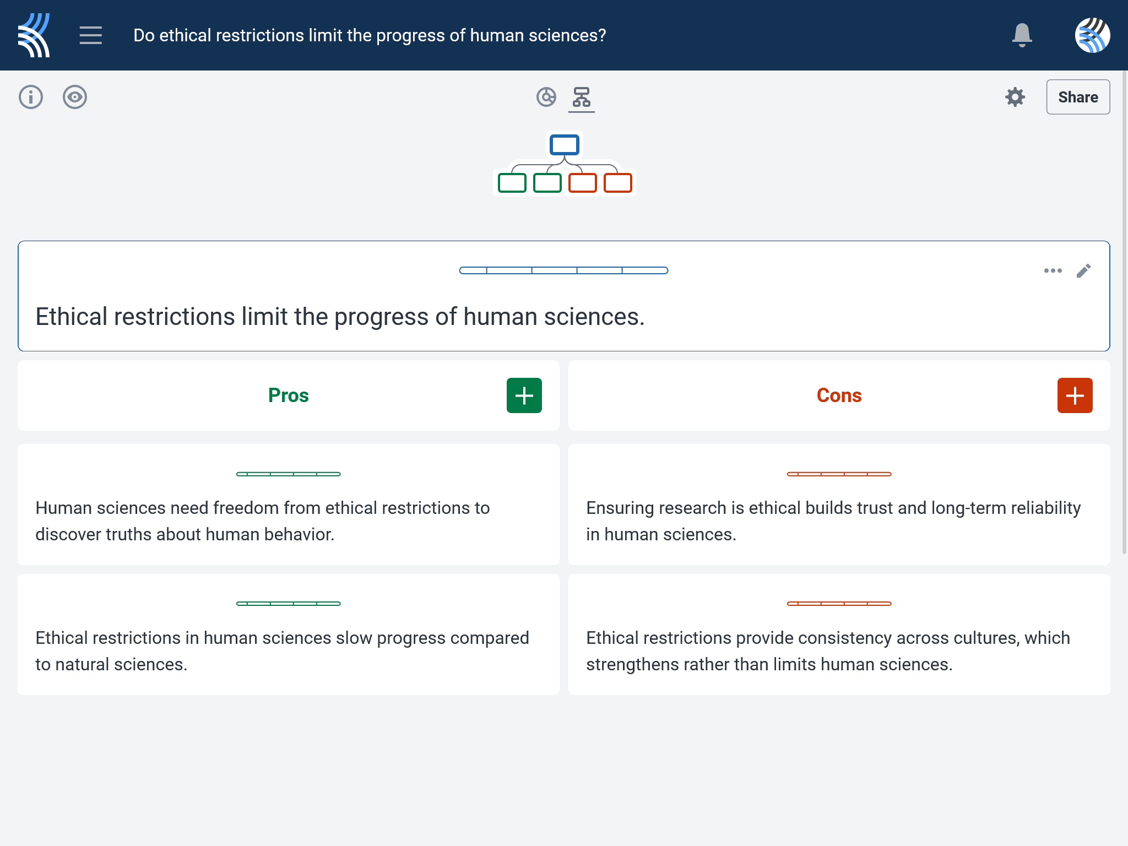
Kialo Discussion: Do ethical restrictions limit the progress of human sciences?
Now that you’ve had chance to discuss your initial thoughts, you are going to add your ideas to a Kialo discussion.
Let’s learn more about having an in-depth discussion on Kialo.

Slide 16
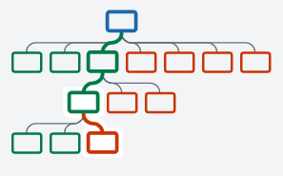

Kialo Discussion: The Argument Tree
On Kialo, the discussion is represented by an argument tree.
The pros are green and the cons are red.
Here are two Kialo argument trees.
Which one represents a more in-depth discussion?

Slide 17
Kialo Discussion: The Argument Tree
In this discussion, everyone has added their own perspective on the thesis.
Some perspectives might be repeated.
Students have not engaged with their peers’ perspectives.
This is unlikely to be an in-depth discussion!
In this discussion, students have added their perspective on the thesis, developed their arguments, and responded to other perspectives.
This results in a more in-depth discussion!

Slide 18
Kialo Discussion: Do ethical restrictions limit the progress of human sciences?
Let’s apply this to a discussion!
Building Arguments
Step 1: Choose the starter claim you most agree with.
Step 2: Develop this claim by adding at least 2 pros.
Step 3: Add at least 2 cons to represent an alternative perspective.
Step 4: Repeat this for at least 3 other starter claims.
Step 5: Your peers will also add claims to the discussion. Try to respond to at least 3 of these.
Check the argument tree: How deep is the discussion?

Slide 19
Kialo Discussion: Do ethical restrictions limit the progress of human sciences?
Questions to Consider
Should results from unethical studies (e.g., Tuskegee data) ever be used?
Are ethics absolute, or can they change depending on culture or context?
Do corporations have too much power over research ethics?
Is “progress” without responsibility actually regress?
How do the TOK concepts of responsibility, perspective, and power help us evaluate these dilemmas?

Slide 20
Reflection Task: Ethical Restrictions in Human Sciences
Discussion Questions
Did ethics in these cases strengthen or weaken the reliability of knowledge?
Can unethical research ever be justified by its results?
Who should bear responsibility for protecting participants — researchers, governments, or communities?
How does perspective (Western vs. non-Western, corporate vs. academic) change what is seen as ethical?
How do power structures influence what research questions get asked, funded, or silenced?

Slide 21
Lesson Objectives: Recap
Examine how we justify whether something counts as scientific knowledge.
Explore how interpretations of scientific evidence can vary depending on method, values, or institutional context.
Recognize the role of perspective, objectivity, and justification in shaping scientific authority.
Challenge assumptions about science being neutral, purely empirical, or universally accepted.

