Slide 1
How do real-world examples of contested or suppressed historical narratives reveal tensions between power, representation, and knowledge?
History:
The Objectivity of History
Lesson 2: Fact-Finding Task

Slide 2


How does Kialo work?
If you’re new to Kialo, watch this video to discover how the platform works. Otherwise, let’s get started!

Slide 3

Lesson Objectives
Investigate real-world case studies that show how power and perspective influence which histories are preserved, erased, or contested
Substantiate or challenge claims from Lesson 1 using evidence from media, academic sources, and historical debates
Develop critical thinking and source evaluation skills by connecting practical examples to TOK concepts like evidence, power, perspective, and responsibility

Slide 4

TOK Concepts
Responsibility: Who is responsible for ensuring that the historical narrative in your case study was accurate, inclusive, or ethical?
Evidence: What types of evidence were used in your case study, and how did they influence whose version of history was accepted?
Certainty: Did the case study reveal gaps, contradictions, or contested sources that made historical certainty difficult or impossible?
Today’s lesson links to these TOK concepts.
By completing the activities, you will build knowledge that can help with your assessments.

Slide 5
Introduction: Suppression of Historical Narratives
Today’s lesson is about using case studies to expand your knowledge on the suppression of historical narratives.
Step 1(inc. homework)
Conduct in-depth research into a specific case, and give a short presentation to the class.
Step 2
Present your findings, and refine your arguments in your Kialo discussions.
Step 3
Reflect on the control of historical narratives.

Slide 6
Case Study: Suppression of Historical Narratives
Your teacher will assign you a case study for homework.
The “Prehistoric” Label for Indigenous Societies
Focus: How defining “history” by written records excludes oral traditions and Indigenous knowledge systems.
Key Question: What counts as historical evidence, and who decides?
Rewriting National History Textbooks
Focus: Government influence on shaping national identity through history curricula.
Key Question: Who controls the “official” version of the past, and why?
Controversies over Historical Statues/Monuments
Focus: Debates around memory, honor, and historical accountability.
Key Question: Does taking down a monument erase history — or reframe it?
Museum Repatriation Debates
Focus: Ethical debates around who owns cultural artifacts and who gets to tell their stories.
Key Question: Is the act of displaying history also an act of control?

Slide 7

Case Study: Suppression of Historical Narratives
You will need to give a short presentation to the class on your case study.
Presentation
Your presentation should focus on:
What happened in the case.
How perspective and power dynamics influenced what was included as historical evidence in the case and what was excluded and why.
Which TOK concept (perspective, evidence, certainty) is most relevant.
Whether the case supports or challenges a claim from Lesson 1.

Slide 8

Introduction: Suppression of Historical Narratives
Class Discussion
What claims did you find most convincing or problematic in last class’s debate?
Were there any arguments that felt hard to prove without real-world examples?

Slide 9
Introduction: Suppression of Historical Narratives
Class Discussion
How do real-world examples of contested or suppressed historical narratives highlight tensions between power, evidence, and responsibility in the construction of history?

Slide 10
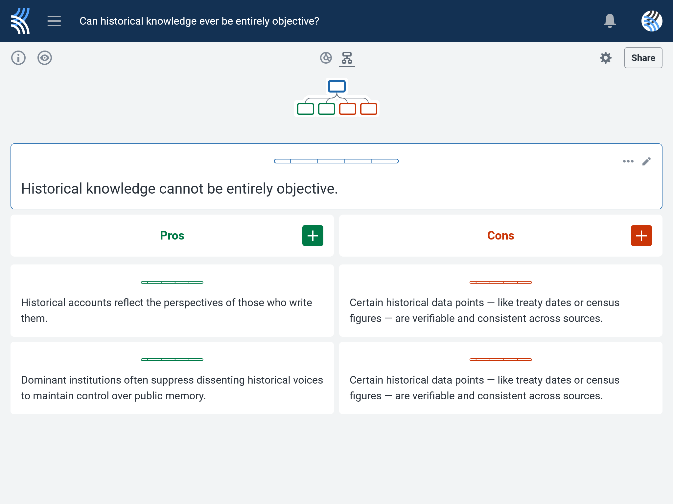
Kialo Discussion: Can historical knowledge ever be entirely objective?
Use your case study and any other research to support, challenge, or refine your initial arguments in your Kialo discussion!

Slide 11
Reflection Task: Suppression of Historical Narratives
How did your case study affect your understanding of who gets to define and preserve history?
What made certain examples feel more like suppression or distortion — versus empowerment or reclamation?
In your case, who had the most control over the historical narrative — governments, institutions, or communities?

Slide 12
Reflection Task: Suppression of Historical Narratives
Can efforts to include marginalized histories ever be truly equal when power and access to platforms remain uneven?
What role should visibility, credibility, and consent play in deciding how histories are shared or retold?
Should all public uses of historical knowledge require consultation with the communities they represent — or are there exceptions?

Slide 13
Lesson Objectives: Recap
Investigate real-world case studies that show how power and perspective influence which histories are preserved, erased, or contested
Substantiate or challenge claims from Lesson 1 using evidence from media, academic sources, and historical debates
Develop critical thinking and source evaluation skills by connecting practical examples to TOK concepts like evidence, power, perspective, and responsibility

