Slide 1
Can historical knowledge ever be entirely objective?
History:
The Objectivity of History
Lesson 1: Opening Debate

Slide 2


How does Kialo work?
If you’re new to Kialo, watch this video to discover how the platform works. Otherwise, let’s get started!

Slide 3

Lesson Objectives
Explore different views on what constitutes historical truth and objectivity
Recognize the tension between seeking objective accounts and acknowledging the role of perspective and interpretation in shaping historical narratives
Introduce the concepts of truth, objectivity, perspective, and bias in relation to historical knowledge

Slide 4

TOK Concepts
Perspective: How does the background or viewpoint of the historian shape the version of history we receive?
Evidence: Can we trust historical evidence to tell the truth, or does its meaning depend on how it’s interpreted?
Responsibility: What responsibilities do historians have when deciding which stories to tell — and which to leave out?
Today’s lesson links to these TOK concepts.
By completing the activities, you will build knowledge that can help with your assessments.

Slide 5
Introduction: The Objectivity of History
Today’s lesson is about sharing your existing knowledge and perspectives on whether history can ever be objective.
Step 1
Discuss the class’s initial response to the question.
Step 2
Share your existing knowledge and perspectives and respond to those of your peers in an in-depth Kialo discussion.
Step 3
Reflect on the nature of historical truth.

Slide 6
Introduction: The Objectivity of History
Objectivity (Oxford Reference)
The idea that things exist, or that statements about things are true, in absolute terms and independently of human existence or belief.
Subjectivity (Oxford Reference)
The self-conscious perspective of the person or subject.

Slide 7

Introduction: The Objectivity of History
Class Discussion
Can historical knowledge ever be entirely objective?

Slide 8

Introduction: The Objectivity of History
Challenge
Can you find headlines or images reporting the same historical event from different newspapers or time periods?
Discussion Questions
Whose perspective is reflected in this version of history — and whose is missing?
If historical facts remain the same, why do different groups tell such different stories?
Does removing bias from historical accounts make them more accurate, or less meaningful?

Slide 9
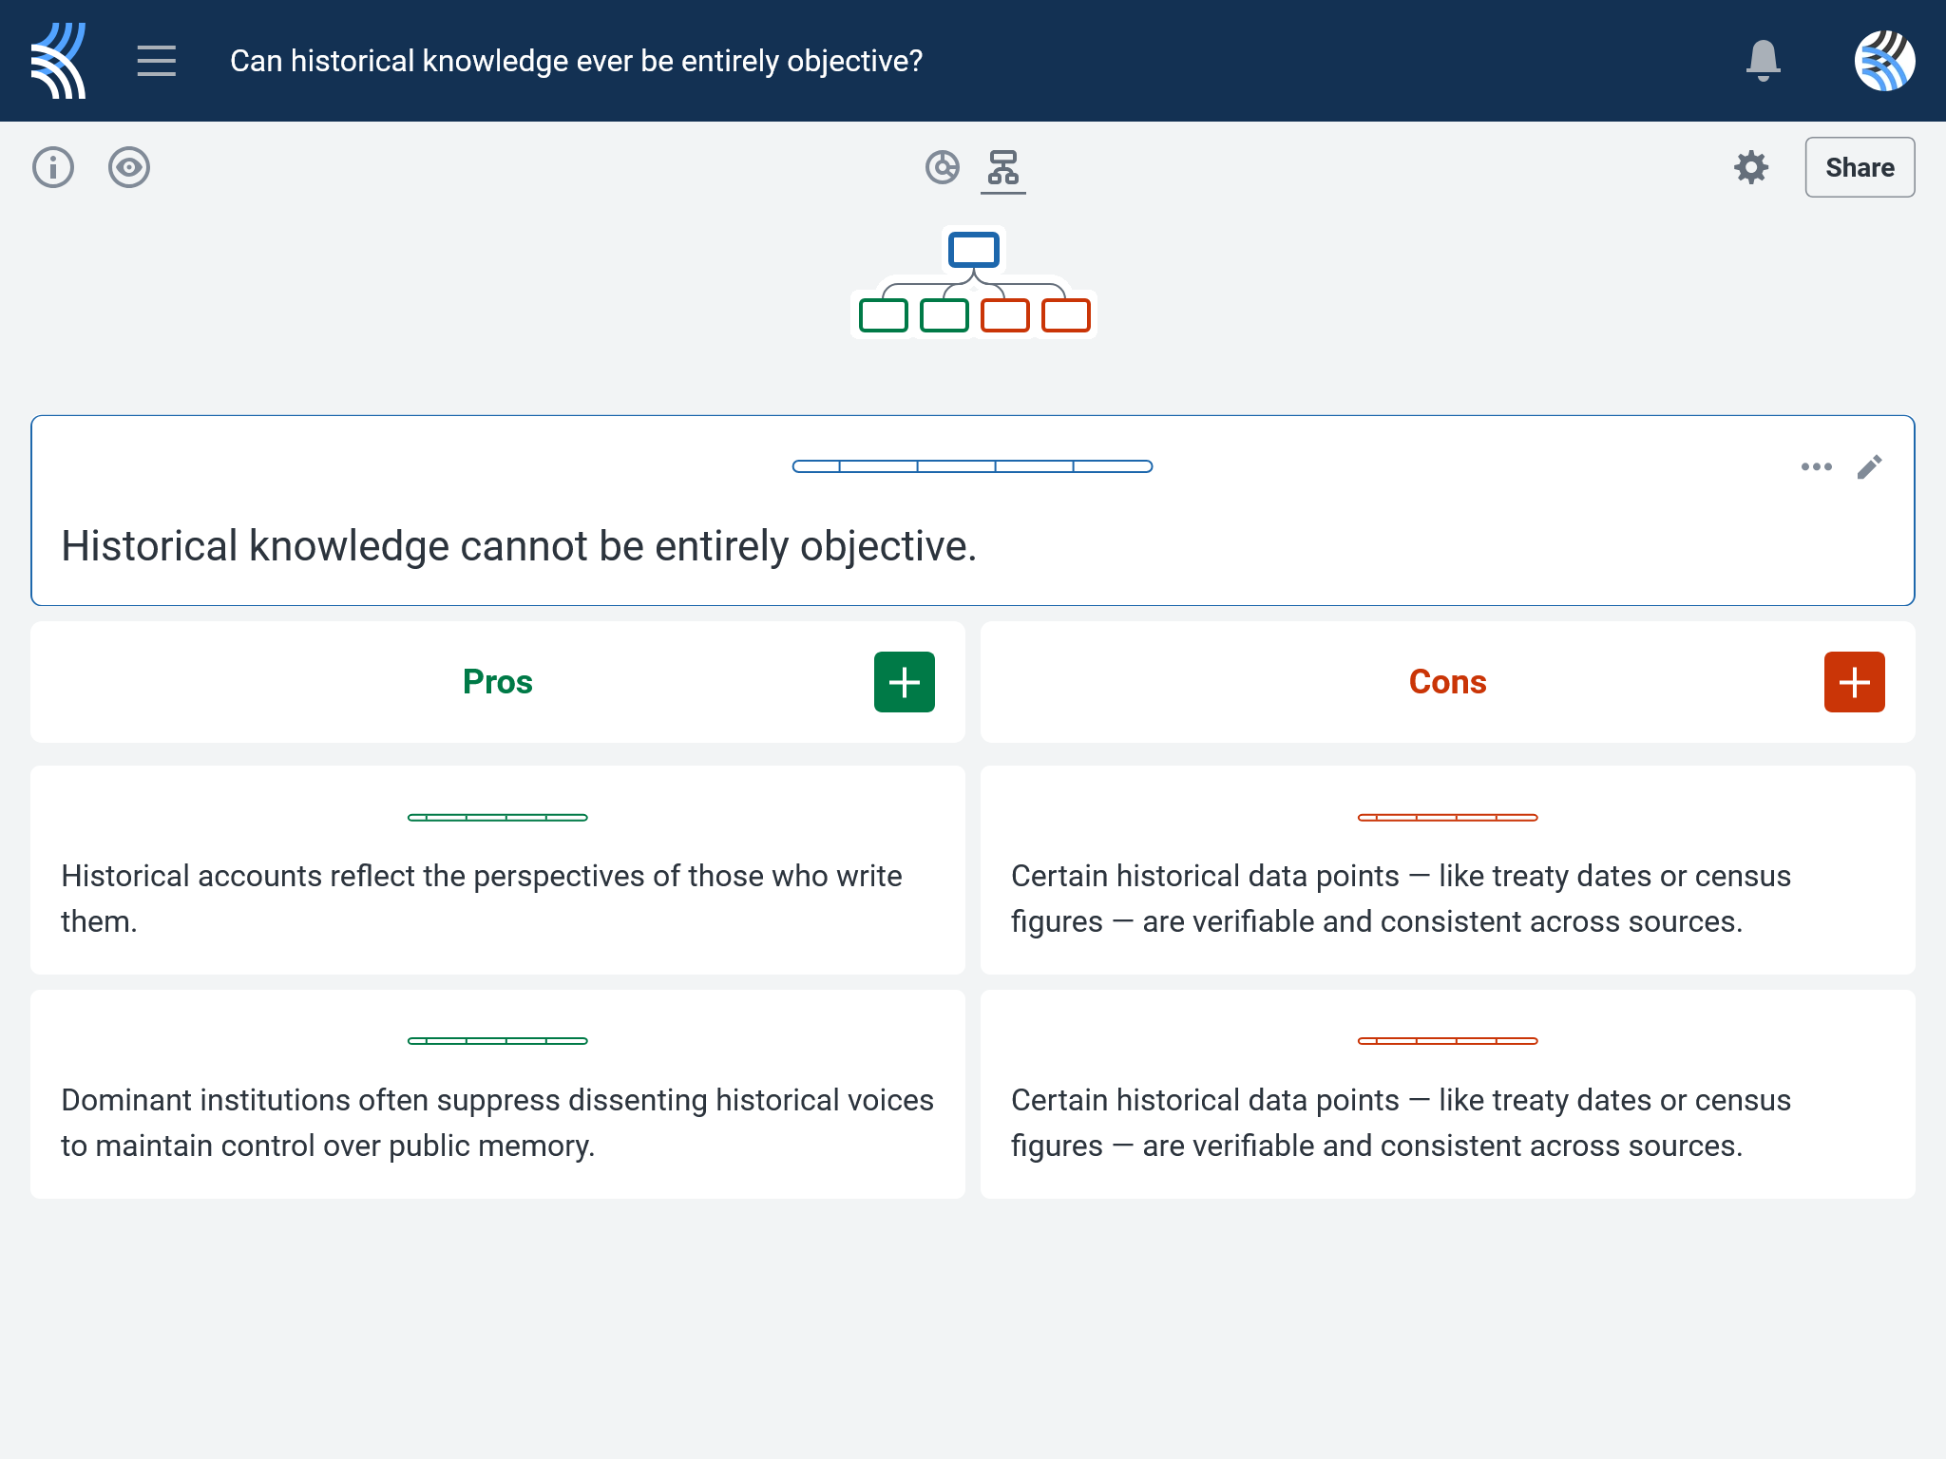
Kialo Discussion: Can historical knowledge ever be entirely objective?
Now that you’ve had chance to discuss your initial thoughts, you are going to add your ideas to a Kialo discussion.
Let’s learn more about having an in-depth discussion on Kialo.

Slide 10
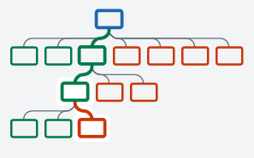

Kialo Discussion: The Argument Tree
On Kialo, the discussion is represented by an argument tree.
The pros are green and the cons are red.
Here are two Kialo argument trees.
Which one represents a more in-depth discussion?

Slide 11
Kialo Discussion: The Argument Tree
In this discussion, everyone has added their own perspective on the thesis.
Some perspectives might be repeated.
Students have not engaged with their peers’ perspectives.
This is unlikely to be an in-depth discussion!
In this discussion, students have added their perspective on the thesis, developed their arguments, and responded to other perspectives.
This results in a more in-depth discussion!

Slide 12

Kialo Discussion: Can censorship ever be justified?
Let’s apply this to a discussion!
Building Arguments
Step 1: Choose the starter claim you most agree with.
Step 2: Develop this claim by adding at least 2 pros.
Step 3: Add at least 2 cons to represent an alternative perspective.
Step 4: Repeat this for at least 3 other starter claims.
Step 5: Your peers will also add claims to the discussion. Try to respond to at least 3 of these.
Check the argument tree: How deep is the discussion?

Slide 13
Kialo Discussion: Can historical knowledge ever be entirely objective?
Questions to Consider
What does it mean for a historian to be “objective”? Is that a realistic or useful goal?
Can subjectivity in historical writing ever be a strength rather than a flaw?
If every historian brings their own perspective, does that make all historical knowledge equally valid?
Is bias something we can eliminate from history — or something we should learn to recognize and interrogate?
How do concepts like justification and evidence help us decide what to believe about the past?

Slide 14
Reflection Task: The Objectivity of History
Did today’s discussion change how you think about historical truth? Why or why not?
Which argument from the Kialo debate did you find most convincing, and what made it strong?
Can you think of an example where history felt one-sided or incomplete? What do you think was missing?
How does knowing that history is shaped by perspective affect your trust in textbooks, museums, or official narratives?
Do you think historians have a responsibility to be objective — or to amplify marginalized voices? Can they do both at the same time?
What role does power play in shaping the historical knowledge we accept as truth?
Which TOK concepts helped you understand today’s topic most clearly? Why?

Slide 15
Lesson Objectives: Recap
Explore different views on what constitutes historical truth and objectivity
Recognize the tension between seeking objective accounts and acknowledging the role of perspective and interpretation in shaping historical narratives
Introduce the concepts of truth, objectivity, perspective, and bias in relation to historical knowledge

