Slide 1
Which type of adaptation gives organisms the greatest survival advantage in the era of rapid climate change?
Statement of inquiry: Relationships between an organism’s form and function allow it to adapt to its environment.

Slide 2
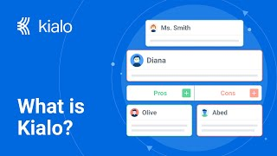

How does Kialo work?
If you’re new to Kialo, watch this video to discover how the platform works. Otherwise, let’s get started!

Slide 3

Lesson Objectives: Criterion A - Knowing and Understanding
i. Outline structural, behavioral, and physiological adaptations.
iii. Interpret information to make scientifically supported judgments: how different types of adaptation improve an animal’s survival in a particular environment.

Slide 4

Key and Related Concepts
Relationships: How are these elements connected?
Form: What does something look like?
Function: What is its purpose?
Adaptation: How does the form of an organism change to survive in its environment? Structural - How do physical features of an organism help it survive in its environment?
Behavioral - In what ways do animals change their actions in response to environmental pressures? Physiological - How do bodily functions adjust to changing environments?
Today’s lesson links to these concepts.
By completing the activities, you will build knowledge that can help build your understanding.

Slide 5
Introduction: Options Explosion
Today’s lesson is about consolidating what we know about adaptation through discussing our debatable question..
Step 1
Get into your groups
Step 2
Look at the photos assigned to your group.
Step 3
List as many possible adaptations as you can think of that would help these organisms survive their changing habitat.

Slide 6
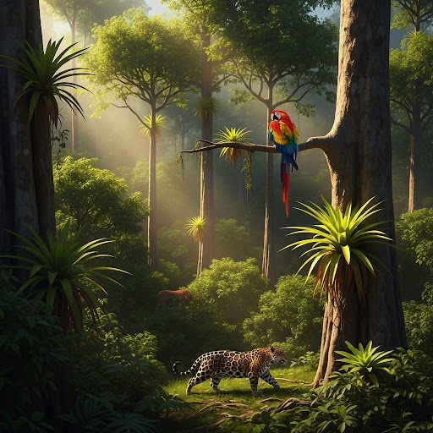
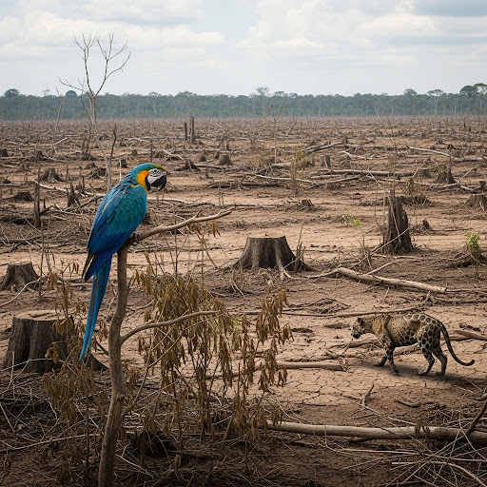
Biome: Rainforest

Slide 7
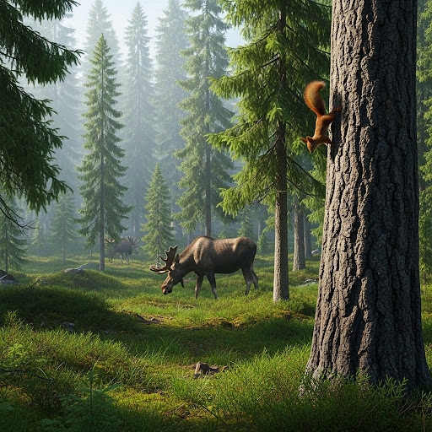
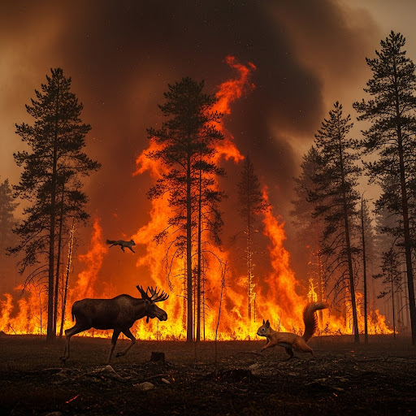
Biome: Taiga

Slide 8
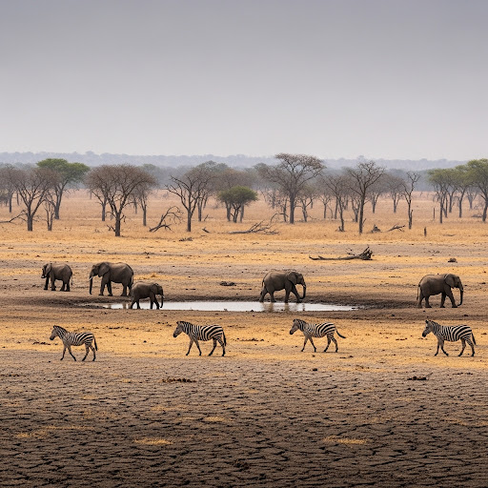
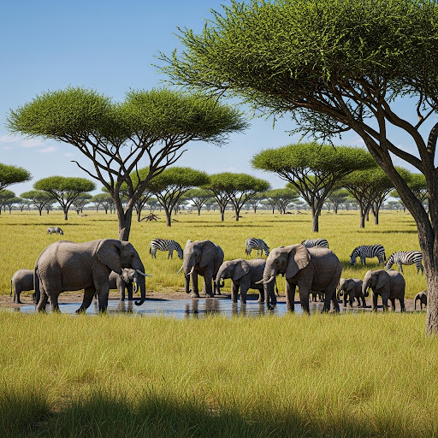
Biome: Grasslands
BEFORE
NOW

Slide 9
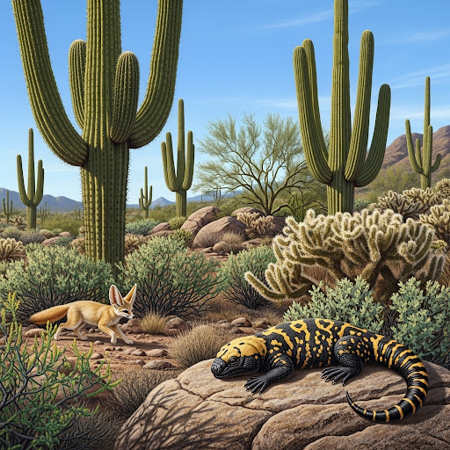
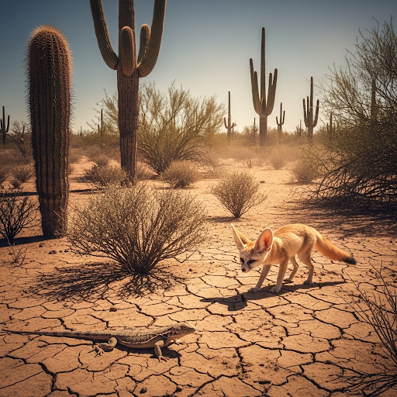
Biome: Desert
BEFORE
NOW

Slide 10
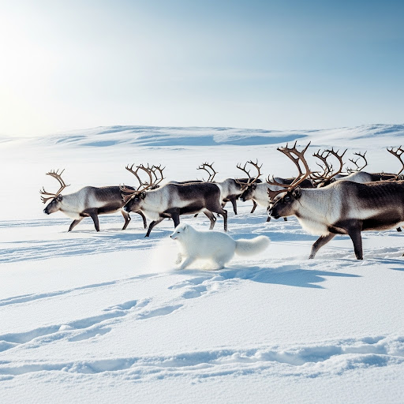
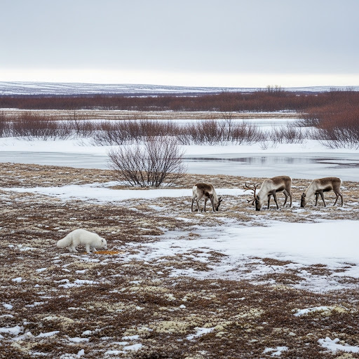
Biome: Tundra
BEFORE
NOW

Slide 11
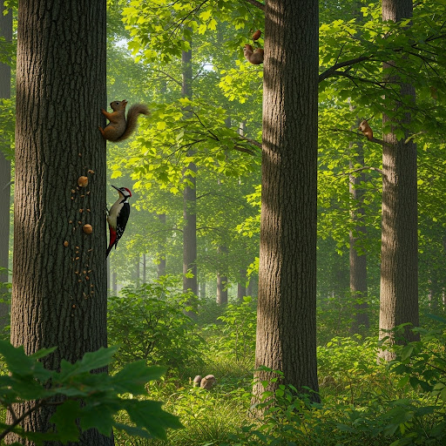
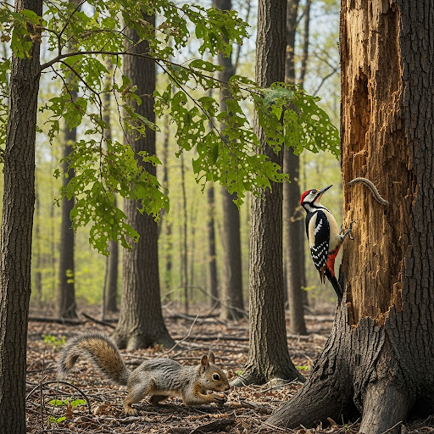
Biome: Temperate deciduous forest
BEFORE
NOW

Slide 12

Concept review
What function would this adaptation serve?
How would it change the animal, and how would it improve its chances?

Slide 13
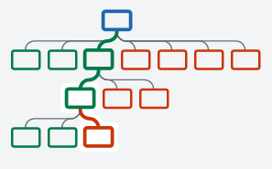

Kialo Discussion: The Argument Tree
On Kialo, the discussion is represented by an argument tree.
The pros are green and the cons are red.
Here are two Kialo argument trees.
Which one represents a more in-depth discussion?

Slide 14
Kialo Discussion: The Argument Tree
In this discussion, everyone has added their own perspective on the thesis.
Some perspectives might be repeated.
Students have not engaged with their peers’ perspectives.
This is unlikely to be an in-depth discussion!
In this discussion, students have added their perspective on the thesis, developed their arguments, and responded to other perspectives.
This results in a more in-depth discussion!

Slide 15

Kialo Discussion: Can religious artifacts and miracle claims serve as reliable sources of knowledge?
Let’s apply this to a discussion!
Building Arguments
Stage 1: Add starting claims for and against the different types of adaptations. Add claims for all three forms of adaptation.
Stage 2: Develop claims by adding examples and evidence, or explain why a claim is incorrect — Developing 1 of YOUR claims and 9 from other students.
Stage 3: No more claims can be added. Read through the claims and vote on the ones you feel create the best argument.
Check the argument tree: How deep is the discussion?

Slide 16
Exit Ticket: Reflecting on our critical thinking skills
Before I thought… At the beginning of the discussion, which form of adaptation did you believe may provide an organism with the greatest chance of survival? Why?
Now I think... After interacting with your peers and reviewing their arguments, how has your perspective changed? Provide an example of evidence from a peer.

Slide 17
Lesson Objectives: Recap Criterion A - Knowing and Understanding
i. Outline structural, behavioral, and physiological adaptations.
iii. Interpret information to make scientifically supported judgments: how different types of adaptation improve an animal’s survival in a particular environment.

