Slide 1
How can knowledge users develop strong, structured arguments?
Knowledge and Technology:
AI, Knowledge, and Accountability
Lesson 4: Writing a TOK Essay

Slide 2

Lesson Objectives
Write a fully developed TOK essay claim using the TOK essay structure.
Apply real-world examples and counterclaims to support arguments.
Engage critically with TOK concepts (e.g., bias, responsibility, and perspective).
Practice structured writing for the TOK essay assessment.

Slide 3

TOK Concepts
Bias and Responsibility: How can biases in data or algorithms shift the locus of responsibility?
Perspective: Are certain voices left out of AI design, and how does that affect the knowledge produced?
Ethical Implications: Should AI be treated as an independent knower or an extension of human agency?
Knowledge Construction: How does AI’s “black box” nature challenge our usual methods of validating knowledge claims?
Today’s lesson links to these TOK concepts.
By completing the activities, you will build knowledge that can help with your assessments.

Slide 4
Introduction: The TOK Essay
Today’s lesson is about applying your learning to practice writing a section of the TOK essay.
Step 1
Learn about the structure of the TOK essay.
Step 2
Plan and write your own section of the TOK essay, using what you’ve learnt on AI and accountability.
Step 3
Peer-review your writing, and revise it based on feedback.

Slide 5

Introduction: The TOK Essay
How do we develop a strong argument in a TOK essay?

Slide 6

Class Discussion: What makes a TOK essay unique?
A TOK essay should:
Focus on knowledge (not merely opinions).
Use real-world examples drawn from multiple Areas of Knowledge (AOKs).
Include counterclaims.
Refer to TOK concepts (e.g., bias, responsibility, perspective).
Reflect on the implications and limitations of the argument.

Slide 7
Structuring a TOK Essay: AOK 1
Introduction
Assume a position.
Define key topic-specific terms.
Introduce chosen AOKs.
Explain the aspects of the topic you will explore.
{
Knowledge claim (AOK 1), including real-life example
Make a claim that links this AOK with the PT.
Explain how the example supports your claim.
Try to make links to your other subjects.
Lesson Focus
Counterclaim (AOK 1)
Evaluate a contrasting perspective in relation to your main claim.
Explain how the example, if used, supports your claim.
Try to make links to your other subjects.

Slide 8
Structuring a TOK Essay: AOK 2
Knowledge claim (AOK 2), including real-life example
Make a claim that links this AOK with the PT.
Explain how the example supports your claim.
Try to make links to your other subjects.
Counterclaim (AOK 2)
Evaluate a contrasting perspective in relation to your main claim.
Explain how the example, if used, supports your claim.
Try to make links to your other subjects.
Conclusion
Integrate the different AOKs and perspectives.
Explain your insights and their implications.
Refer to any limitations or unresolved questions.

Slide 9
Deconstructing a TOK Essay
Your teacher will provide you with a section of a TOK essay.
You should annotate the features listed below.
Claim: The stance or argument addressing the TOK prompt.
Example: A real-world situation supporting or illustrating the claim.
Counterclaim: A contrasting perspective that challenges the claim and may include a further real-life example.
TOK links: Explicit connection to TOK concepts (e.g., bias, responsibility, perspective) and reflection on how knowledge is produced or validated.

Slide 10

Deconstructing a TOK Essay
Discussion Questions
How does the example strengthen the claim?
Which Ways of Knowing (WOKs) or Areas of Knowledge (AOKs) are relevant here?
Does the counterclaim effectively challenge the claim, encouraging deeper exploration?

Slide 11
Application: TOK Essay Prescribed Titles
How do these prompts apply to the topics we’ve covered?
Can you identify any other prompts that link?
Do the ever-improving tools of an area of knowledge always result in improved knowledge?
(May 2025)
How can we reconcile the relentless drive to pursue knowledge with the finite resources we have available? (May 2025)
Nothing is more exciting than fresh ideas, so why are areas of knowledge often so slow to adopt them?
(May 2024)
Do we need custodians of knowledge?
(May 2024)

Slide 12
Writing a TOK Essay
Step 1
Select an essay prompt from the list your teacher provides.
Step 2
Plan your claim and real-world example.
You could use one of the examples from this unit.
Step 3
Plan your counterclaim, using another real-life example if possible.
Step 4
Use your plan to write your essay section.
It should be clear and coherent, with a TOK focus.

Slide 13
Writing a TOK Essay: Example Structure
Claim: A clear stance responding to the prompt (e.g., “Human programmers remain accountable for AI knowledge outputs because they determine the data and algorithms.”).
Example: A concrete case (e.g., self-driving car accident, AI-based court sentencing tools) demonstrating how accountability is shared or abdicated.
Counterclaim: A nuanced alternative (e.g., “Once AI systems learn from massive datasets, accountability may diffuse beyond a single group of developers.”).
TOK Link: Reference how knowledge is generated, validated, or potentially distorted (e.g., bias in data sets, black-box algorithms, ethical frameworks).
AOKs: Reference relevant AOKs (e.g., viewing AI accountability through ethical frameworks, or exploring how AI is transforming creative expression in the arts.)

Slide 14
Writing a TOK Essay
You can use a blank Kialo discussion to plan out your essay section.
Step 1
Add your prescribed title to a Kialo discussion as the Discussion Name.
Step 2
Create a multi-thesis discussion.
Use the AOKs as your theses.
Step 3
Add your main claim under your first thesis.
Add pros to support this based on your examples and evaluation.
Step 4
Add a contrasting perspective using a con.
Break your examples and evidence down into single claims to help you build a logical line of reasoning.

Slide 15
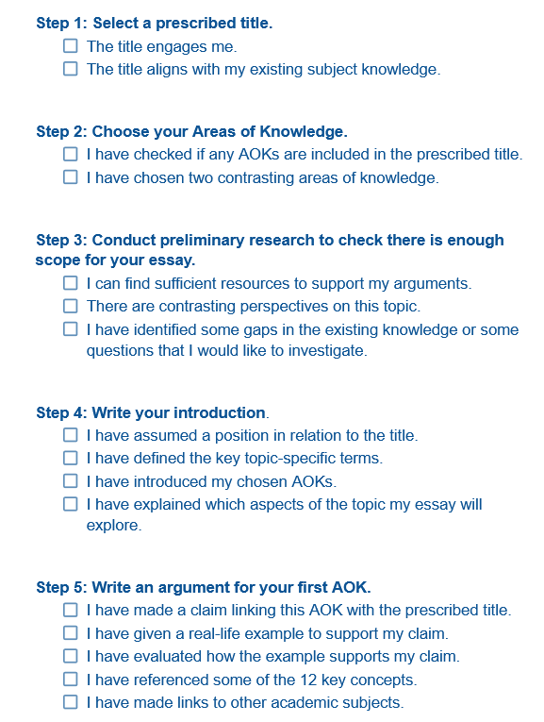

Peer Review: TOK Essay Checklist
Exchange your writing with your peers.
Use the relevant sections of the checklist to evaluate your peers’ work.
Revise your work based on their feedback.

Slide 16
Peer Review: Developing Feedback
Discussion Points
Claim: Is it clearly stated, and does it tie back to the prompt?
Example: Is it concrete, relevant, and well-explained?
Counterclaim: Is it meaningfully different or just a weaker version of the claim?
TOK link: Does it show awareness of how knowledge is justified, constructed, or challenged?
Language and clarity: Are there any vague statements or unclear references?

Slide 17
Reflection Task: TOK Essay Writing
What was the most challenging part of writing this essay section?
How do different perspectives influence AI accountability debates?
How will this practice help you prepare for the TOK essay assessment?

Slide 18
Extension/Homework Activities: TOK Essay
Option A: Expand the paragraph by adding another real-world example or a deeper analysis of the counterclaim.
Option B: Research a different context (another region or era) to see if the claim holds universally or changes with cultural/political conditions.
Option C: Draft an introductory or concluding paragraph linking the argument to a broader TOK theme (e.g., ethics of technology, the nature of bias, or trust in knowledge systems).

Slide 19
Lesson Objectives: Recap
Write a fully developed TOK essay claim using the TOK essay structure.
Apply real-world examples and counterclaims to support arguments.
Engage critically with TOK concepts (e.g., bias, responsibility, and perspective).
Practice structured writing for the TOK essay assessment.

