Slide 1
Will AI do more harm than good?
Knowledge and Technology:
AI, Knowledge, and Accountability
Lesson 3: Listening Task

Slide 2
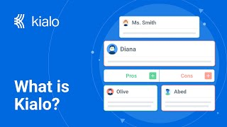

How does Kialo work?
If you’re new to Kialo, watch this video to discover how the platform works. Otherwise, let’s get started!

Slide 3

Lesson Objectives
Analyze and evaluate the strength of arguments in debates about AI ethics.
Evaluate the ethical implications of AI technologies from multiple stakeholder perspectives.

Slide 4

TOK Concepts
Ethics: What ethical principles guide how we assign responsibility for AI decisions?
Perspectives: Why might speakers present AI ethics from different angles?
Values: How do cultural or societal values shape ethical principles in the field of AI?
Today’s lesson links to these TOK concepts.
By completing the activities, you will build knowledge that can help with your assessments.

Slide 5
Introduction: The Impact of AI
Today’s lesson is about listening to debates relating to the impact of AI and related ethical issues and evaluating the strength of arguments.
Step 1
Share your own perspectives on the potential impact of AI.
Step 2
Listen to debates on the topic. Take notes on the main arguments and counterarguments, analyzing their strengths and weaknesses.
Step 3
Use your notes to add the strongest arguments and counterarguments to a Kialo discussion.

Slide 6
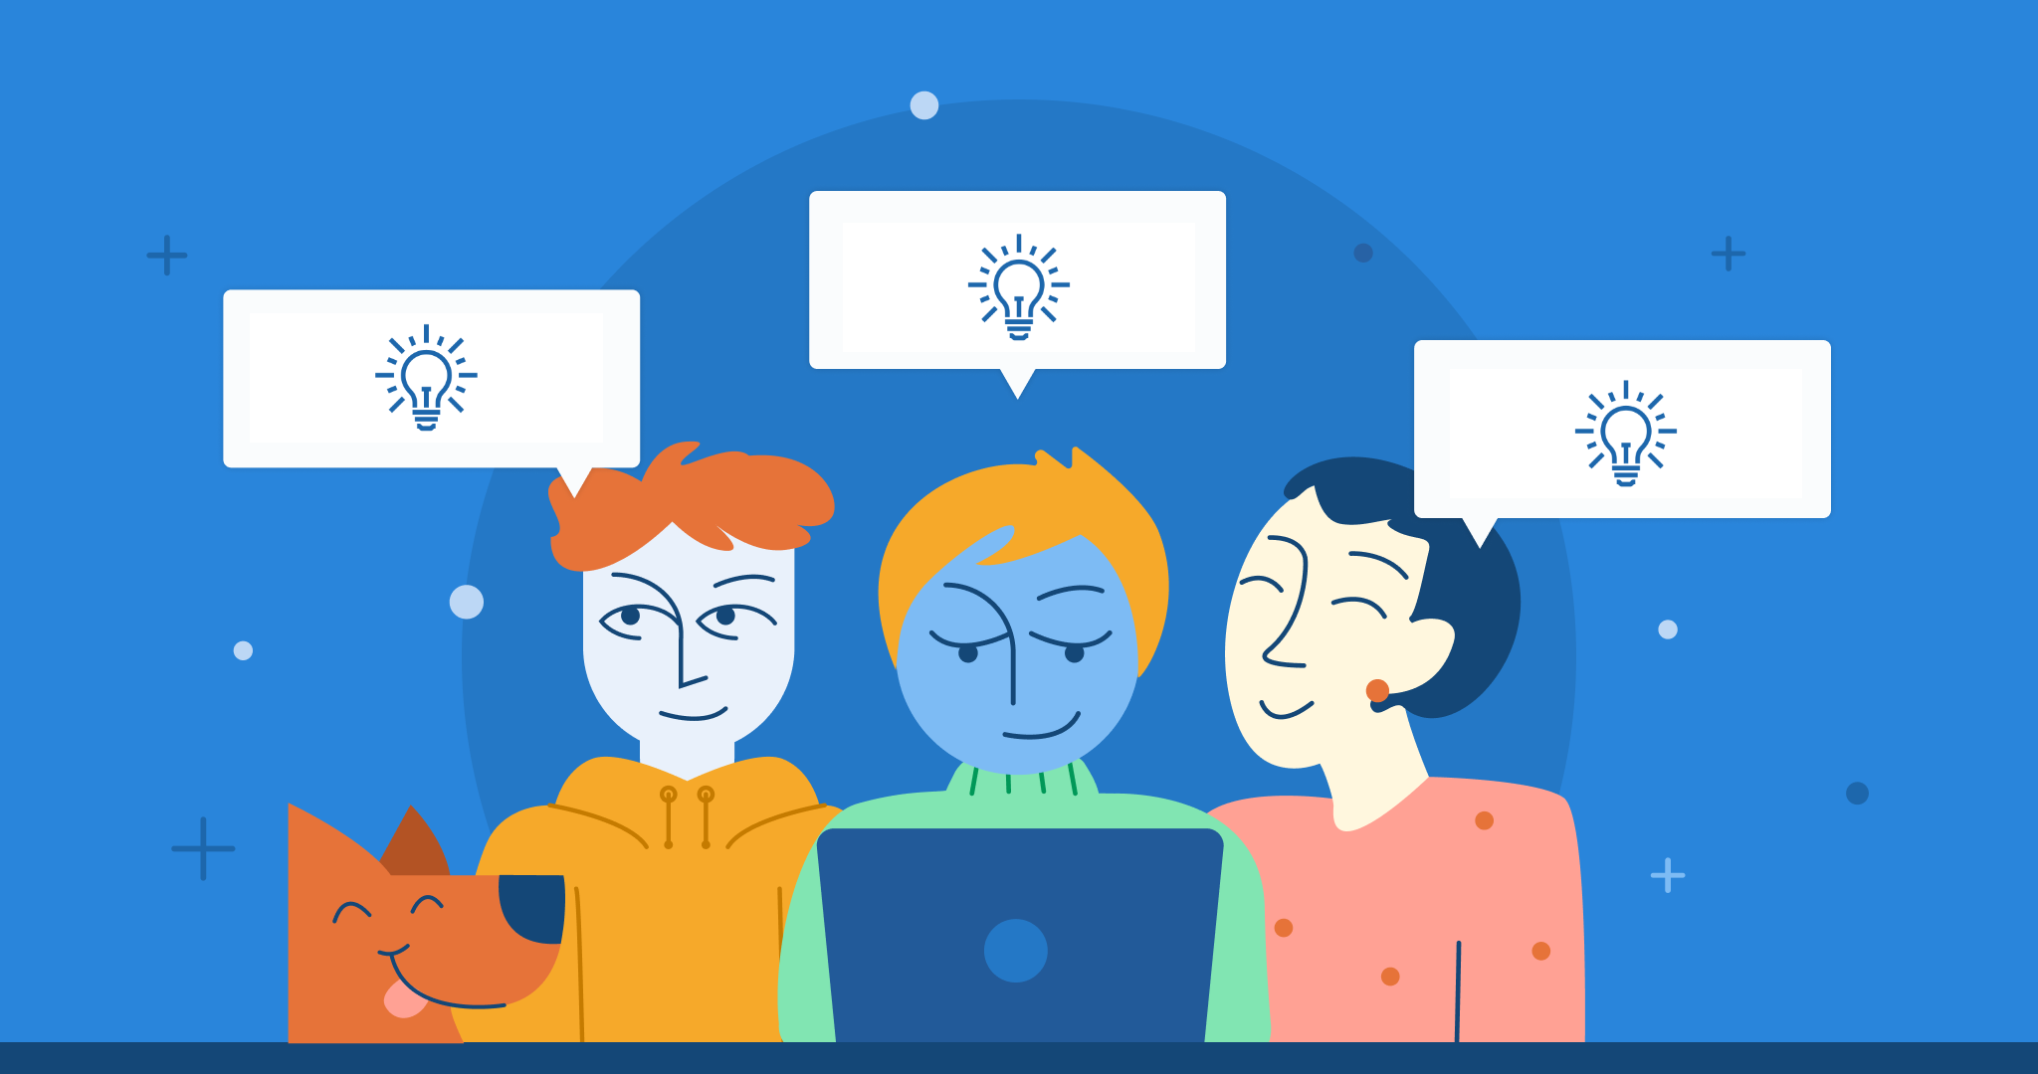
Introduction: The Impact of AI
Class Discussion
Will AI do more harm than good?

Slide 7
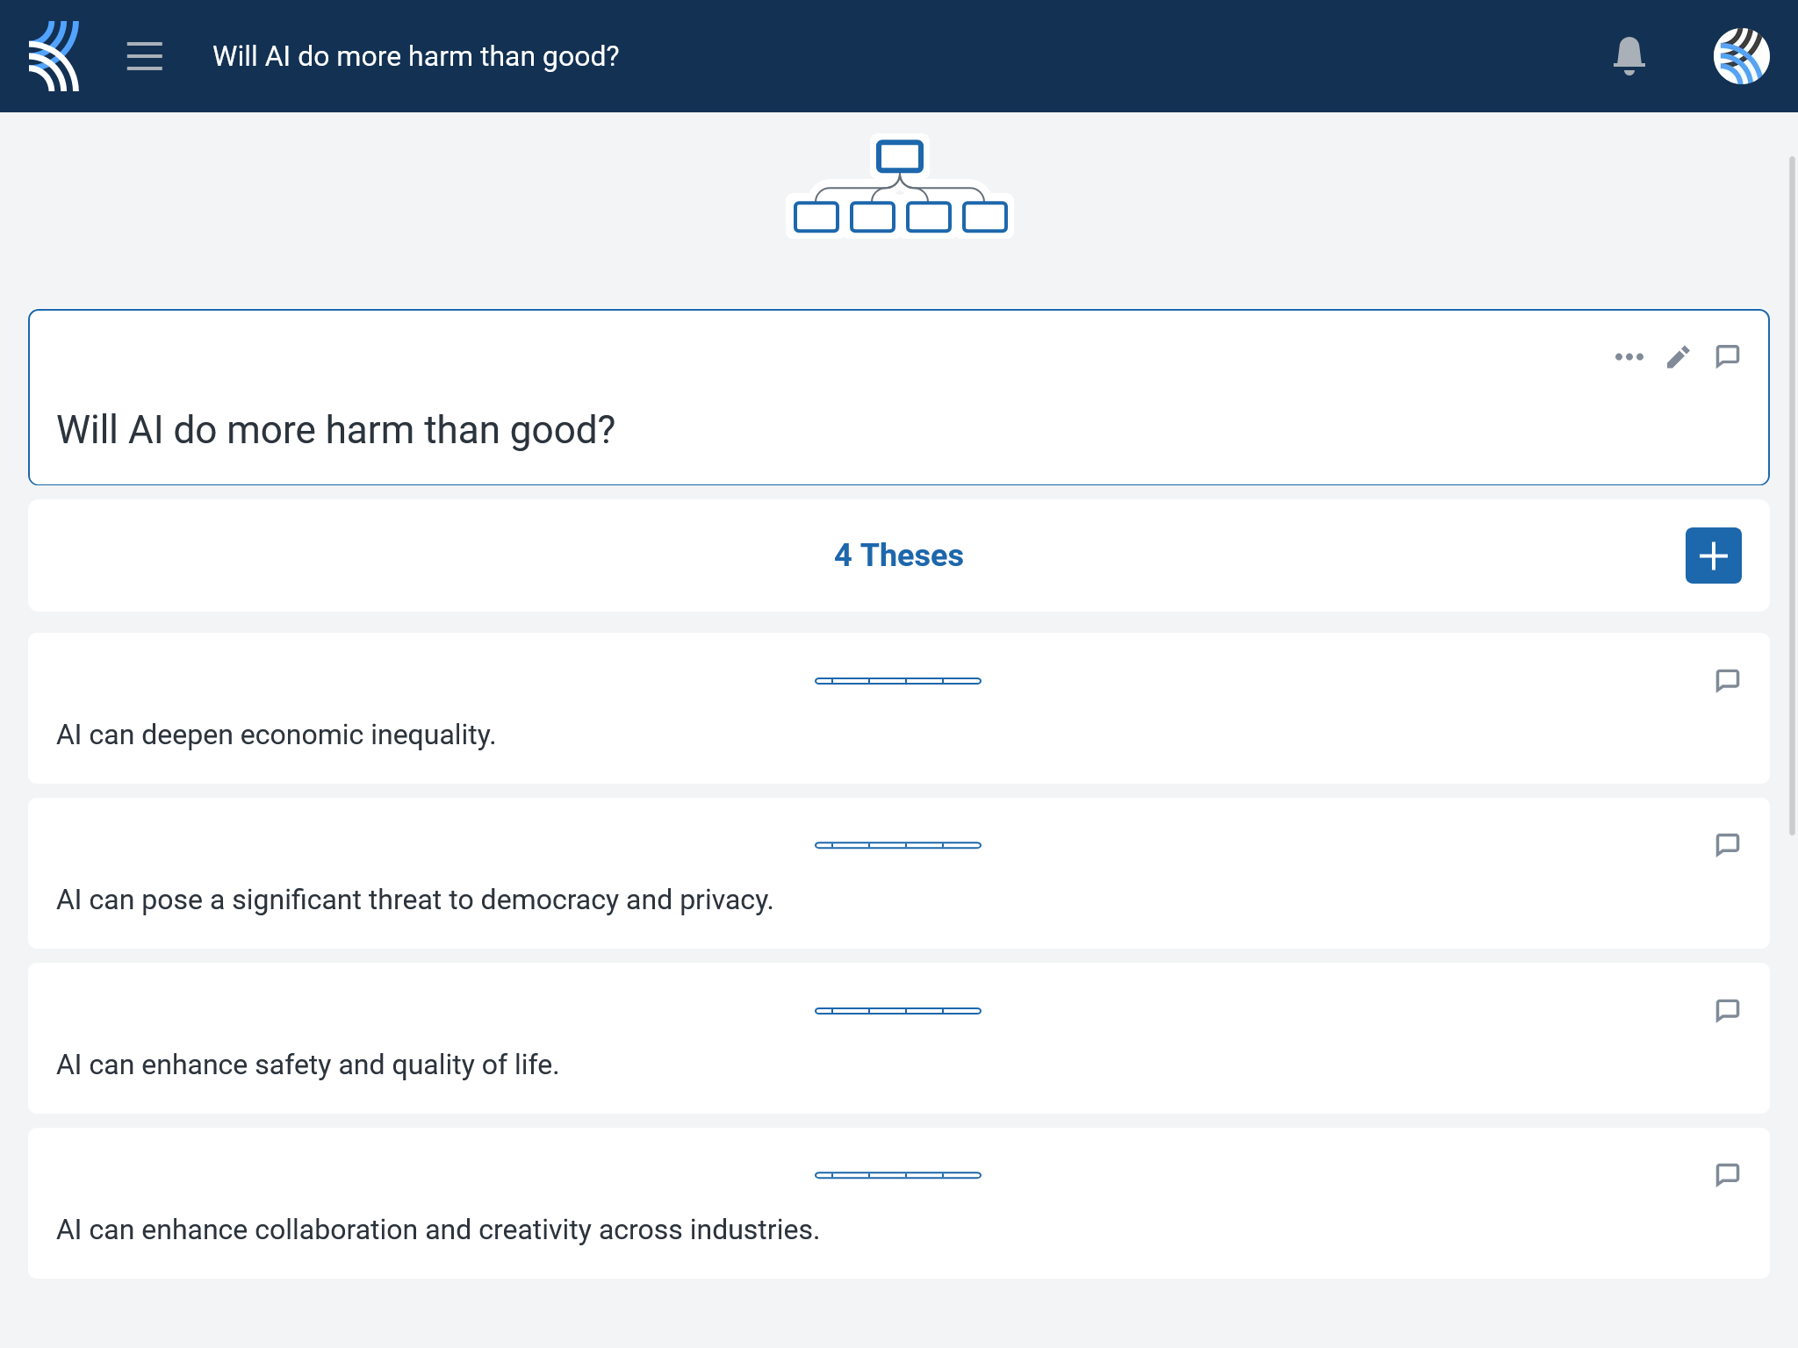
Listening Task: Will AI do more harm than good?
Your teacher will select a video based on today’s key question.
As you watch the video, take notes on the key arguments and counterarguments.
Analyze the strengths and weaknesses of each one.
Consider the arguments in relation to different ethical frameworks.
You will need your notes for today’s Kialo discussion!

Slide 8
Kialo Discussion: Will AI do more harm than good?
You will now use your research in a Kialo discussion.
Your teacher will tell you whether to create your own discussion or use a ready-made version.
Step 1
If you have created your own discussion, add your theses.
These are the main points you wish to argue for or against.
Step 2
Add the strongest arguments (pros) under each thesis, based on your notes and previous research.
Try to include reference to different ethical frameworks.
Step 3
Follow the same approach to add counterarguments (cons) to each branch.
Step 4
Include examples and evidence to support your arguments and counterarguments.

Slide 9
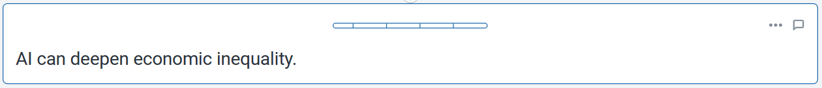


Kialo Discussion: Example Claims
AI disproportionately benefits powerful corporations and governments, centralizing wealth and power while displacing workers.
AI can create new economic opportunities and expand access to markets, particularly in developing nations.
For example, automation replaces jobs without creating sufficient new opportunities, leading to stagnant wages and increased economic disparity.
For example, mobile and AI-driven tools can enhance productivity and empower individuals by providing access to global markets and information.

Slide 10
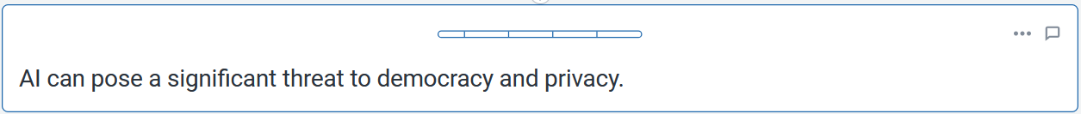
Kialo Discussion: Example Claims
AI-driven algorithms fuel extremism, polarization, and misinformation by prioritizing engagement over reliable information.
Regulatory measures, such as stricter privacy laws can mitigate these risks.
For example, the current business models of tech companies erode democratic discourse, amplify echo chambers, and undermine civic trust.
For example, EU regulations mean AI can improve transparency and promote access to accurate information.

Slide 11
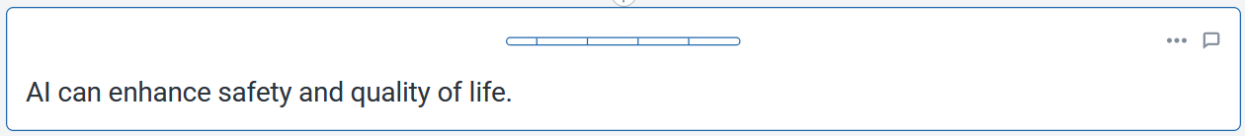
Kialo Discussion: Example Claims
AI-powered innovations can save lives and reduce human error in critical areas, such as healthcare and transportation.
The widespread adoption of AI in safety-critical domains may introduce new risks.
Examples include autonomous vehicles, robotic surgeries, and disease detection algorithms.
These could include reliance on flawed algorithms, data biases, and the potential for catastrophic failures due to hacking or system malfunctions.

Slide 12
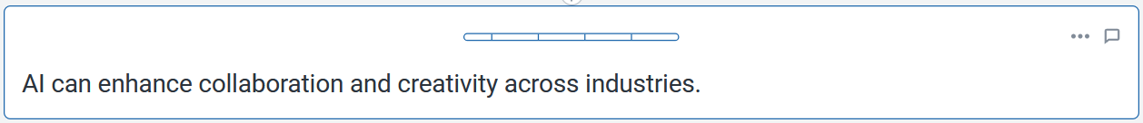
Kialo Discussion: Example Claims
AI tools can augment human creativity and facilitate collaboration by providing innovative solutions and insights.
Over-reliance on AI may stifle human creativity, resulting in standardized outputs.
For example, AI can assist artists in generating new forms of expression, help researchers analyze complex data faster, and enable teams to work more efficiently by automating routine tasks.
For example, if creators rely too heavily on AI-generated content, it might reduce the uniqueness and originality that come from human experience and intuition.

Slide 13
Reflection Task
What ethical frameworks influence our view of responsibility for AI decisions?
What ethical principles guide how we assign responsibility for AI decisions?
How do cultural or societal values shape these principles?

Slide 14
Lesson Objectives: Recap
Analyze and evaluate the strength of arguments in debates about AI ethics.
Evaluate the ethical implications of AI technologies from multiple stakeholder perspectives.

