Slide 1
Who is responsible for real-world AI failures?
Knowledge and Technology:
AI, Knowledge, and Accountability
Lesson 2: Fact-Finding Task

Slide 2
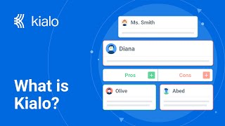

How does Kialo work?
If you’re new to Kialo, watch this video to discover how the platform works. Otherwise, let’s get started!

Slide 3

Lesson Objectives
Critically analyze real-world AI failures
Identify biases, evaluate evidence, and refine arguments about AI accountability

Slide 4

TOK Concepts
Evidence: How does evidence shape our understanding of accountability in AI systems?
Justification: How do the ethical justifications used by companies to implement AI systems hold up in the face of AI failures?
Power: In what ways do powerful stakeholders (e.g., tech companies, governments) shape the narrative around AI failures?
Today’s lesson links to these TOK concepts.
By completing the activities, you will build knowledge that can help with your assessments.

Slide 5
Introduction: AI Accountability
Today’s lesson is about finding and evaluating new evidence on the concept of accountability in AI-generated knowledge.
Step 1(inc. homework)
Conduct in-depth research into a specific case and give a short presentation to the class.
Step 2
Present your findings and refine your arguments in your Kialo discussions.
Step 3
Reflect on how biases and evidence influence our understanding of AI accountability.

Slide 6
Case Studies: Who is responsible for real-world AI failures?
You teacher will assign you a case study for homework.
Tesla’s Autopilot Failure
Focus: The real-world consequences of AI-assisted driving and the blurred line between human control and AI autonomy.
Task: Examine to what extent Tesla users, the company, and the AI system itself are responsible for accidents involving Autopilot.
AI Leadership
Focus: The responsibilities of AI leaders in anticipating the impact of advanced AI systems, such as AGI.
Task: Evaluate the ethical responsibilities of AI CEOs and developers in preparing for possible future failures of high-stakes AI systems.
User Responsibility
Focus: Platforms are holding users liable when AI tools generate offensive or false content on social platforms.
Task: Analyze whether it is fair for users to bear responsibility for AI-generated content, especially when they may not fully understand or control how the tools work.
Medical Note-Taking
Focus: Doctors are increasingly relying on AI tools to transcribe and summarize patient consultations, aiming to reduce administrative burden and burnout.
Task: Examine who should be held accountable if an AI note-taking tool introduces an error that leads to a medical misdiagnosis or improper treatment.

Slide 7

Discussion: AI Accountability
Class Discussion
Who is responsible for real-world AI failures?

Slide 8
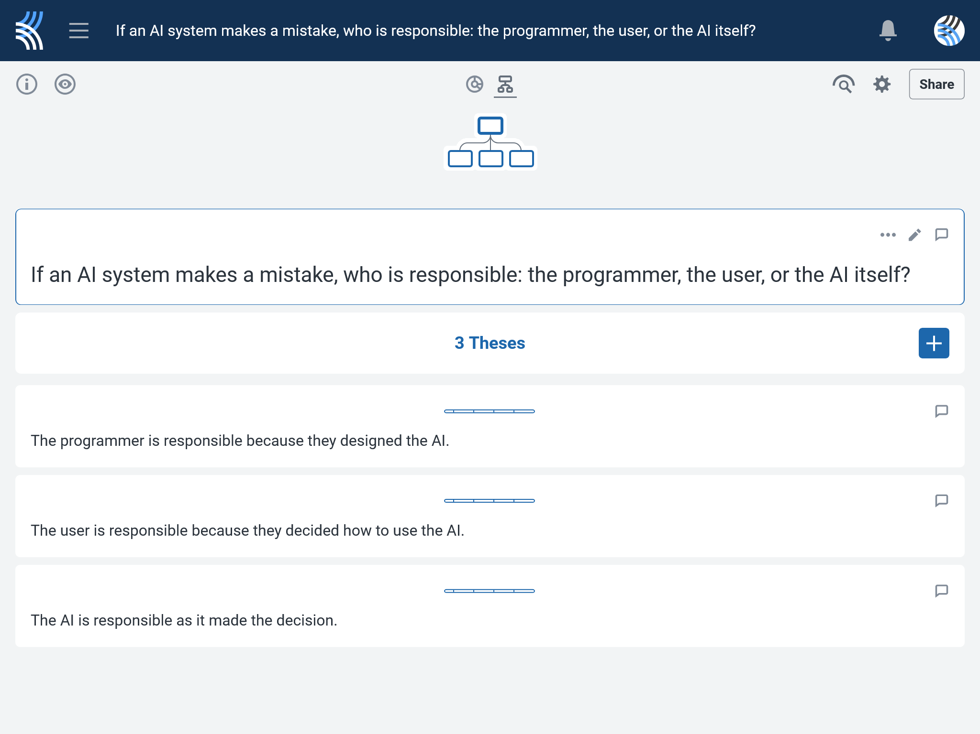
Fact-Finding: If an AI system makes a mistake, who is responsible: the programmer, the user, or the AI itself?
Use your research to support, challenge, or refine your initial arguments in your Kialo discussion!

Slide 9
Reflection Task: AI Accountability
If users are thoroughly informed about an AI tool’s limitations but still rely on it, how does that affect their share of responsibility when errors occur?
What biases are evident in these cases?
How does evidence shape our understanding of accountability in AI systems?

Slide 10
Lesson Objectives: Recap
Critically analyze real-world AI failures
Identify biases, evaluate evidence, and refine arguments about AI accountability

