Slide 1
If an AI system makes a mistake, who is responsible: the programmer, the user, or the AI itself?
Knowledge and Technology:
AI, Knowledge, and Accountability
Lesson 1: Opening Debate

Slide 2
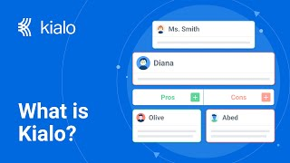

How does Kialo work?
If you’re new to Kialo, watch this video to discover how the platform works. Otherwise, let’s get started!

Slide 3

Lesson Objectives
Explore different perspectives on the concept of accountability in AI-generated knowledge
Reflect on the ethical and societal implications of AI decision-making

Slide 4

TOK Concepts
Responsibility: What does it mean to take responsibility for knowledge production?
Perspectives: How do values, norms, or local regulations shape our perceptions of AI accountability?
Power: How do existing power structures impact the development and deployment of AI technologies?
Today’s lesson links to these TOK concepts.
By completing the activities, you will build knowledge that can help with your assessments.

Slide 5
Introduction: AI Accountability
Today’s lesson is about sharing your existing knowledge and perspectives on the concept of accountability in AI-generated knowledge.
Step 1
Discuss the class’s initial response to the question.
Step 2
Share your existing knowledge and perspectives and respond to those of your peers in an in-depth Kialo discussion.
Step 3
Reflect on what it means to be responsible for knowledge creation.

Slide 6

Introduction: AI Accountability
Class Discussion
If an AI system makes a mistake, who is responsible: the programmer, the user, or the AI itself?
What are your initial thoughts?

Slide 7

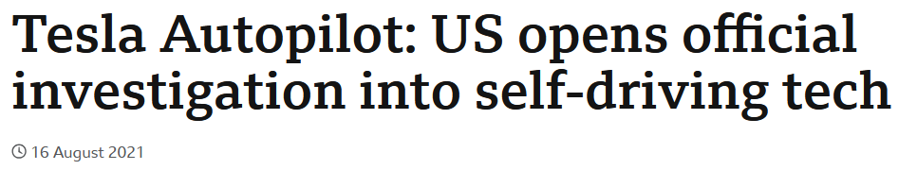
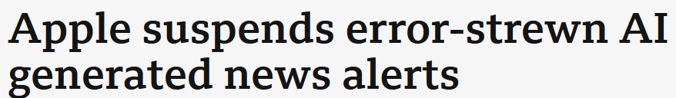
Introduction: AI Accountability
Who should be held responsible when AI systems fail or produce harmful outcomes?

Slide 8
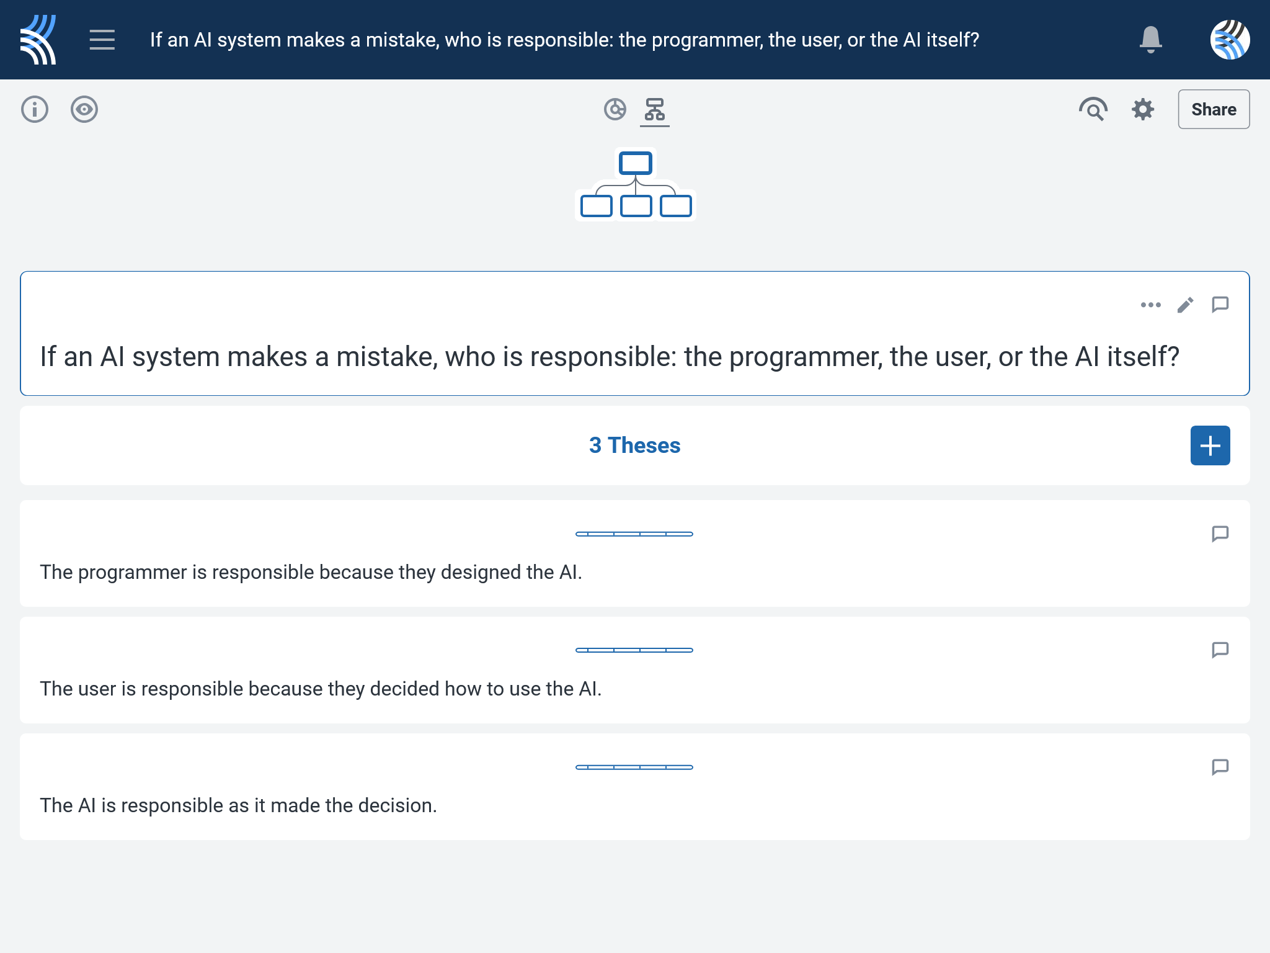
Kialo Discussion: If an AI system makes a mistake, who is responsible: the programmer, the user, or the AI itself?
Now that you’ve had chance to discuss your initial thoughts, you are going to add your ideas to a Kialo discussion.
Let’s learn more about having an in-depth discussion on Kialo.

Slide 9
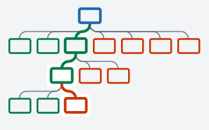

Kialo Discussion: The Argument Tree
On Kialo, the discussion is represented by an argument tree.
The pros are green and the cons are red.
Here are two Kialo argument trees.
Which one represents a more in-depth discussion?

Slide 10
Kialo Discussion: The Argument Tree
In this discussion, everyone has added their own perspective on the thesis.
Some perspectives might be repeated.
Students have not engaged with their peers’ perspectives.
This is unlikely to be an in-depth discussion!
In this discussion, students have added their perspective on the thesis, developed their arguments, and responded to other perspectives.
This results in a more in-depth discussion!

Slide 11

Kialo Discussion: If an AI system makes a mistake, who is responsible: the programmer, the user, or the AI itself?
Let’s apply this to a discussion!
Presenting Your Perspective
Step 1: Choose the thesis you most agree with.
Step 2: Write at least 2 pros to explain why you agree.
Step 3: Develop your argument by adding another pro under each of these.
Step 4: Think about how someone might argue against this thesis.
Step 5: Repeat steps 2 and 3 with counterarguments (cons).

Slide 12
Kialo Discussion: If an AI system makes a mistake, who is responsible: the programmer, the user, or the AI itself?
Engaging With Other Perspectives
Step 1: Choose a different thesis and read your peers’ claims.
Step 2: Respond to at least 2 of these by adding your own pros and cons underneath.
Step 3: Repeat this for the final thesis.
Step 4: Revisit your first thesis to see how your peers have responded to your claims.
Step 5: Try to respond with further pros and cons!
Check the argument tree: How deep is the discussion?

Slide 13
Reflection Task: AI Accountability
What does it mean to be responsible for knowledge creation?
How do different perspectives influence how we assign responsibility?
How should we respond when AI systems fail repeatedly?
Can responsibility be shared or must it lie with one party?

Slide 14
Lesson Objectives: Recap
Explore different perspectives on the concept of accountability in AI-generated knowledge
Reflect on the ethical and societal implications of AI decision-making

