Slide 1
Can religious knowledge be evaluated without shared definitions, agreed-upon evidence, or universal standards of truth?
Knowledge and Religion:
Evidence of the Sacred
Lesson 3: Listening Task

Slide 2


How does Kialo work?
If you’re new to Kialo, watch this video to discover how the platform works. Otherwise, let’s get started!

Slide 3

Lesson Objectives
Analyze Kwame Anthony Appiah’s critique of how religion is defined and debated.
Explore the cultural and historical differences in how religion, science, and knowledge interact.
Use the video to generate new claims and counterclaims about the nature of religious knowledge and evaluation.

Slide 4

TOK Concepts
Evidence: How do different cultures use different kinds of evidence to support religious beliefs, and should religious claims be tested using scientific evidence?
Truth: How can we understand the difference between truth based on scientific evidence and truth based on personal belief or faith?
Certainty: Should knowledge always require certainty?
Today’s lesson links to these TOK concepts.
By completing the activities, you will build knowledge that can help with your assessments.

Slide 5
Introduction: Evaluating Religious Knowledge
Today’s lesson is based around a video discussing the nature of religion.
Step 1
Share your own perspectives on the nature of religious knowledge.
Step 2
Watch a video on the topic. Take notes on the main arguments and counterarguments, analyzing their strengths and weaknesses.
Step 3
Use your notes to add the strongest arguments and counterarguments to a Kialo discussion.

Slide 6

Introduction: Evaluating Religious Knowledge
Truth (Collins Dictionary)
The truth about something is all the facts about it, rather than things that are imagined or invented.
A truth is something that is believed to be true.
Evidence (Collins Dictionary)
Evidence is anything that you see, experience, read, or are told that causes you to believe that something is true or has really happened.

Slide 7

Introduction: Evaluating Religious Knowledge
Class Discussion
What do you think makes something a “religion”?
Can religious knowledge be evaluated in the same way as scientific knowledge?
Do different societies treat religious knowledge the same way?

Slide 8
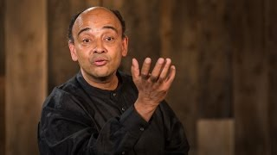
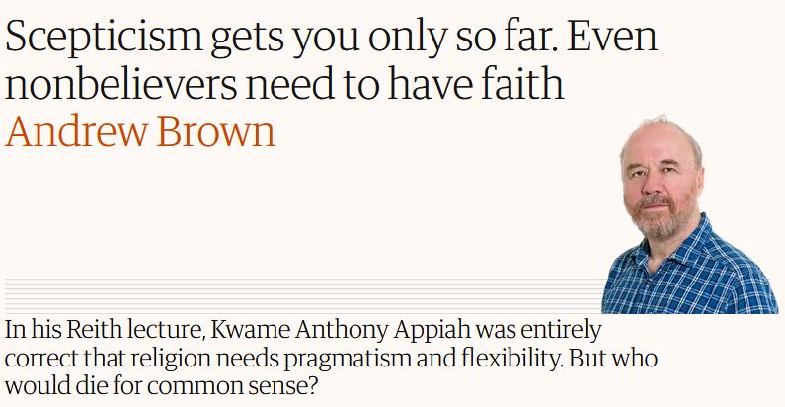
Listening Task: Is Religion Good or Bad?
As you watch the video, take notes on the key arguments and counterarguments.
Analyze the strengths and weaknesses of each argument.
Find other sources to support your analysis.
You will need your notes for today’s Kialo discussion!

Slide 9
Listening Task: Is Religion Good or Bad?
As you watch the video, take notes on the key arguments and counterarguments, analyzing their strengths and weaknesses.
Note-Taking Framework
Main arguments for defining religion: There is no single, universal definition of religion. What we call “religion” is a constructed category shaped by Christian colonial perspectives.
Main arguments against: A broad enough definition could still apply across traditions and justify using “religion” as a general category.
Science-Religion Divide argument: The separation of science and religion is a recent, Western phenomenon. In many cultures, religion still serves as the explanatory system for natural events.
Key Points to Listen For
What is Appiah’s main argument about the concept of religion?
How does he challenge traditional definitions of religion, especially those based on belief in God?
What role did European colonialism play in how we define and categorise religion?
What does Appiah say about the historical relationship between science and religion?
How do we treat religious knowledge and truth?

Slide 10
Kialo Discussion: Can religious knowledge be evaluated without universal definitions of religion, truth, and evidence?
You will now use your research in a Kialo discussion.
Your teacher will tell you whether to create your own discussion or use a ready-made version.
Step 1
If you have created your own discussion, add your thesis and starter claims.
These are the main points you wish to argue for or against.
Step 2
Add the strongest arguments (pros) under each starter claim, based on your notes and previous research.
Be sure to reference evidence, truth, and certainty.
Step 3
Follow the same approach to add counterarguments (cons) to each branch.
Step 4
Include examples and evidence to support your arguments and counterarguments.

Slide 11
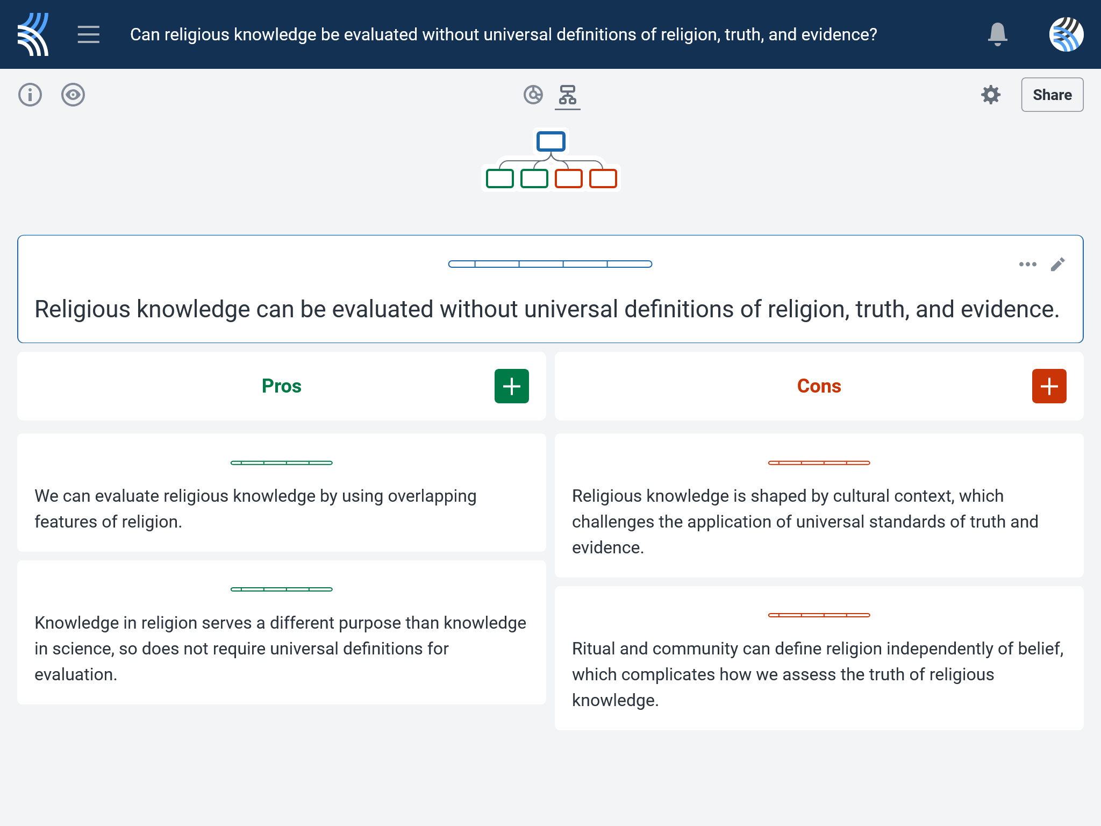
Kialo Discussion: Can religious knowledge be evaluated without universal definitions of religion, truth, and evidence?
Points to Consider
What are the main arguments for and against defining religion?
How relevant is the science-religion divide? Which power structures perpetuate this divide?
What are the impacts of cultural relativism on how religion is defined across different societies?
What is the role of rituals and practices in supporting religious knowledge?

Slide 12
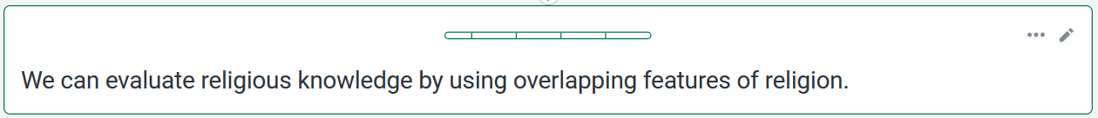


Kialo Discussion: Example Claims
While definitions vary, most religions include some combination of belief, ritual, moral code, and cosmology.
Focusing on common features oversimplifies the depth and diversity of religious knowledge and risks marginalizing less conventional practices.
These common features allow for meaningful comparison.
A focus on belief excludes non-theistic traditions like Buddhism or purely ritualistic forms of Judaism.

Slide 13
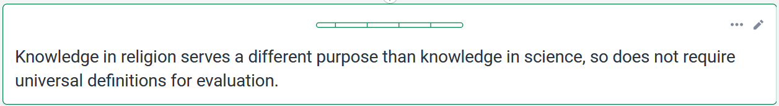
Kialo Discussion: Example Claims
Religious “truth” often aims at existential or spiritual meaning, not empirical accuracy.
Without a shared understanding of truth, any belief could be labeled as “religious truth,” making critical engagement impossible.
Evaluating it by scientific standards misses its purpose.
For example, Flat Earth beliefs or faith-healing claims could be insulated from scrutiny under the guise of religious truth.

Slide 14
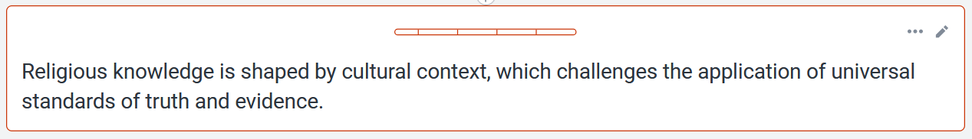
Kialo Discussion: Example Claims
What counts as “truth” or “evidence” varies significantly across cultures.
If all religious truth is relative, meaningful dialogue or evaluation becomes impossible.
For example, ancestor worship may be accepted as a valid religious truth in one culture, yet dismissed as superstition in another.
A complete rejection of shared standards can lead to moral relativism and epistemic conflict.

Slide 15
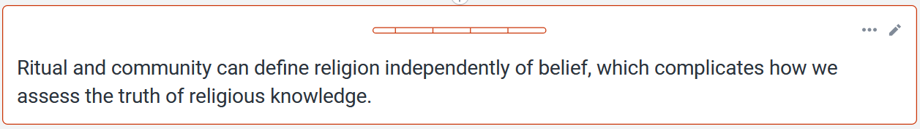
Kialo Discussion: Example Claims
Many people participate in religious life for cultural or communal reasons rather than theological belief.
Without sincere belief, religious rituals risk becoming empty gestures, making it harder to see them as sources of genuine knowledge.
For example, in Islamic contexts, performing rituals without Iman may be viewed as hypocrisy, reducing the perceived authenticity of religious knowledge.
This suggests that religious knowledge may reside more in practice than propositional truth.

Slide 16
Reflection Task: Evaluating Religious Knowledge
Reflection Questions
What stood out to you most in Kwame Anthony Appiah’s argument? Why?
Did this talk challenge how you define religion? How so?
What role does culture play in shaping what we accept as religious knowledge?
Can something be “true” for one community and not another? Is that still knowledge?
What kinds of evidence do different cultures use to justify religious beliefs?
Do you think religious claims should be tested with empirical evidence? Why or why not?
If a belief is meaningful to someone but cannot be proven, is it still valid knowledge?
Can truth exist without a shared definition of what we’re discussing (such as “religion”)?
How does not having a single definition of religion affect our ability to discuss it as knowledge?
Should knowledge always require certainty? What does religion show us about uncertainty?
Is it possible to be confident in something without being certain? Does this apply to religion?

Slide 17
Lesson Objectives: Recap
Analyze Kwame Anthony Appiah’s critique of how religion is defined and debated.
Explore the cultural and historical differences in how religion, science, and knowledge interact.
Use the video to generate new claims and counterclaims about the nature of religious knowledge and justification.

