Slide 1
Is whistleblowing necessary to prevent corporate censorship silencing political perspectives?
Knowledge and Politics:
Censorship and Whistleblowing
Lesson 3: Listening Task

Slide 2
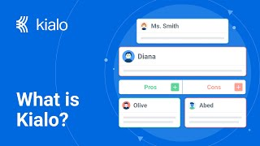
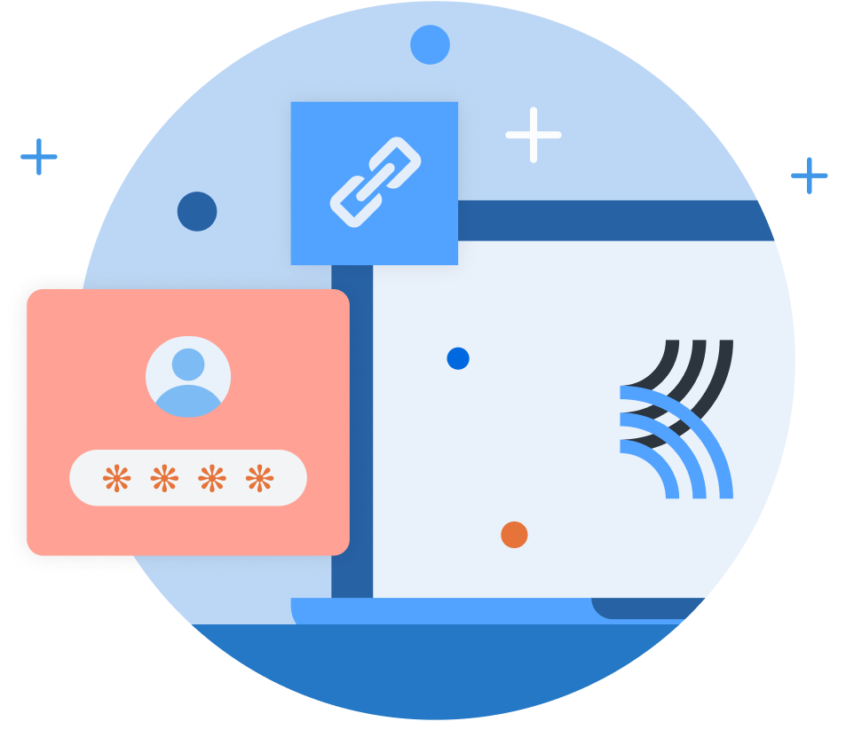
How does Kialo work?
If you’re new to Kialo, watch this video to discover how the platform works. Otherwise, let’s get started!

Slide 3

Lesson Objectives
Analyze the role of power and bias in the censorship of information and whistleblowing cases.
Evaluate how censorship affects the dissemination of knowledge and how whistleblowers challenge power structures.

Slide 4

TOK Concepts
Bias: How does bias shape social media policies and censorship decisions?
Responsibility: What responsibilities do platforms and governments hold in maintaining transparency and trust?
Perspectives: How do we balance free speech principles with a desire for stricter content moderation?
Power: How do power structures shape decisions about what content is allowed and how whistleblowers are treated?
Today’s lesson links to these TOK concepts.
By completing the activities, you will build knowledge that can help with your assessments.

Slide 5
Introduction: Censorship and Whistleblowing
Today’s lesson is based around a video discussing Meta’s Palestine censorship.
Step 1
Share your own perspectives on whether whistleblowing is necessary to prevent corporate censorship.
Step 2
Watch a video on the topic. Take notes on the main arguments and counterarguments, analyzing their strengths and weaknesses.
Step 3
Use your notes to add the strongest arguments and counterarguments to a Kialo discussion.

Slide 6
Introduction: Censorship and Whistleblowing
Censorship (Oxford Languages)
The suppression or prohibition of any parts of books, films, news, etc., that are considered obscene, politically unacceptable, or a threat to security.
Whistleblowing (Oxford Reference)
A source who makes public information about alleged wrongdoing, typically by or within the organization in which they are employed.
Who decides what information
is censored?
Why might someone choose to blow the whistle?
What are the risks of whistleblowing?

Slide 7
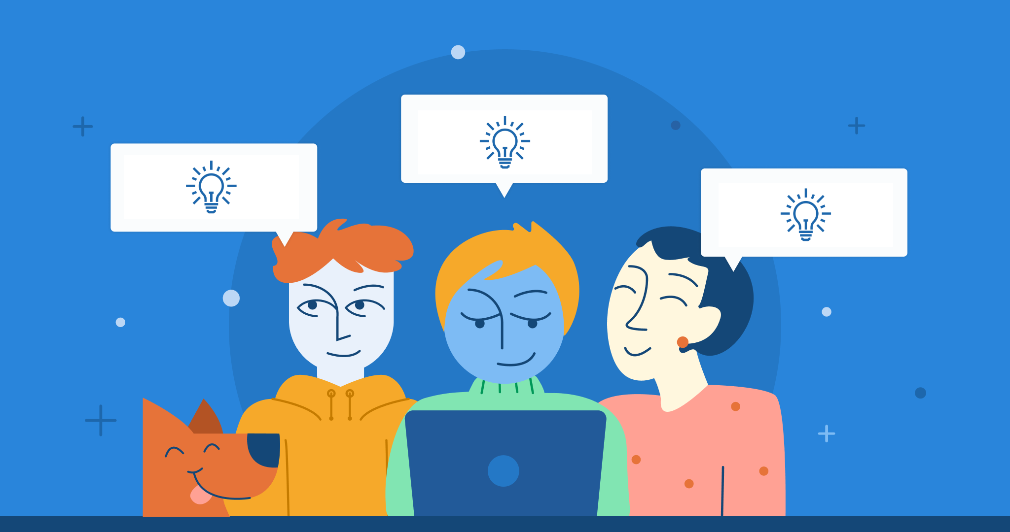
Introduction: Censorship and Whistleblowing
Class Discussion
Is whistleblowing necessary to prevent corporate censorship silencing political perspectives?

Slide 8
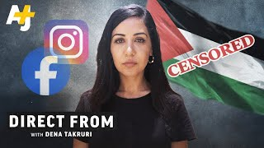
Listening Task: Inside Meta’s Palestine Censorship
As you watch the video, take notes on the key arguments and counterarguments.
Analyze the strengths and weaknesses of each argument.
Find other sources to support your analysis.
You will need your notes for today’s Kialo discussion!

Slide 9
Listening Task: Inside Meta’s Palestine Censorship
As you watch the video, take notes on the key arguments and counterarguments, analyzing their strengths and weaknesses.
Note-Taking Framework
Main arguments for censorship: Why does Meta claim to remove or restrict content?
Main arguments against censorship: Why do critics argue that Meta is suppressing free speech?
Whistleblowing cases: How do whistleblowers describe their experiences?
Key Points to Listen For
How did Meta’s censorship policies impact Palestinian voices?
What were the arguments made by whistleblowers like Omar and Saima?
How did Meta respond to the allegations?
What ethical dilemmas arise in censorship and whistleblowing?

Slide 10
Kialo Discussion: Is whistleblowing necessary to prevent corporate censorship silencing political perspectives?
You will now use your research in a Kialo discussion.
Your teacher will tell you whether to create your own discussion or use a ready-made version.
Step 1
If you have created your own discussion, add your theses or starter claims.
These are the main points you wish to argue for or against.
Step 2
Add the strongest arguments (pros) under each thesis, based on your notes and previous research.
Be sure to reference power, bias, and perspective.
Step 3
Follow the same approach to add counterarguments (cons) to each branch.
Step 4
Include examples and evidence to support your arguments and counterarguments.

Slide 11
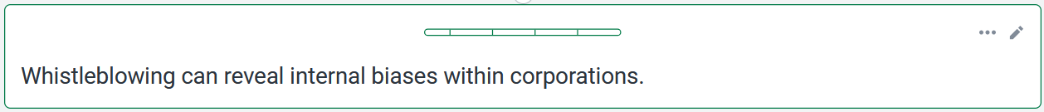
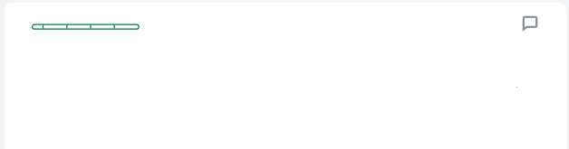
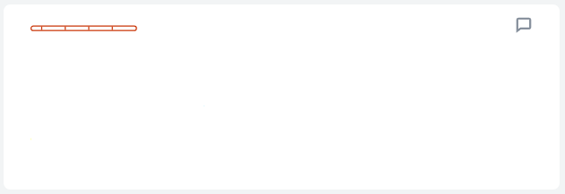
Kialo Discussion: Example Claims
Whistleblowing revealed that Meta’s censorship is biased, favoring certain political interests.
Different conflicts require different moderation policies based on context.
For example, Meta allowed hate speech against Russians during the Ukraine war but strictly moderated Palestinian content.
For example, Meta argues that Hamas is a designated terrorist group, requiring stricter moderation policies.

Slide 12
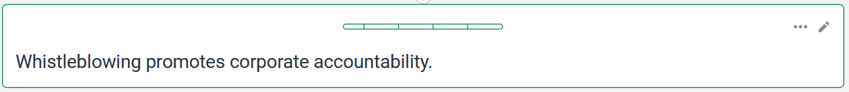
Kialo Discussion: Example Claims
Whistleblowing proved how Meta violated free speech and suppressed political knowledge.
Content moderation is necessary to prevent misinformation and hate speech.
Human Rights Watch found that Meta removed phrases like "Free Palestine" and censored Palestinian journalists
Meta argues that some content may violate its policies on incitement.

Slide 13
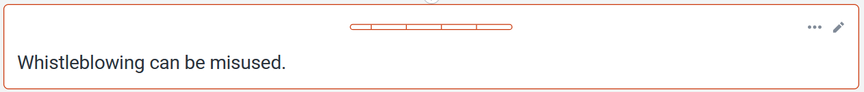
Kialo Discussion: Example Claims
People can use whistleblowing to push personal grievances.
The motivation behind whistleblowing is irrelevant if it reveals the truth about censorship.
For example, Meta claims Omar violated data policies by accessing information he wasn’t authorized to review.
For example, Omar found that Palestinian journalist Motaz Azaiza’s content was mislabeled as pornographic.

Slide 14
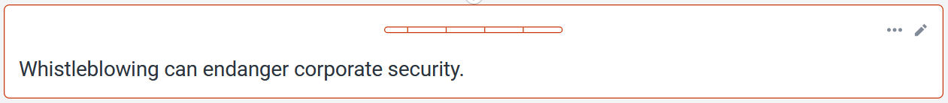
Kialo Discussion: Example Claims
Internal moderation policies should remain private to prevent misinformation that could harm a company.
If companies followed legal regulations, corporate security would be safeguarded.
Meta said these were technical glitches and issued apologies, claiming they were not deliberate acts of censorship.
Meta has uniform global policies, where moderation decisions are made by AI and independent content reviewers, not individual executives.

Slide 15
Reflection Task: Censorship and Whistleblowing
What factors influence censorship and whistleblowing in politics and society?
Does censorship protect society or hinder it?
Who benefits from censorship policies, and who loses?

Slide 16
Reflection Task: Censorship and Whistleblowing
Reflection Questions
Should there be limits to censorship? Who decides these limits?
Can censorship be dangerous, such as in the case of authoritarian governments or political suppression?
How does whistleblowing challenge power structures? Can it lead to meaningful change, or does it cause more harm than good?
How do global power dynamics (e.g., between democratic and authoritarian states) influence the role of social media in censorship?
What surprised you about how platforms like Facebook navigate free speech and content moderation?
Should whistleblowers be protected under international law, or does this undermine national security?
If you could reform one aspect of censorship or whistleblowing policies on social media, what would it be, and why?

Slide 17
Lesson Objectives: Recap
Analyze the role of power and bias in the censorship of information and whistleblowing cases.
Evaluate how censorship affects the dissemination of knowledge and how whistleblowers challenge power structures.

