Slide 1
How do real-world examples of censorship and whistleblowing highlight tensions between ethics, power, and knowledge?
Knowledge and Politics:
Censorship and Whistleblowing
Lesson 2: Fact-Finding Task

Slide 2
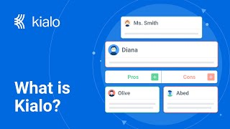
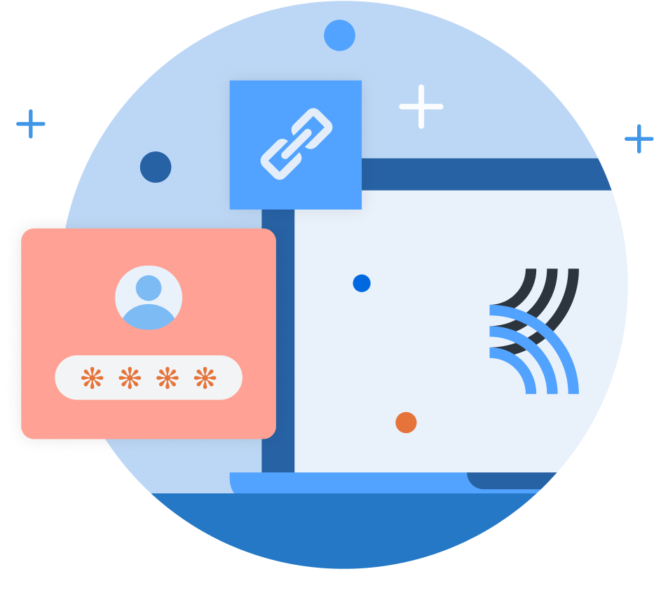
How does Kialo work?
If you’re new to Kialo, watch this video to discover how the platform works. Otherwise, let’s get started!

Slide 3

Lesson Objectives
Analyze real-world cases of censorship and whistleblowing
Evaluate the cases’ ethical implications, power dynamics, and impact on knowledge sharing

Slide 4

TOK Concepts
Perspectives: How do whistleblowers and those enforcing censorship present different viewpoints on the ethical implications of their actions?
Bias and Power: Who controls what knowledge is censored or exposed, and how do these decisions reflect power dynamics?
Justification: What counts as a valid justification for censorship or whistleblowing, and how do we evaluate the reliability of these justifications?
Responsibility: What ethical responsibilities do governments, organizations, and individuals have when censoring or exposing knowledge? Who bears accountability for the consequences of these actions?
Today’s lesson links to these TOK concepts.
By completing the activities, you will build knowledge that can help with your assessments.

Slide 5
Introduction: Censorship and Whistleblowing
Today’s lesson is about using case studies to expand your knowledge on censorship and whistleblowing.
Step 1(inc. homework)
Conduct in-depth research into a specific case, and give a short presentation to the class.
Step 2
Present your findings, and refine your arguments in your Kialo discussions.
Step 3
Reflect on the balance between censorship, whistleblowing, and ethical responsibility.

Slide 6

Case Study Preparation: Censorship and Whistleblowing
You teacher will assign you a case study for homework.
Key Questions
What is the knowledge being censored or exposed?
Who controls the dominant narrative, and why?
What ethical justifications or challenges exist for the censorship/whistleblowing?
How do power structures, cultural values, or political goals shape the knowledge in this case?
Is the censorship or whistleblowing justifiable? Why or why not?

Slide 7
Case Study Preparation: Censorship and Whistleblowing
China’s Great Firewall
Focus: Government-imposed internet censorship.
Task: Analyze the ethical and power dynamics of restricting access to global information and platforms.
Edward Snowden and NSA Leaks
Focus: Whistleblowing about government surveillance.
Task: Evaluate the ethical justifications for Snowden’s actions versus the U.S. government’s claims about national security.
Book Bans in U.S. Schools
Focus: Local censorship of literature due to ideological or moral concerns.
Task: Investigate how cultural values shape censorship decisions and their impact on freedom of thought.
Facebook and Myanmar Genocide
Focus: Social media platforms’ role in censorship and propaganda.
Task: Examine Facebook’s decision to censor hate speech related to the Rohingya crisis and its ethical implications.
Wikileaks and Julian Assange
Focus: Whistleblowing through mass document leaks.
Task: Explore whether Wikileaks’ exposure of classified information serves the public good or compromises national security.
Turkey’s Media Crackdown
Focus: Censorship of journalists and media outlets.
Task: Analyze how government censorship suppresses dissent and how whistleblowers attempt to challenge these restrictions.

Slide 8
Case Study Preparation: Censorship and Whistleblowing
You will need to give a short presentation to the class on your case study.
Presentation
Your presentation should focus on:
The conflict or alignment between ethics and power.
Examples of bias or justification.
Summary of your case study’s key takeaways.

Slide 9
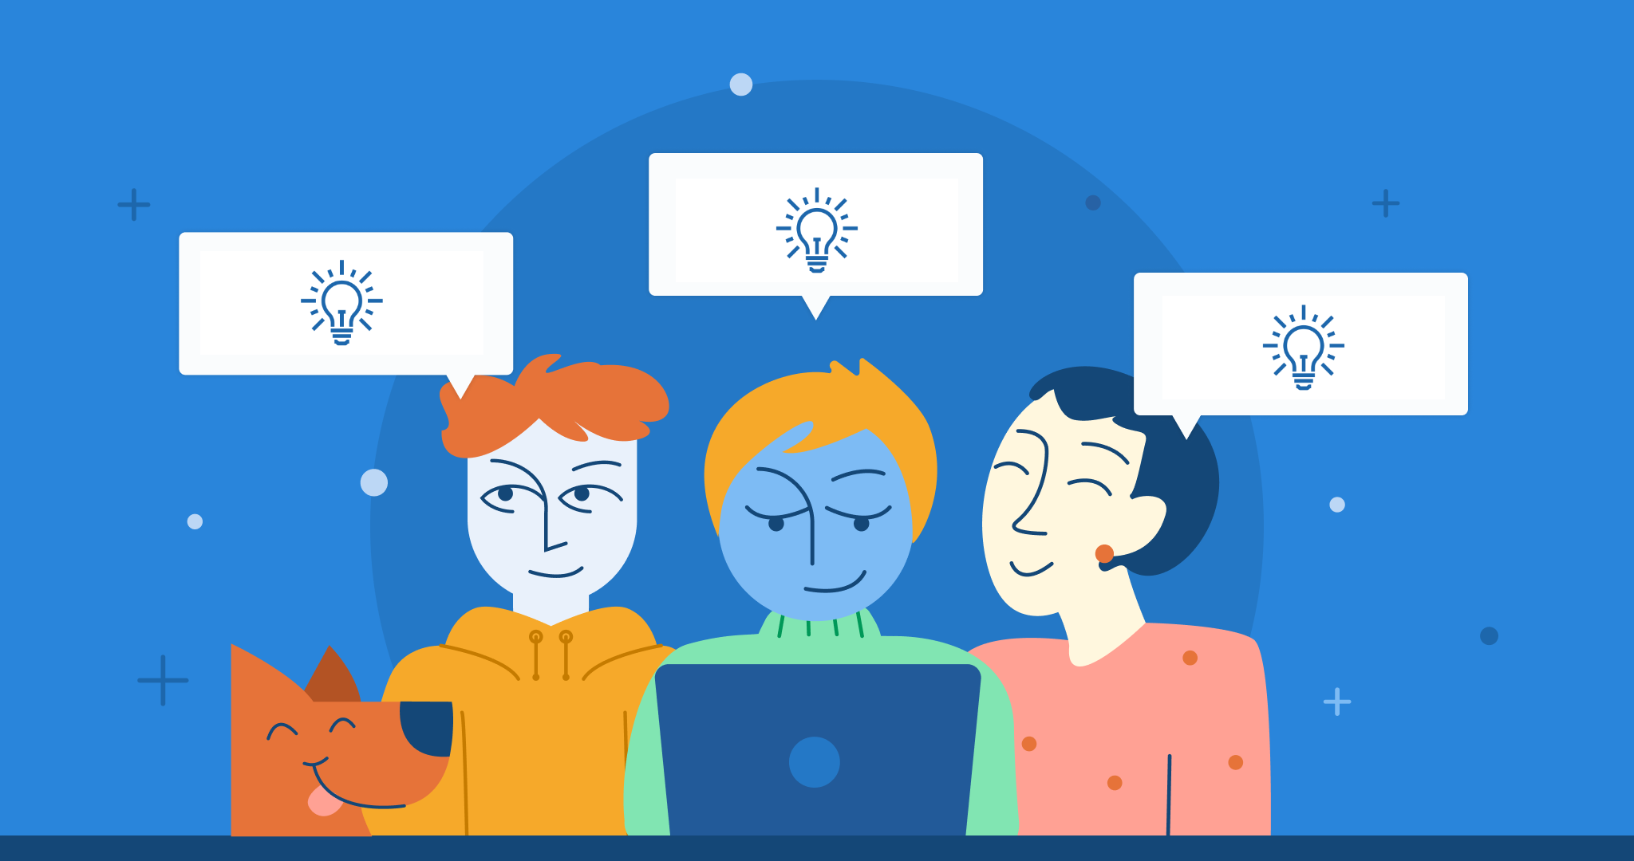
Introduction: Censorship and Whistleblowing
Class Discussion
Who decides what is censored?
How does censorship impact individual freedoms?

Slide 10
Introduction: Censorship and Whistleblowing
Class Discussion
How do censorship and whistleblowing reflect ethical concerns and power structures?

Slide 11
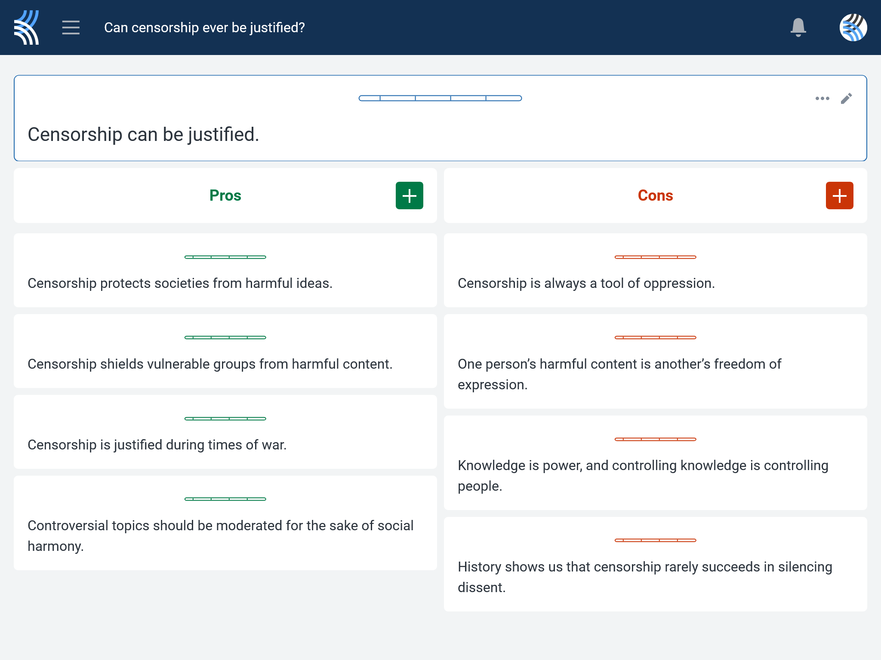
Kialo Discussion: Can censorship ever be justified?
Use your case study and any other research to support, challenge, or refine your initial arguments in your Kialo discussion!

Slide 12
Reflection Task: Censorship and Whistleblowing
How does this case shape your understanding of the balance between censorship, whistleblowing, and ethical responsibility?
Are certain types of knowledge always justifiable to censor or expose?
Why or why not?
How should societies navigate the tension between protecting individual freedoms and ensuring collective safety?

Slide 13
Lesson Objectives: Recap
Analyze real-world cases of censorship and whistleblowing
Evaluate the cases’ ethical implications, power dynamics, and impact on knowledge sharing

