Slide 1
Can censorship ever
be justified?
Knowledge and Politics:
Censorship and Whistleblowing
Lesson 1: Opening Debate

Slide 2
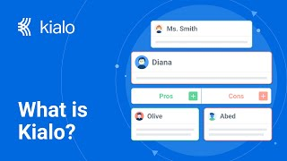
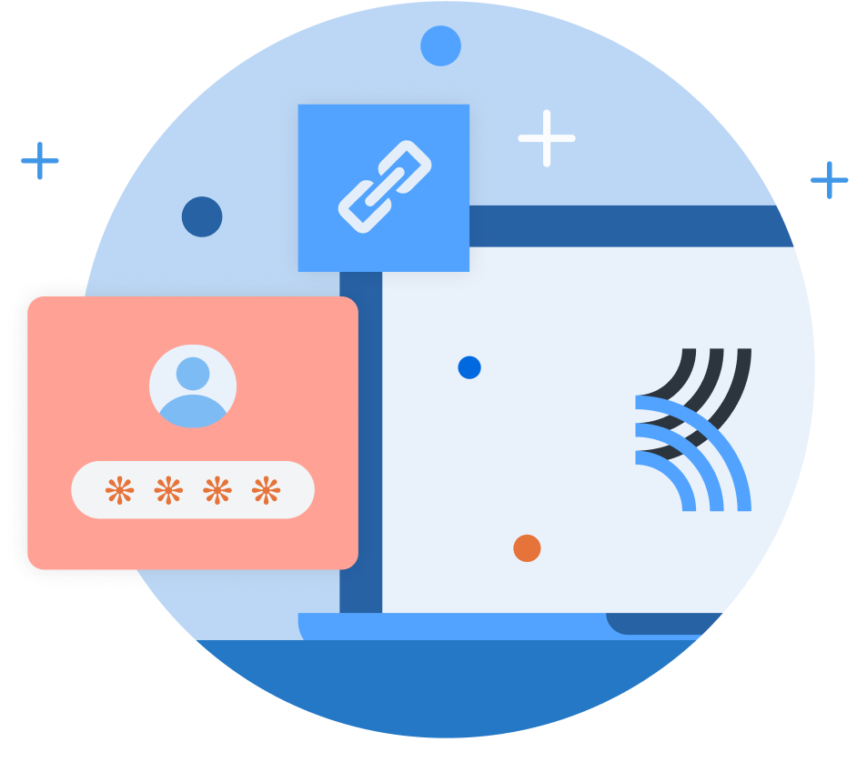
How does Kialo work?
If you’re new to Kialo, watch this video to discover how the platform works. Otherwise, let’s get started!

Slide 3

Lesson Objectives
Examine how censorship impacts the development of knowledge, including what is studied, published, and taught
Explore diverse perspectives on the ethics of censorship, focusing on power dynamics, societal impact, and individual rights

Slide 4
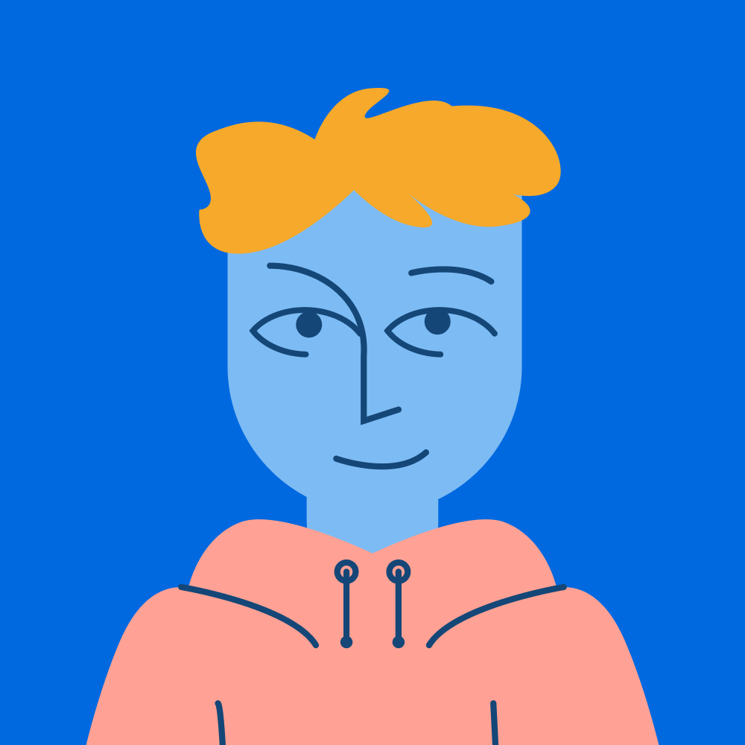
TOK Concepts
Ethics: What are the moral implications of suppressing or exposing knowledge?
Power: How can censorship or whistleblowing reinforce or challenge power structures?
Justification: How do governments and whistleblowers justify their actions?
Today’s lesson links to these TOK concepts.
By completing the activities, you will build knowledge that can help with your assessments.

Slide 5
Introduction: Censorship
Today’s lesson is about sharing your existing knowledge and perspectives on whether censorship can ever be justified.
Step 1
Discuss the class’s initial response to the question.
Step 2
Share your existing knowledge and perspectives and respond to those of your peers in an in-depth Kialo discussion.
Step 3
Reflect on the ethical issues surrounding censorship.

Slide 6
Introduction: Censorship and Whistleblowing
Censorship (Oxford Languages)
The suppression or prohibition of any parts of books, films, news, etc., that are considered obscene, politically unacceptable, or a threat to security.
Whistleblowing (Oxford Reference)
A source who makes public information about alleged wrongdoing, typically by or within the organization in which they are employed.
Who decides what information
is censored?
Why might someone choose to blow the whistle?

Slide 7
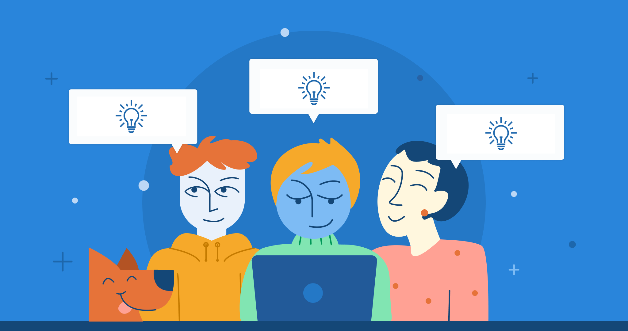
Introduction: Censorship
Class Discussion
Can you think of examples of government censorship?
Can censorship ever be justified?

Slide 8
Introduction: Censorship
Examples
The Great Firewall of China: The Chinese government heavily censors the internet.
North Korea's media control: North Korea has a state-run media system.
Iran's censorship of social media: The Iranian government blocks social media sites and monitors online activity.
United States’ book bans: Some states have banned books, particularly those focused on LGBTQ+ people and people of color.
Visit Freedom House to discover more.

Slide 9
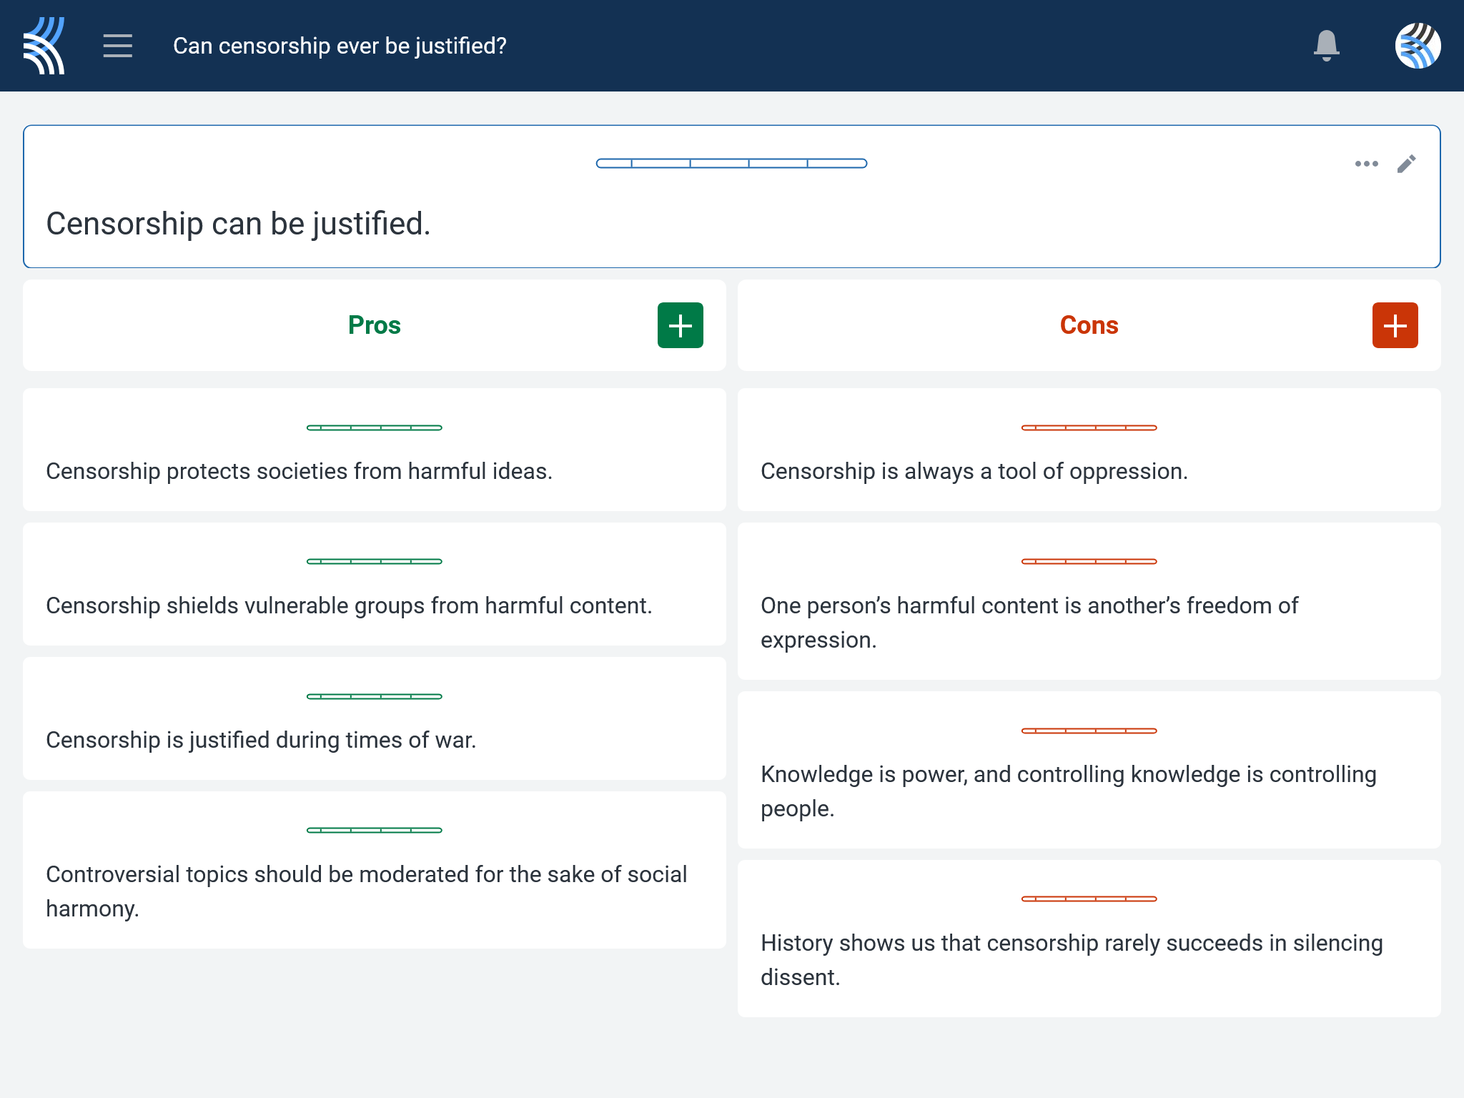
Kialo Discussion: Can censorship ever be justified?
Now that you’ve had chance to discuss your initial thoughts, you are going to add your ideas to a Kialo discussion.
Let’s learn more about having an in-depth discussion on Kialo.

Slide 10
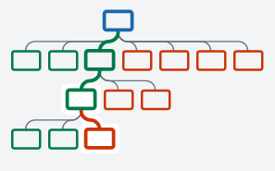

Kialo Discussion: The Argument Tree
On Kialo, the discussion is represented by an argument tree.
The pros are green and the cons are red.
Here are two Kialo argument trees.
Which one represents a more in-depth discussion?

Slide 11
Kialo Discussion: The Argument Tree
In this discussion, everyone has added their own perspective on the thesis.
Some perspectives might be repeated.
Students have not engaged with their peers’ perspectives.
This is unlikely to be an in-depth discussion!
In this discussion, students have added their perspective on the thesis, developed their arguments, and responded to other perspectives.
This results in a more in-depth discussion!

Slide 12
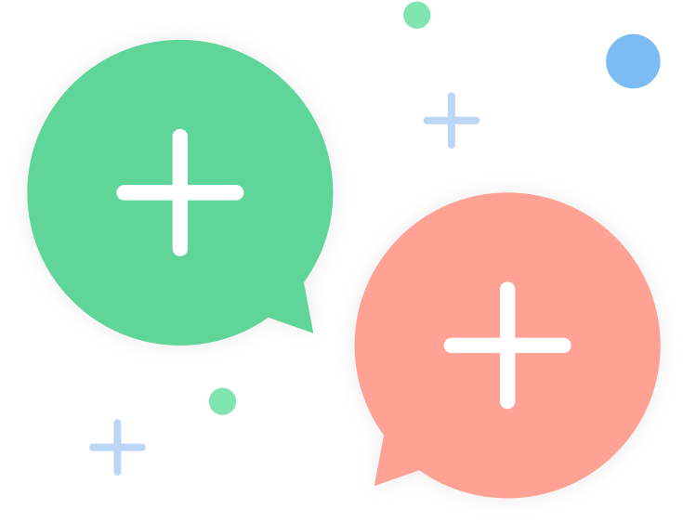
Kialo Discussion: Can censorship ever be justified?
Let’s apply this to a discussion!
Building Arguments
Step 1: Choose the starter claim you most agree with.
Step 2: Develop this claim by adding at least 2 pros.
Step 3: Add at least 2 cons to represent an alternative perspective.
Step 4: Repeat this for at least 3 other starter claims.
Step 5: Your peers will also add claims to the discussion. Try to respond to at least 3 of these.
Check the argument tree: How deep is the discussion?

Slide 13
Reflection Task: Censorship
Who decides what knowledge is censored?
Is censorship always about power, or can it reflect genuine ethical concerns?
How do societal values influence what is deemed acceptable or harmful?

Slide 14
Exit Ticket Task: Censorship
How does censorship impact individual freedoms versus collective safety?
Can censorship ever be entirely unbiased?
Why or why not?

Slide 15
Lesson Objectives: Recap
Examine how censorship impacts the development of knowledge, including what is studied, published, and taught
Explore diverse perspectives on the ethics of censorship, focusing on power dynamics, societal impact, and individual rights

