Slide 1
Should English be the dominant language (lingua franca) for global communication and knowledge systems?
Knowledge and Language:
Lingua Franca
Lesson 3: Listening Task

Slide 2
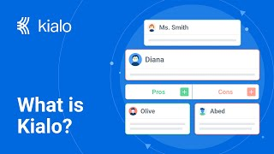

How does Kialo work?
If you’re new to Kialo, watch this video to discover how the platform works. Otherwise, let’s get started!

Slide 3

Lesson Objectives
Analyze Ruiyuan Yuan’s critique of English-language dominance in education, technology, and culture.
Explore how language infrastructure shapes access to knowledge and reinforces or resists power structures.
Create and analyze claims and counterclaims about linguistic dominance.
Reflect on how cultural, political, and technological forces contribute to linguistic inequality.

Slide 4

TOK Concepts
Power: How does the global dominance of English shape who can access, produce, and validate knowledge?
Culture: How does the spread of English affect cultural identity and the preservation of diverse knowledge systems?
Perspective: In what ways does speaking English influence which worldviews are amplified or marginalized globally?
Today’s lesson links to these TOK concepts.
By completing the activities, you will build knowledge that can help with your assessments.

Slide 5
Introduction: Lingua Franca
Today’s lesson is based around a video discussing whether English is a dominating language.
Step 1
Share your own perspectives on dominance of a language.
Step 2
Watch a video on the topic. Take notes on the main arguments and counterarguments, analyzing their strengths and weaknesses.
Step 3
Use your notes to add the strongest arguments and counterarguments to a Kialo discussion.

Slide 6

Introduction: Lingua Franca
Class Discussion
What does it mean for one language to dominate a global system?
Can language ever be truly neutral, or does it always reflect power and identity?
What happens when most knowledge is accessible only through a single language?

Slide 7

Listening Task: Is English a Dominating Language?
As you watch the video, take notes on the key arguments and counterarguments.
Analyze the strengths and weaknesses of each argument.
Find other sources to support your analysis.
You will need your notes for today’s Kialo discussion!

Slide 8
Listening Task: Is English a Dominating Language?
As you watch the video, take notes on the key arguments and counterarguments, analyzing their strengths and weaknesses.
Note-Taking Framework
Main arguments for a global language: Facilitates global communication, education, and access to shared knowledge systems (e.g., coding, academia).
Main arguments against: Marginalizes other languages, creates access barriers, and reinforces global inequality.
Language and identity argument: Language shapes cultural identity and emotional expression; dominance of English risks loss of nuance and belonging.
Knowledge access and infrastructure argument: Digital systems are built in English, limiting participation for non-speakers; new tools in other languages may reverse this.
Linguistic echo chambers argument: Relying on one language can isolate users from alternative perspectives and global diversity.
Key Points to Listen For
What examples does Yuan give of English-language dominance?
What are the emotional, social, and political consequences she describes?
Does she argue for or against English as a global language — or something more nuanced?
How does her personal identity as a non-native English speaker shape her perspective?

Slide 9
Kialo Discussion: Should English be the dominant language for global communication and knowledge systems?
You will now use your research in a Kialo discussion.
Your teacher will tell you whether to create your own discussion or use a ready-made version.
Step 1
If you have created your own discussion, add your thesis and starter claims.
These are the main points you wish to argue for or against.
Step 2
Add the strongest arguments (pros) under each starter claim, based on your notes and previous research.
Be sure to reference power, culture, and perspective.
Step 3
Follow the same approach to add counterarguments (cons) to each branch.
Step 4
Include examples and evidence to support your arguments and counterarguments.

Slide 10
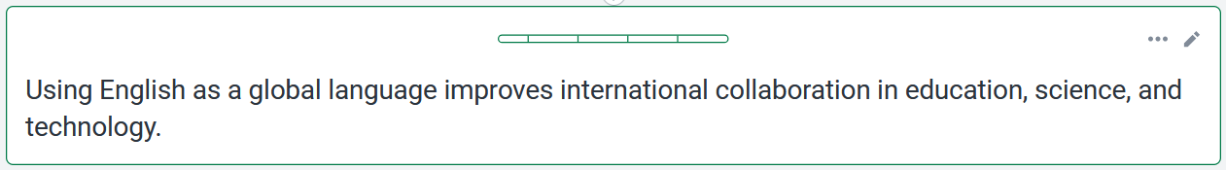


Kialo Discussion: Example Claims
English allows researchers, coders, and professionals to collaborate more easily, reducing translation costs and delays.
Relying on English as a global language can reduce the motivation to learn other languages, leading to linguistic homogenization.
For example, most scientific journals and academic conferences use English as the standard.
For example, students and professionals may prioritize English over their native or regional languages, causing these languages to decline in use and status.

Slide 11

Kialo Discussion: Example Claims
English simplifies communication in international travel, diplomacy, and humanitarian work.
Using only English risks erasing linguistic and cultural nuance, flattening local expressions and values in translation.
For example, English is the working language of the UN and many NGOs.
For example, culturally rooted concepts often lose meaning when explained in English.

Slide 12
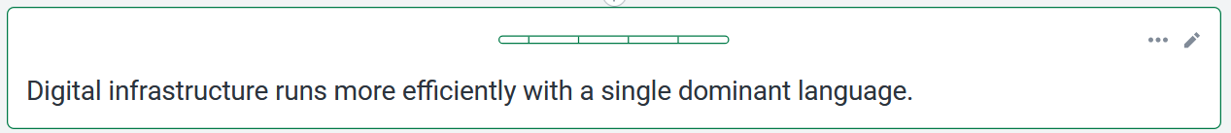
Kialo Discussion: Example Claims
Standardizing code, online platforms, and technical documentation in English streamlines innovation.
This centralization makes non-English users dependent on foreign systems, reducing digital autonomy.
For example, most programming languages and AI systems are built in English.
For example, Chinese tech developers must work in English-based frameworks to participate globally.

Slide 13
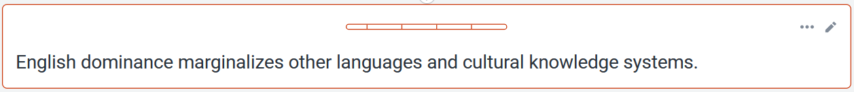
Kialo Discussion: Example Claims
Many Indigenous or regional languages lack digital representation, leading to knowledge loss.
English can still coexist with native languages if multilingual policies are actively promoted.
For example, oral traditions and local epistemologies are rarely digitized in global platforms.
For example, bilingual education systems and translation tools can help bridge the gap.

Slide 14
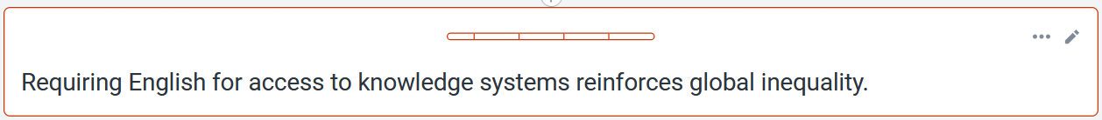
Kialo Discussion: Example Claims
Language barriers block millions from contributing to academia, coding, and policymaking.
Translation technologies are rapidly improving and may soon reduce these gaps.
For example, non-native English speakers are underrepresented in global research.
For example, tools like Google Translate and DeepL offer near-real-time access to information.

Slide 15
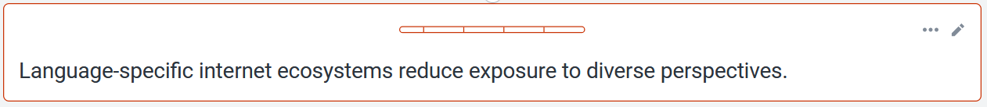
Kialo Discussion: Example Claims
When users stay within their own language online, they form echo chambers and miss cross-cultural understanding.
Localized internet ecosystems can protect cultural sovereignty and resist foreign dominance.
For example, Chinese, English, and Russian web spaces often operate in parallel with little overlap.
For example, countries developing their own digital tools in local languages reclaim control.

Slide 16
Reflection Task: Lingua Franca
Reflection Questions
How did Ruiyuan Yuan’s talk challenge or confirm your assumptions about the role of English in the world?
Do you think a global language unites people or creates new forms of exclusion? Why?
Can we truly preserve cultural identity and local knowledge if one language dominates global systems?
Have you ever felt empowered or disadvantaged because of the language(s) you speak? How did that affect your access to knowledge or participation?
What responsibilities do global platforms, institutions, or individuals have in promoting linguistic equity?

Slide 17
Lesson Objectives: Recap
Analyze Ruiyuan Yuan’s critique of English-language dominance in education, technology, and culture.
Explore how language infrastructure shapes access to knowledge and reinforces or resists power structures.
Create and analyze claims and counterclaims about linguistic dominance.
Reflect on how cultural, political, and technological forces contribute to linguistic inequality.

