Slide 1
Does the dominance of a language shape what is visible and valued on the internet?
Knowledge and Language:
Lingua Franca
Lesson 2: Fact-Finding Task

Slide 2
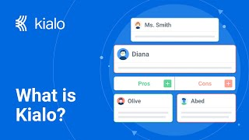

How does Kialo work?
If you’re new to Kialo, watch this video to discover how the platform works. Otherwise, let’s get started!

Slide 3

Lesson Objectives
Investigate real-world case studies that illustrate how language impacts the visibility, credibility, and accessibility of knowledge online.
Substantiate or challenge the claims from Lesson 1 using evidence from media articles, video interviews, and platform case examples.
Develop critical thinking and source evaluation skills by connecting practical examples to abstract knowledge questions.

Slide 4

TOK Concepts
Power: To what extent does language determine who has the authority to create and disseminate knowledge in digital spaces?
Culture: How does the cultural context embedded in language influence the way knowledge is understood and communicated?
Perspective: In what ways do different languages shape distinct versions of reality, and how does this affect our understanding of truth?
Today’s lesson links to these TOK concepts.
By completing the activities, you will build knowledge that can help with your assessments.

Slide 5
Introduction: Does the dominance of a language shape what is visible and valued on the internet?
Today’s lesson is about using case studies to expand your knowledge on how language shapes digital knowledge.
Step 1(inc. homework)
Conduct in-depth research into a specific case and give a short presentation to the class.
Step 2
Present your findings and refine your arguments in your Kialo discussions.
Step 3
Reflect on how language shapes digital knowledge.

Slide 6
Case Study Preparation: Does the dominance of a language shape what is visible and valued on the internet?
You teacher will assign you a case study for homework.
Wikipedia’s Language Divide:
Focus: The manipulation of smaller Wikipedia editions.
Task: Examine how language communities shape the knowledge that is presented and trusted.
Latin America – Invisible Science in Global Media:
Focus: The underrepresentation of Latin American scientists in English-speaking media.
Task: Examine why knowledge produced in non-dominant languages is often undervalued or unseen globally.
Facebook Mistranslation and Content Moderation:
Focus: The impact of translation systems and moderation policies on the transfer of knowledge.
Task: Examine the impact of automated systems and bias policies on the understanding of cultural and linguistic nuance.
Language Infrastructures and the Future of the Internet:
Focus: The way language influences not just content, but the systems that build and deliver knowledge online.
Task: Examine the potential impact of linguistic “bubbles” online.

Slide 7

Case Study Preparation: Does the dominance of a language shape what is visible and valued on the internet?
Prepare a short presentation on your case.
You should:
Explain what happened in the case.
Explain how language influenced what knowledge was visible or valued.
Explain which TOK concept (power, culture, or perspective) is most relevant.

Slide 8

Discussion: Does the dominance of a language shape what is visible and valued on the internet?
Class Discussion
What claims did you find most convincing or most problematic in last class’s debate?
Were there any claims that felt hard to prove or lacked real-world examples?

Slide 9
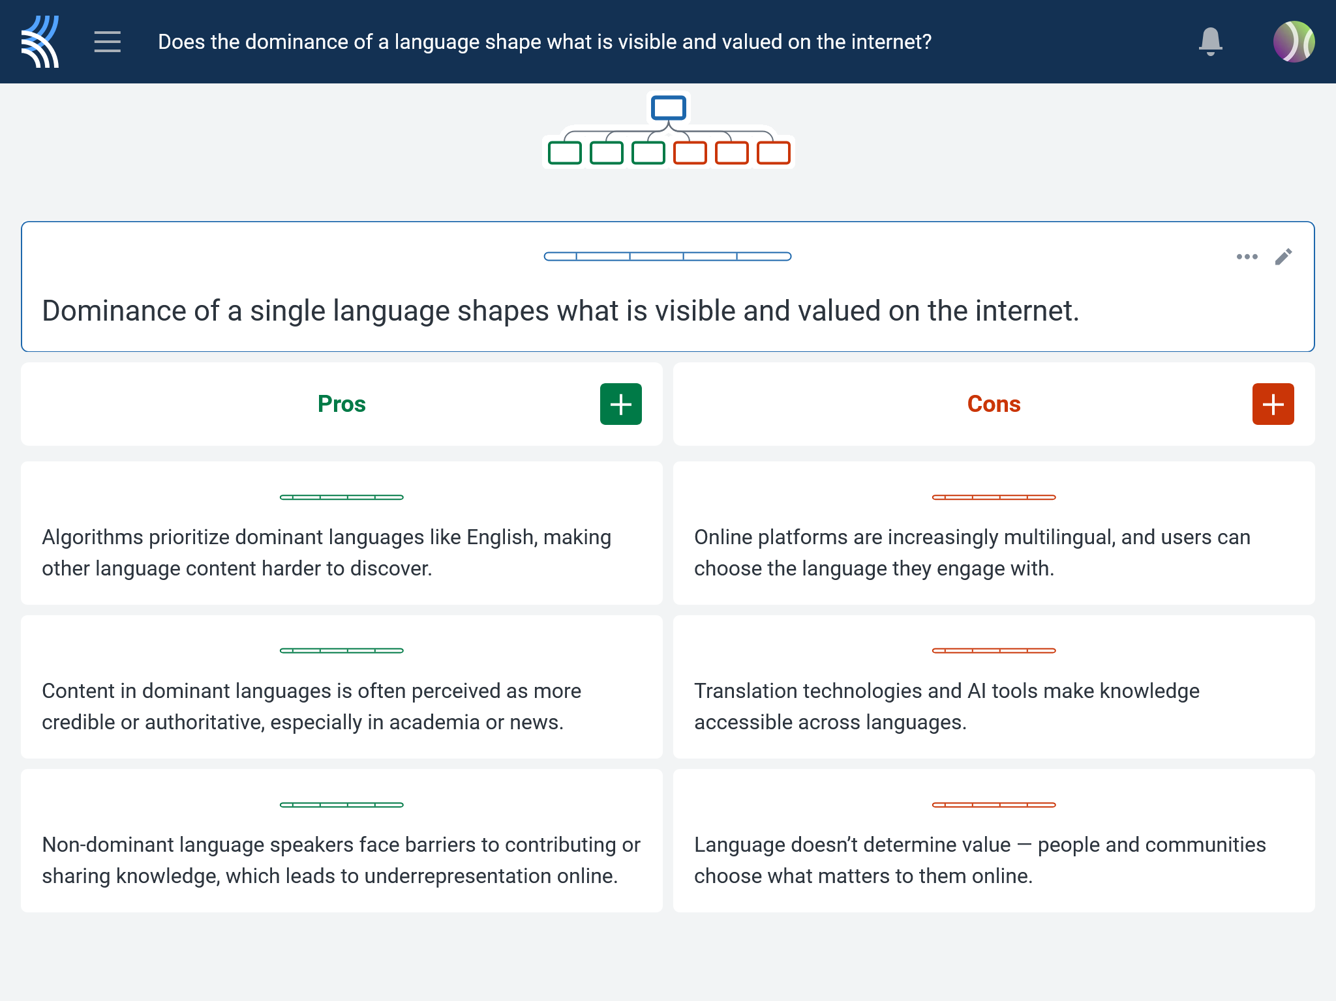
Kialo Discussion: Does the dominance of a language shape what is visible and valued on the internet?
Use your case study and own research to support, challenge, or refine your initial arguments in your Kialo discussion!
Add at least one new claim or counterclaim based on your case study.
Reply to at least one peer’s argument, using insights from another group’s case.
Label your post with the relevant TOK concept (e.g., perspective — Arabic content suppression).

Slide 10
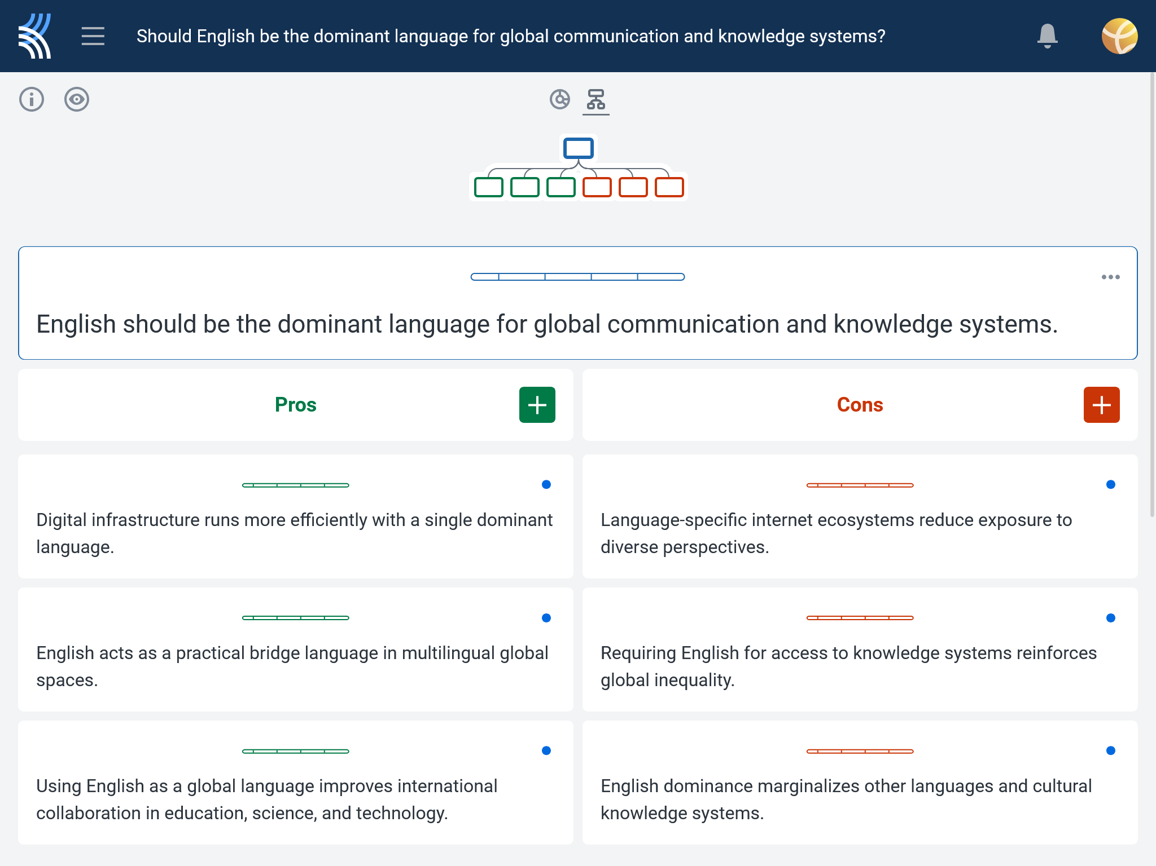
Kialo Discussion: Does the dominance of a language shape what is visible and valued on the internet?
Focus Areas
Digital gatekeeping: Who controls which languages/platforms dominate?
Cultural framing: How do translation and language communities shape meaning?
Linguistic inequality: Are all languages and their speakers equally represented or trusted online?

Slide 11
Reflection Task: Language Dominance
How did the case studies challenge or deepen your understanding of how language influences what we see, trust, or ignore online?
Whose knowledge or perspective was missing, silenced, or distorted in the examples you explored — and why might that matter?
Can knowledge truly be global if it’s shaped by a few dominant languages? What are the consequences for those outside that linguistic majority?
How do language, culture, and power interact to determine which knowledge is made visible and which is hidden on the internet?
What responsibilities do we have — as students, creators, or consumers of knowledge — to engage with linguistic diversity in digital spaces?

Slide 12
Lesson Objectives: Recap
Investigate real-world case studies that illustrate how language impacts the visibility, credibility, and accessibility of knowledge online.
Substantiate or challenge the claims from Lesson 1 using evidence from media articles, video interviews, and platform case examples.
Develop critical thinking and source evaluation skills by connecting practical examples to abstract knowledge questions.

