Slide 1
Is access to knowledge limited by language?
Knowledge and Language:
Lingua Franca
Lesson 1: Opening Debate

Slide 2
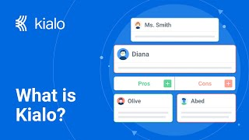
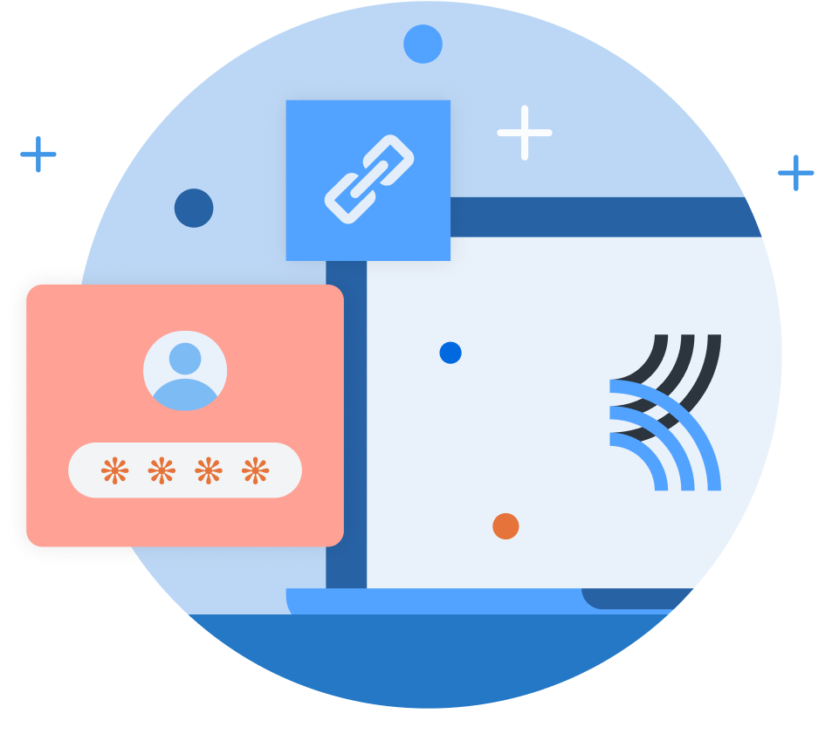
How does Kialo work?
If you’re new to Kialo, watch this video to discover how the platform works. Otherwise, let’s get started!

Slide 3

Lesson Objectives
Identify how language acts as both a gatekeeper and enabler of knowledge in the digital age.
Recognize the dominance of English in online spaces and evaluate its effects on knowledge access and representation.
Begin to understand the relationship between language, power, and knowledge construction.

Slide 4

TOK Concepts
Power: Who controls the platforms, algorithms, and knowledge systems that determine what is seen and valued online?
Perspective: Do speakers of different languages experience the internet — and truth — differently?
Culture: What cultural knowledge is lost or distorted when content is only available in dominant languages?
Today’s lesson links to these TOK concepts.
By completing the activities, you will build knowledge that can help with your assessments.

Slide 5
Introduction: Language Dominance
Today’s lesson is about sharing your existing knowledge and perspectives on how language affects what is visible and valuable on the internet.
Step 1
Discuss the class’s initial response to the question.
Step 2
Share your existing knowledge and perspectives and respond to those of your peers in an in-depth Kialo discussion.
Step 3
Reflect on language dominance in relation to information available on the internet.

Slide 6

Introduction: Language Dominance
Class Discussion
Does the dominance of a language shape what is visible and valued on the internet?

Slide 7
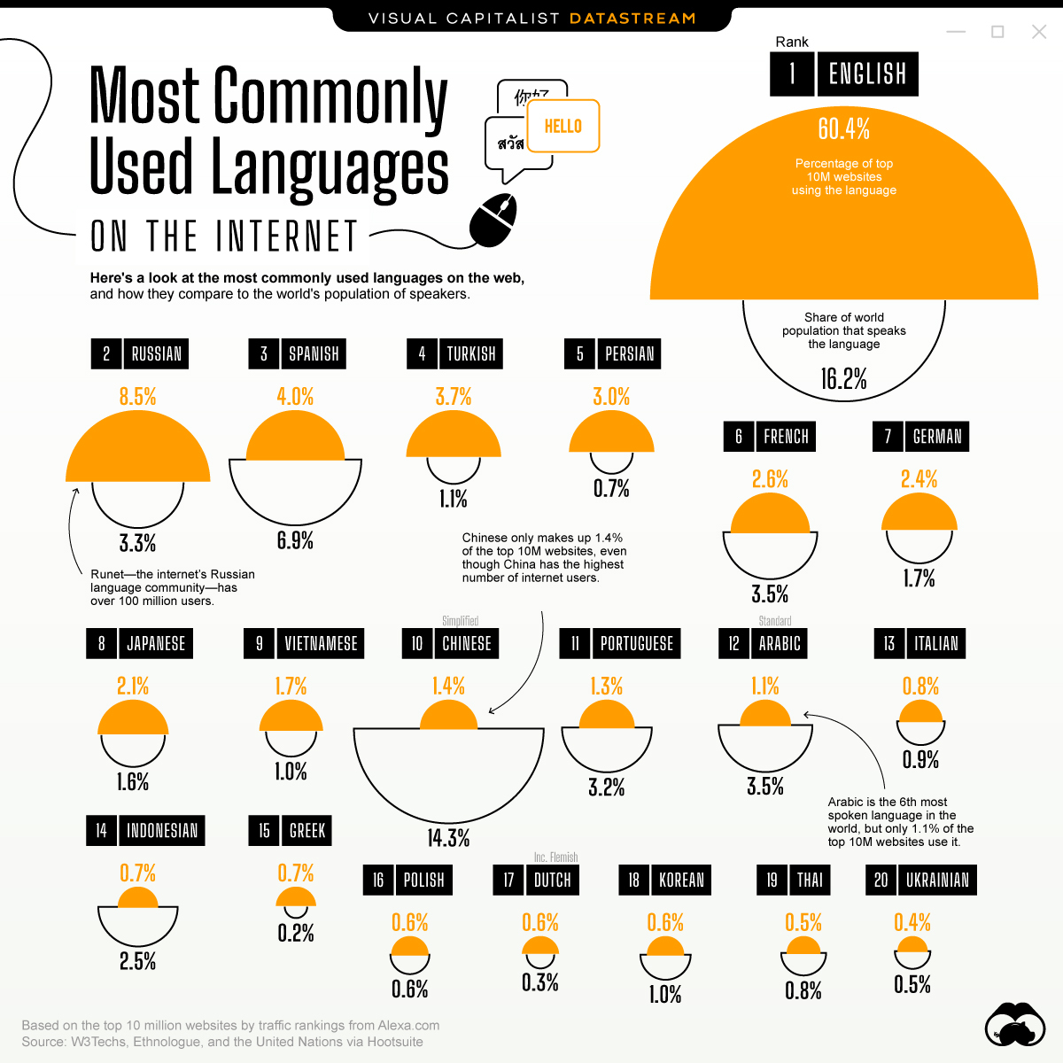
Introduction: Language Dominance
Is the internet equally accessible to speakers of all languages?
If something isn’t available in English, is it less likely to be known or believed?
Does language affect not just what we find online, but how we interpret it?

Slide 8
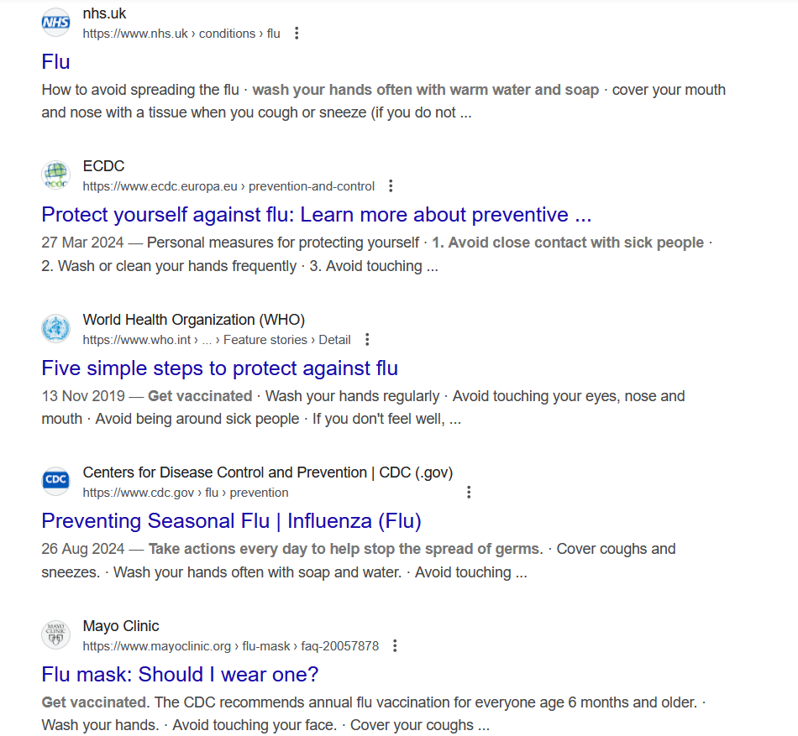
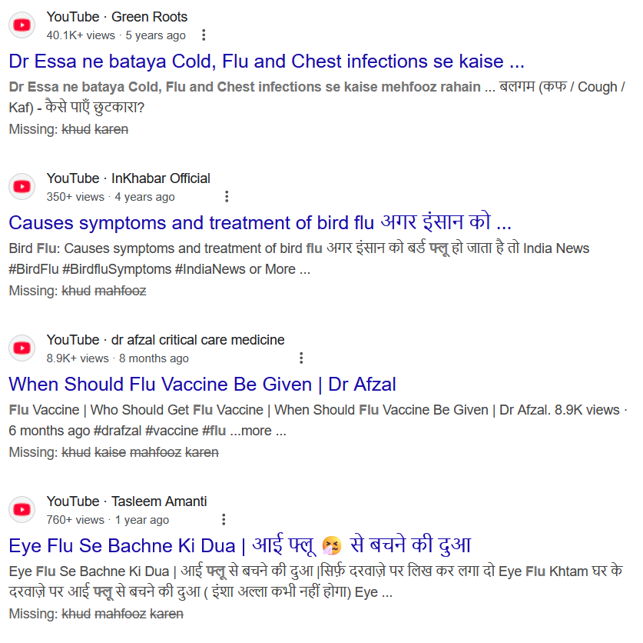
Introduction: Language Dominance
English and Urdu:
How to protect yourself from the flu.
Compare an internet search in English with the same search in another language.
What do you notice about the credibility and quality of the top results?

Slide 9

Introduction: Language Dominance
How does language shape the way we think?

Slide 10
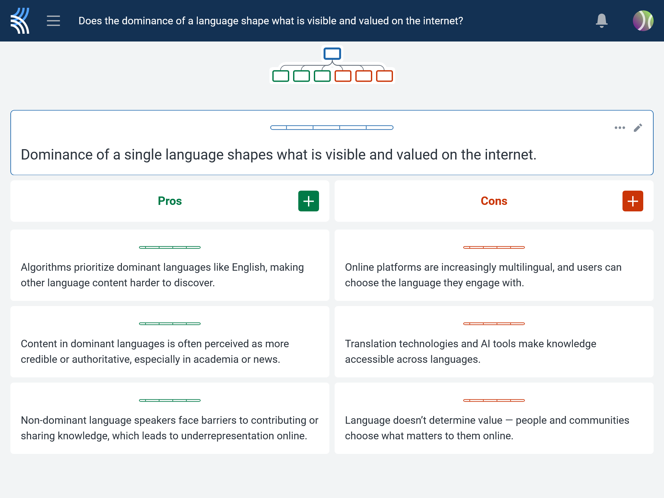
Kialo Discussion: Does the dominance of a language shape what is visible and valued on the internet?
Now that you’ve had chance to discuss your initial thoughts, you are going to add your ideas to a Kialo discussion.
Let’s learn more about having an in-depth discussion on Kialo.

Slide 11
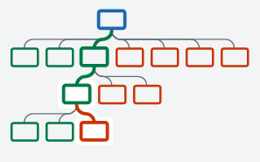

Kialo Discussion: The Argument Tree
On Kialo, the discussion is represented by an argument tree.
The pros are green and the cons are red.
Here are two Kialo argument trees.
Which one represents a more in-depth discussion?

Slide 12
Kialo Discussion: The Argument Tree
In this discussion, everyone has added their own perspective on the thesis.
Some perspectives might be repeated.
Students have not engaged with their peers’ perspectives.
This is unlikely to be an in-depth discussion!
In this discussion, students have added their perspective on the thesis, developed their arguments, and responded to other perspectives.
This results in a more in-depth discussion!

Slide 13

Kialo Discussion: Does the dominance of a language shape what is visible and valued on the internet?
Let’s apply this to a discussion!
Building Arguments
Step 1: Choose the starter claim you most agree with.
Step 2: Develop this claim by adding at least two pros.
Step 3: Add at least two cons to represent an alternative perspective.
Step 4: Repeat this for at least two other starter claims.
Step 5: Your peers will also add claims to the discussion. Try to respond to at least three of these.
Check the argument tree: How deep is the discussion?

Slide 14
Reflection Task: Language Dominance
Whose knowledge do you think is most visible online — and whose is missing? Why?
Have you ever struggled to access or understand information because of a language barrier? What did that experience reveal to you about language and knowledge?
Does using translation tools give you full access to knowledge, or do they filter and change it?
If most “credible” knowledge is published in English, how might that shape what people believe to be true?
Is the ability to access information the same as the ability to understand and value it? Why or why not?

Slide 15
Personal Prompt: Language Dominance
If you could redesign the internet to make knowledge more linguistically equal, what would you change and why?

Slide 16
Lesson Objectives: Recap
Identify how language acts as both a gatekeeper and enabler of knowledge in the digital age.
Recognize the dominance of English in online spaces and evaluate its effects on knowledge access and representation.
Begin to understand the relationship between language, power, and knowledge construction.

