Slide 1
How do indigenous designers challenge cultural appropriation?
Knowledge and Indigenous Societies: Cultural Ownership
Lesson 3: Listening Task

Slide 2


How does Kialo work?
If you’re new to Kialo, watch this video to discover how the platform works. Otherwise, let’s get started!

Slide 3

Lesson Objectives
Analyze how cultural appropriation in fashion interacts with power, ownership, and representation.
Evaluate how Indigenous designers use fashion to transmit cultural knowledge and resist commodification.
Reflect on how ethical engagement with Indigenous knowledge challenges mainstream practices.

Slide 4

TOK Concepts
Power: Should fashion companies have the right to use cultural designs without asking permission?
Ethics: Is it right to turn sacred cultural symbols into fashion items for profit?
Culture: How can Indigenous fashion help protect and share cultural knowledge?
Today’s lesson links to these TOK concepts.
By completing the activities, you will build knowledge that can help with your assessments.

Slide 5
Introduction: Cultural Authenticity
Today’s lesson is based around a video discussing how our fashion choices reflect our values.
Step 1
Share your own perspectives on cultural authenticity in fashion.
Step 2
Watch a video on the topic. Take notes on the main arguments and counterarguments, analyzing their strengths and weaknesses.
Step 3
Use your notes to add the strongest arguments and counterarguments to a Kialo discussion.

Slide 6
Introduction: Terminology
Cultural appreciation (Oxford Review)
The respectful recognition and understanding of the cultural traditions, practices, and beliefs of a group that differs from one’s own.
Indigenous knowledge systems
Ways of knowing rooted in community, land, history, and language.
Cultural appropriation (Oxford Languages)
The unacknowledged or inappropriate adoption of the customs, practices, ideas, etc. of one people or society by members of another, typically more dominant, people or society.

Slide 7

Introduction: Cultural Authenticity
Class Discussion
Can Indigenous fashion maintain its cultural authenticity in the global market?

Slide 8
Introduction: Cultural Authenticity
Class Discussion
Who has the right to use cultural symbols in fashion?
Can a global industry like fashion engage with Indigenous cultures ethically?
What happens when cultural expression becomes commodified?

Slide 9
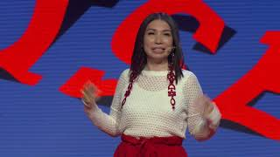
Listening Task: Sage Paul
As you watch the video, take notes on the key arguments and counterarguments.
Analyze the strengths and weaknesses of each argument.
Find other sources to support your analysis.
You will need your notes for today’s Kialo discussion!

Slide 10
Listening Task: Sage Paul
As you watch the video, take notes on the key arguments and counterarguments, analyzing their strengths and weaknesses.
Note-Taking Framework
Main Arguments
What is Sage Paul’s central message about fashion and politics?
How does she define the ethical problems in the fashion industry?
What does she say about cultural appropriation vs. appreciation?
Supporting examples:
What personal stories does she share from her childhood and family?
Which specific incidents or brands does she reference?
What examples does she give of Indigenous resistance or creativity?
Counterarguments:
What might a mainstream fashion brand argue in defence of “borrowing”?
Does Sage Paul address these views, directly or indirectly?
Can fashion ever be truly “global” without borrowing?

Slide 11
Kialo Discussion: Can Indigenous fashion maintain its cultural authenticity in the global market?
You will now use your research in a Kialo discussion.
Your teacher will tell you whether to create your own discussion or use a ready-made version.
Step 1
If you have created your own discussion, add your thesis and starter claims.
These are the main points you wish to argue for or against.
Step 2
Add the strongest arguments (pros) under each starter claim, based on your notes and previous research.
Be sure to reference evidence, truth, and certainty.
Step 3
Follow the same approach to add counterarguments (cons) to each branch.
Step 4
Include examples and evidence to support your arguments and counterarguments.

Slide 12
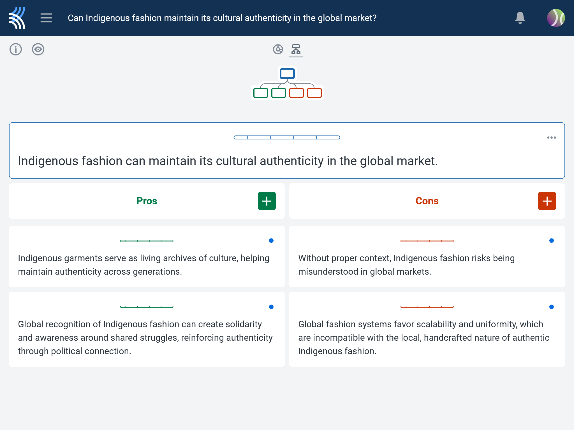
Kialo Discussion: Can Indigenous fashion maintain its cultural authenticity in the global market?
Use your analysis to ensure you select the strongest arguments from the listening task.
Add these to the Kialo discussion as arguments, counterarguments, examples, and evaluations.
Refer to the concepts of power, culture, and ethics in your arguments.

Slide 13
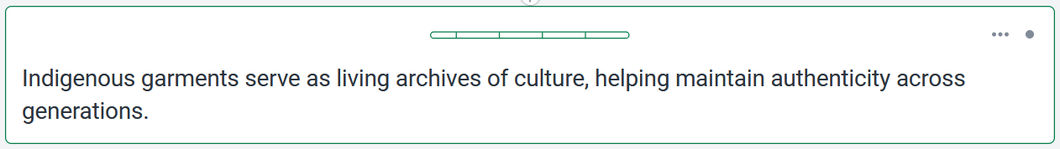


Kialo Discussion: Example Claims
Clothing can tell stories using colors, patterns, or symbols that show a group’s history, struggles, or beliefs.
Traditional clothing can lose its meaning even within Indigenous communities if younger people are not taught what it stands for.
For example, the Ajrak from Sindh is a powerful symbol of culture and resistance, made using a traditional block-printing method.
For example, some youth may have beaded clothing or woven sashes but don’t know their purpose or the stories behind them.

Slide 14
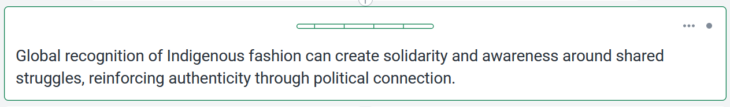
Kialo Discussion: Example Claims
When Indigenous garments are worn in solidarity or protest, they can raise awareness of ongoing resistance movements.
Political symbols in fashion can be misused or adopted without genuine understanding, weakening their original meaning.
For example, Sage Paul believes that wearing Indigenous fashion is inherently political, asserting sovereignty and resilience.
For example, the keffiyeh has been used in fashion magazines without reference to Palestine, erasing its political significance.

Slide 15

Kialo Discussion: Example Claims
If garments are not accompanied by education, their deeper cultural meaning often remains inaccessible or misunderstood.
Fashion can spark curiosity and conversations that lead to deeper engagement with cultural knowledge.
For example, Maasai designs are often used in fashion without credit, stripping them of their ceremonial and cultural importance.
For example, Sage Paul’s own designs and runway shows often include narratives or artist statements that invite the public to learn more.

Slide 16
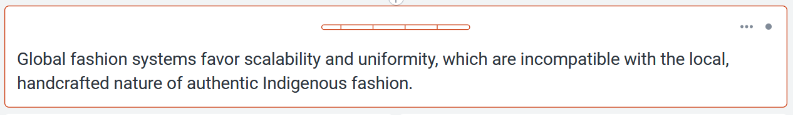
Kialo Discussion: Example Claims
The slow, small-batch production central to many Indigenous traditions cannot meet global demand without sacrificing authenticity.
Global markets can be reimagined to support ethical, small-scale production.
For example, Ajrak producers in Sindh face pressure to mechanize or simplify designs for export, risking dilution of their complex cultural patterns.
For example, initiatives like the Indigenous Fashion Arts festival in Canada create space for authenticity by promoting slow fashion and artisan-led practices.

Slide 17
Reflection Task: Cultural Authenticity
Reflection Questions
How does Indigenous fashion challenge the dominant values of the global fashion industry?
What ethical responsibilities do consumers and companies hold?
Should fashion companies have to get consent before using cultural motifs?
Can buying Indigenous-made fashion help reverse historical harms?
What are the consequences of commodifying sacred or symbolic knowledge?
How does reclaiming fashion help preserve Indigenous knowledge systems?
Should governments create stronger legal protections for Indigenous cultural expression?
What surprised you about Sage Paul’s talk?

Slide 18
Lesson Objectives: Recap
Analyze how cultural appropriation in fashion interacts with power, ownership, and representation.
Evaluate how Indigenous designers use fashion to transmit cultural knowledge and resist commodification.
Reflect on how ethical engagement with Indigenous knowledge challenges mainstream practices.

