Slide 1
How do real-world examples of Indigenous fashion co-option and genuine collaboration highlight tensions between ethics, cultural ownership, and knowledge?
Knowledge and Indigenous Societies:
Cultural Ownership
Lesson 2: Fact-Finding Exercise

Slide 2


How does Kialo work?
If you’re new to Kialo, watch this video to discover how the platform works. Otherwise, let’s get started!

Slide 3

Lesson Objectives
Investigate real-world case studies that illustrate how the co-option of Indigenous fashion impacts the visibility, credibility, and accessibility of knowledge.
Substantiate or challenge claims from Lesson 1 using evidence from media articles, video interviews, and brand case examples.
Develop critical thinking and source evaluation skills by connecting practical examples to abstract knowledge questions.

Slide 4

TOK Concepts
Power: How do global brands, economic systems, and media platforms influence whose cultural knowledge is amplified, commercialized, or silenced?
Ethics: What responsibilities do brands and creators have when engaging with cultural knowledge from communities that have historically been marginalized?
Perspective: How do different cultural, social, or economic positions influence how people interpret an act as appropriation or respectful collaboration?
Today’s lesson links to these TOK concepts.
By completing the activities, you will build knowledge that can help with your assessments.

Slide 5
Introduction: Indigenous Designs in Fashion
Today’s lesson is about using case studies to expand your knowledge on the use of Indigenous designs in fashion.
Step 1(inc. homework)
Conduct in-depth research into a specific case and give a short presentation to the class.
Step 2
Present your findings and refine your arguments in your Kialo discussions.
Step 3
Reflect on the debate between cultural appropriation vs. collaboration.

Slide 6
Case Studies: How does a brand's use of Indigenous fashion affect the visibility, credibility, or accessibility of knowledge?
Your teacher will assign you a case study for homework.
Isabel Marant and Mixe Blouse
Focus: Alleged cultural appropriation of traditional Mixe embroidery from Santa María Tlahuitoltepec, Oaxaca, Mexico.
Task: Examine the debate surrounding the originality of designs, intellectual property rights, and community impact.
Louis Vuitton and Maasai Check
Focus: Use of the iconic Maasai shuka (red and blue checked fabric) in Louis Vuitton's collection without initial recognition or compensation.
Task: Analyze the ethical implications of using globally recognized Indigenous patterns and the subsequent efforts towards negotiation or legal protection.
Urban Outfitters and Navajo Nation
Focus: Controversy over Urban Outfitters using "Navajo" and other tribal names for products without permission, leading to a legal battle.
Task: Investigate the legal challenges of trademarking Indigenous names and designs, and the concept of cultural brand dilution.
Stella Jean and Haitian Artists/Artisans
Focus: A Haitian-Italian designer known for highlighting Haitian craftsmanship on global runways. Celebrated for promoting cultural visibility, her work also invites reflection on what fair and authentic collaboration looks like.
Task: Explore how Stella Jean’s approach balances empowerment and complexity in cross-cultural partnerships.

Slide 7

Case Studies: How does a brand's use of Indigenous fashion affect the visibility, credibility, or accessibility of knowledge?
Prepare a short presentation on your case.
You should include details about:
What happened in the case.
How cultural appropriation or collaboration influenced what Indigenous knowledge was visible or valued.
Which TOK concept (power, culture, perspective, or ethics) is most relevant.
Whether the case supports or challenges a claim from Lesson 1.

Slide 8

Discussion: Indigenous Designs in Fashion
Class Discussion
How do real-world examples of Indigenous fashion co-option and genuine collaboration highlight tensions between ethics, cultural ownership, and knowledge?

Slide 9
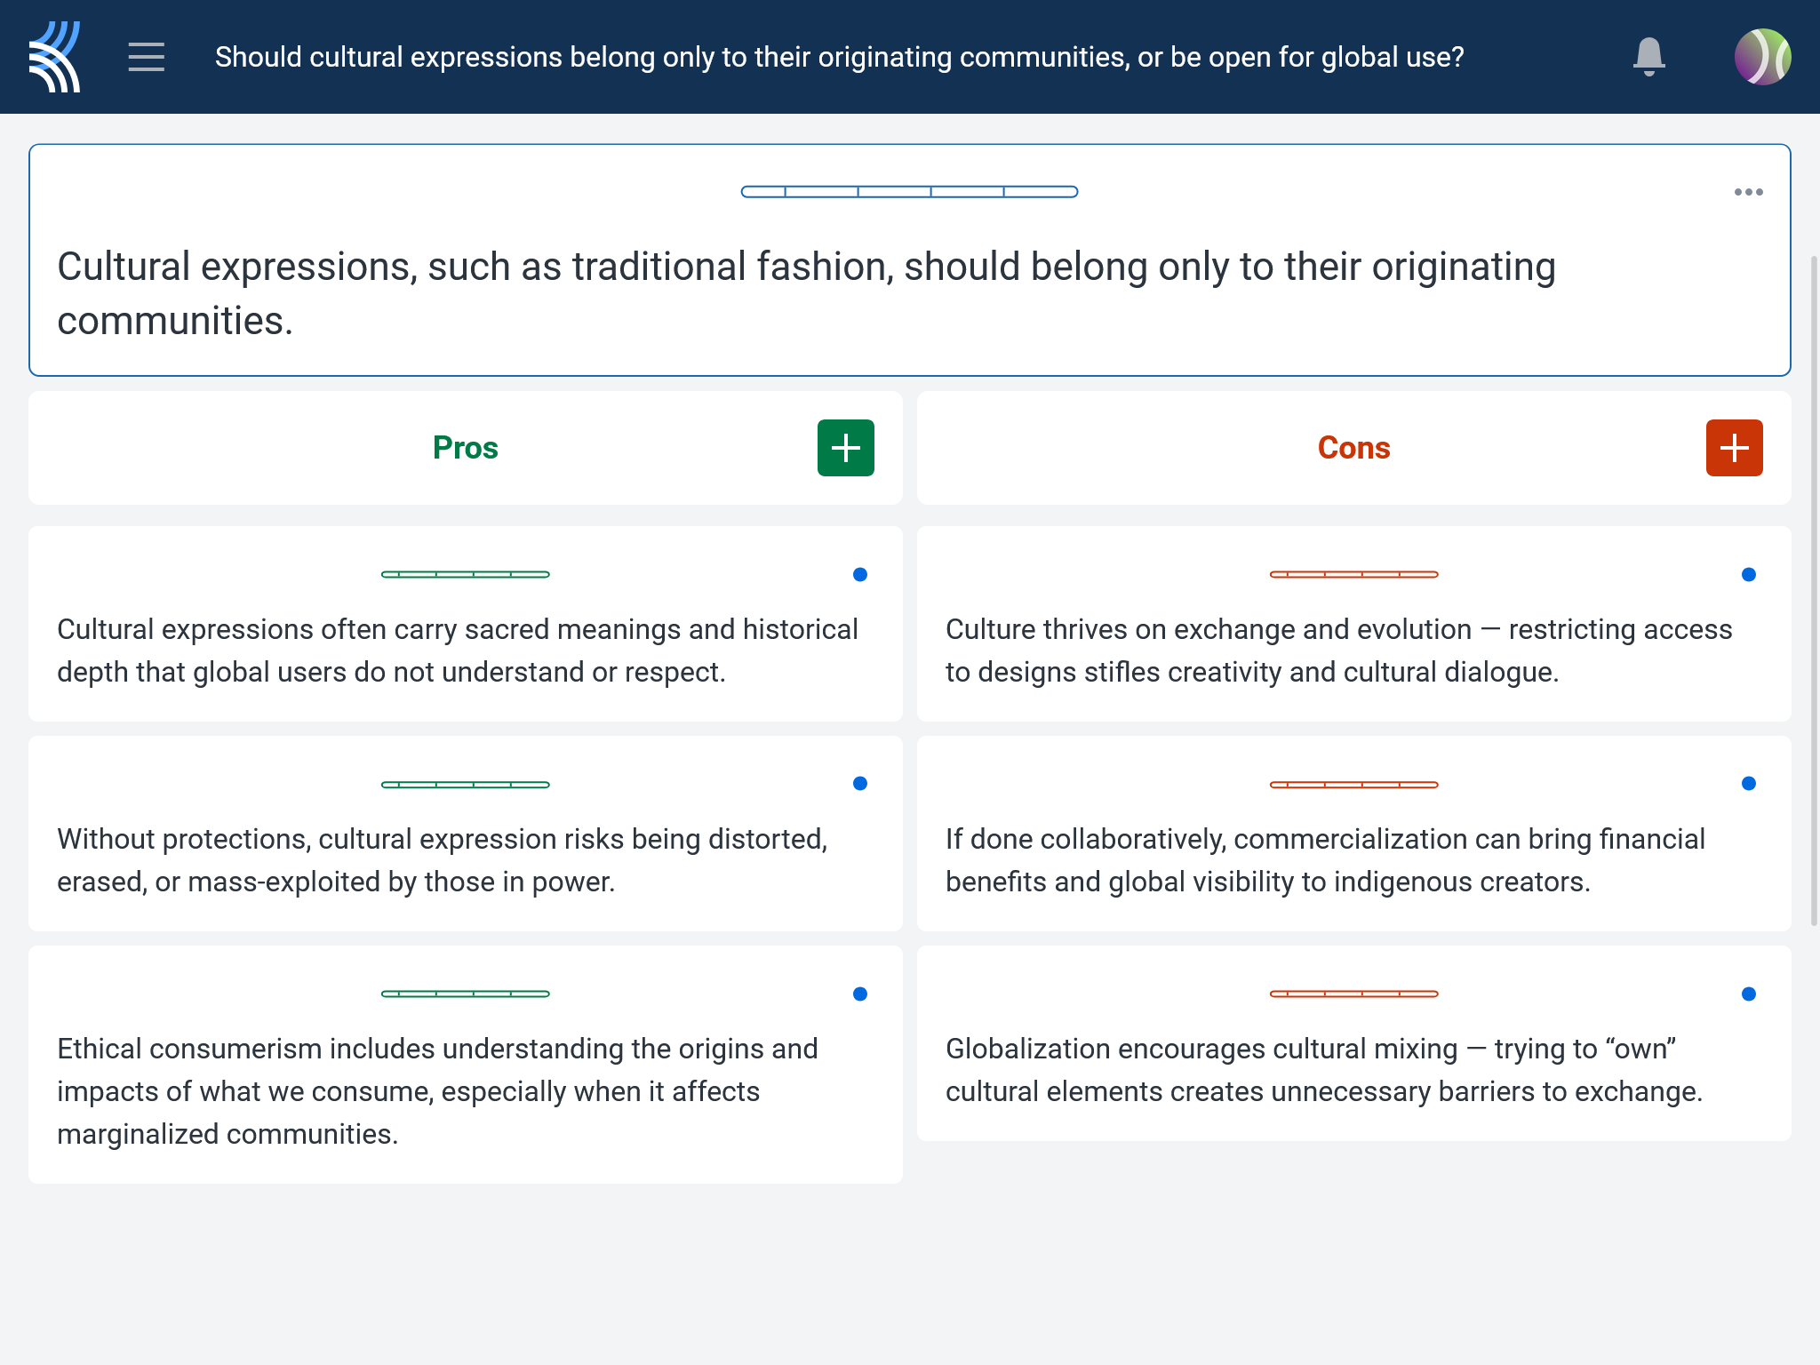
Kialo Discussion: Should cultural expressions belong only to their originating communities, or be open for global use?
Use your case study and any other research to support, challenge, or refine your initial arguments in your Kialo discussion!

Slide 10
Kialo Discussion: Should cultural expressions belong only to their originating communities, or be open for global use?
Focus Areas
Cultural Gatekeeping: Who controls which cultural designs/stories are shared or profited from?
Ethical Framing: How do collaborations and appropriations shape the meaning and value of Indigenous fashion?
Knowledge Inequality: Are all cultural knowledge systems equally respected or valued in the global fashion industry?

Slide 11
Reflection Task: Indigenous Designs in Fashion
Who has the authority to decide whether cultural knowledge should be protected, shared, or commercialized?
Is the debate over cultural appropriation primarily about ethics, economics, or power?
How do social, historical, and political contexts shape our understanding of “ownership” in culture?

Slide 12
Exit Ticket Task: Indigenous Designs in Fashion
Can the use of Indigenous designs by non-Indigenous brands ever be truly respectful — or is it always extractive?
How do your own cultural background and values influence the way you see this issue?
What responsibilities do individuals and institutions have when engaging with knowledge rooted in marginalized cultures?

Slide 13
Lesson Objectives: Recap
Investigate real-world case studies that illustrate how the co-option of Indigenous fashion impacts the visibility, credibility, and accessibility of knowledge.
Substantiate or challenge claims from Lesson 1 using evidence from media articles, video interviews, and brand case examples.
Develop critical thinking and source evaluation skills by connecting practical examples to abstract knowledge questions.

