Slide 1
Should cultural expressions, such as traditional fashion, belong only to their originating communities, or be open for global use?
Knowledge and Indigenous Societies:
Cultural Ownership
Lesson 1: Opening Debate

Slide 2


How does Kialo work?
If you’re new to Kialo, watch this video to discover how the platform works. Otherwise, let’s get started!

Slide 3

Lesson Objectives
Explore diverse perspectives on intellectual property, cultural appropriation, and the ownership of traditional knowledge.
Recognize the tension between creative freedom and the protection of Indigenous cultural heritage.
Introduce the concepts of ownership and power in relation to cultural knowledge.

Slide 4

TOK Concepts
Power: Who controls how Indigenous cultural knowledge is used, valued, or commercialized in global fashion?
Perspective: How do different cultural backgrounds shape contrasting views on appropriation, ownership, and creativity?
Culture: How is knowledge embedded in fashion expressions, and what happens when cultural meaning is removed from its original context?
Today’s lesson links to these TOK concepts.
By completing the activities, you will build knowledge that can help with your assessments.

Slide 5
Introduction: Ownership of Indigenous Fashion
Today’s lesson is about sharing your existing knowledge and perspectives on the ownership of Indigenous fashion.
Step 1
Discuss the class’s initial response to the question.
Step 2
Share your existing knowledge and perspectives and respond to those of your peers in an in-depth Kialo discussion.
Step 3
Reflect on the use of Indigenous designs by non-Indigenous people.

Slide 6

Introduction: Ownership of Indigenous Fashion
Class Discussion
Should cultural expressions, such as traditional fashion, belong only to their originating communities, or be open for global use?

Slide 7
Introduction: Terminology
According to the UN, the most fruitful approach is to identify, rather than define Indigenous peoples.
The UN’s understands that Indigenous peoples:
self-identify as Indigenous peoples at the individual level and are accepted by the community as their member;
maintain historical continuity with pre-colonial and/or pre-settler societies;
have strong link to territories and surrounding natural resources;
have distinct social, economic or political systems;
have a distinct language, culture and beliefs;
form non-dominant groups of society;
resolve to maintain and reproduce their ancestral environments and systems as distinctive peoples and communities.
Source: UN Factsheet, Indigenous Peoples, Indigenous Voices

Slide 8
Introduction: Terminology
Intellectual property (GOV.UK)
Intellectual property is something that you create using your mind, for example, a story, an invention, an artistic work, or a symbol.
Cultural heritage (UNESCO)
Cultural heritage includes artifacts, monuments, a groups of buildings and sites, and museums that have a diversity of values including symbolic, historic, artistic, aesthetic, ethnological or anthropological, scientific, and social significance.
Cultural appropriation (Oxford Languages)
Cultural appropriation is the unacknowledged or inappropriate adoption of the customs, practices, ideas, etc. of one people or society by members of another, typically more dominant, people or society.

Slide 9
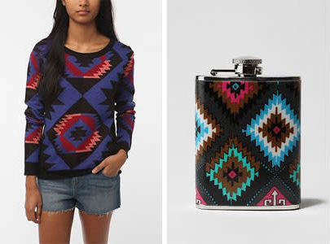
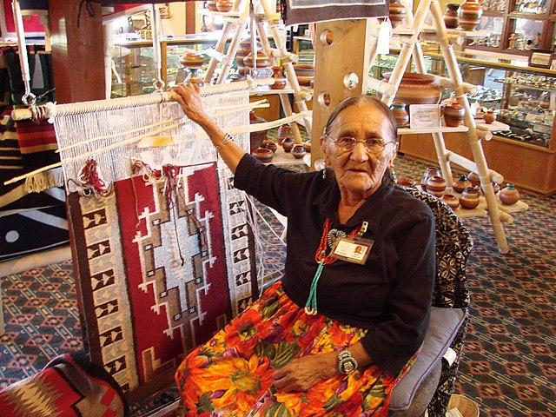
Introduction: Ownership of Indigenous Fashion
What do these images show?
Why might some people feel these designs are being appropriated?
What kind of knowledge is embedded in these designs, and how is this knowledge justified?
Urban Outfitters under fire for 'Navajo' collection
Source

Slide 10
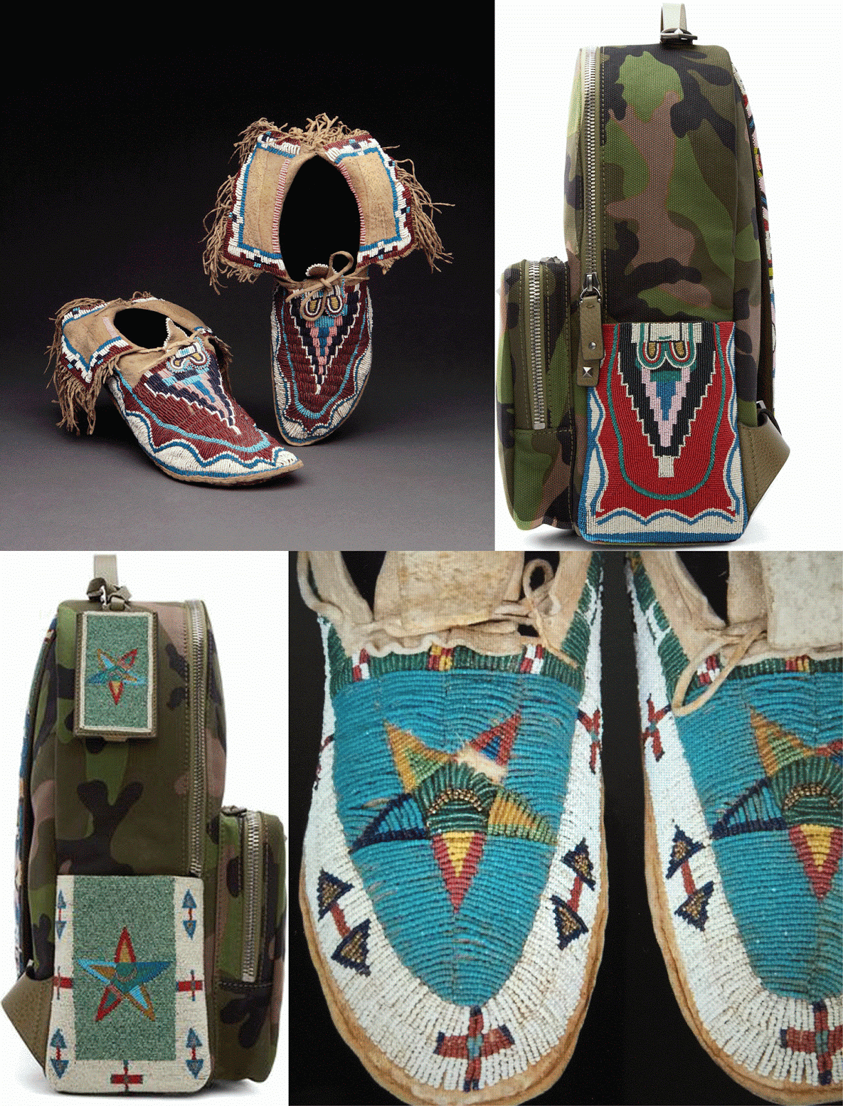
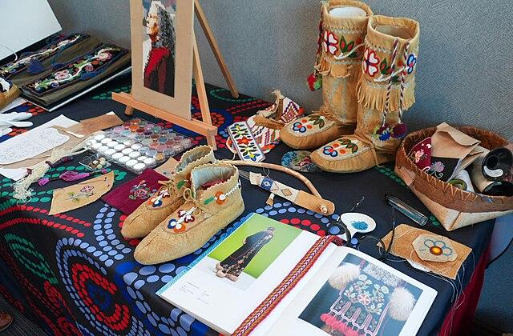
Introduction: Ownership of Indigenous Fashion
What do these images show?
Why might some people feel these designs are being appropriated?
What kind of knowledge is embedded in these designs, and how is this knowledge justified?
Oh No, Valentino | Appropriation and the Case of the Stolen Beadwork
Source

Slide 11
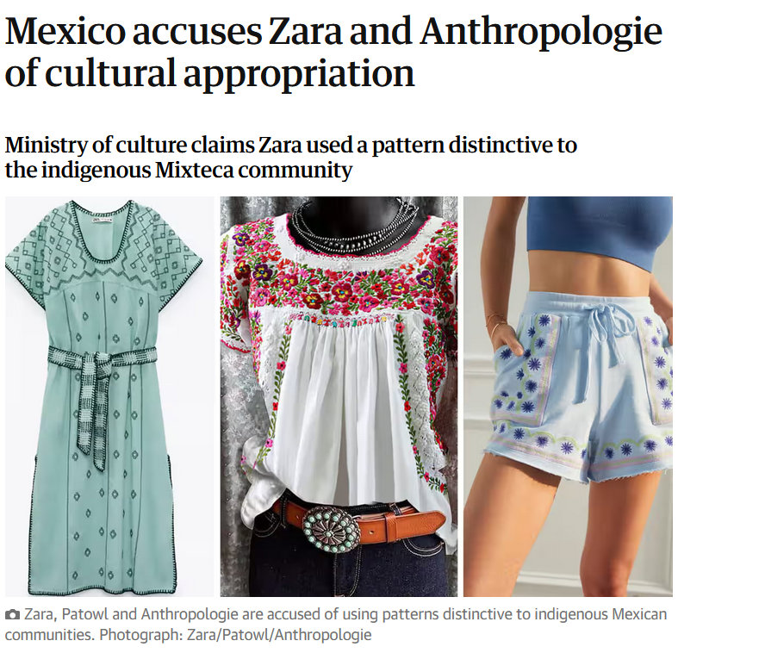
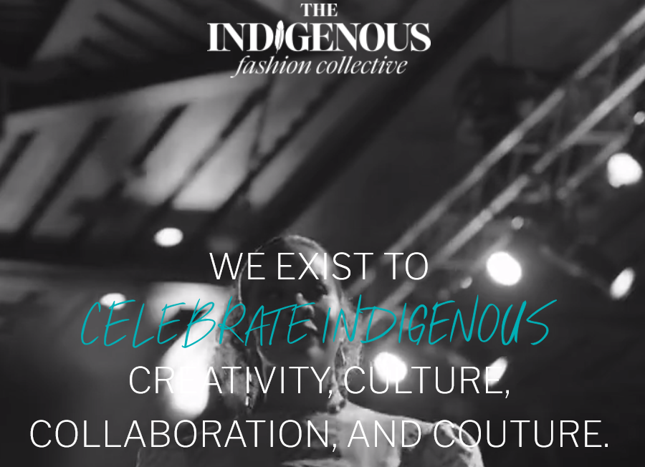
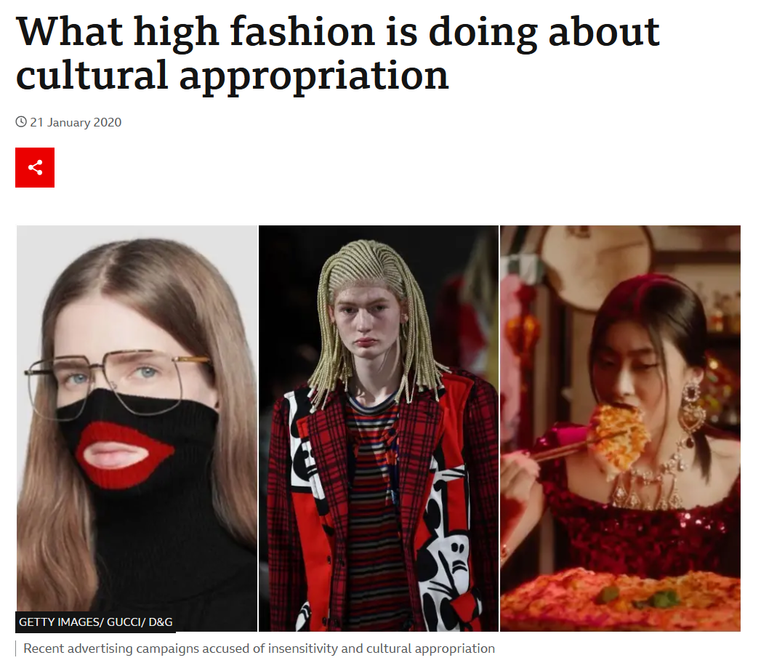
Introduction: Ownership of Indigenous Fashion
Use the links below for further research.

Slide 12
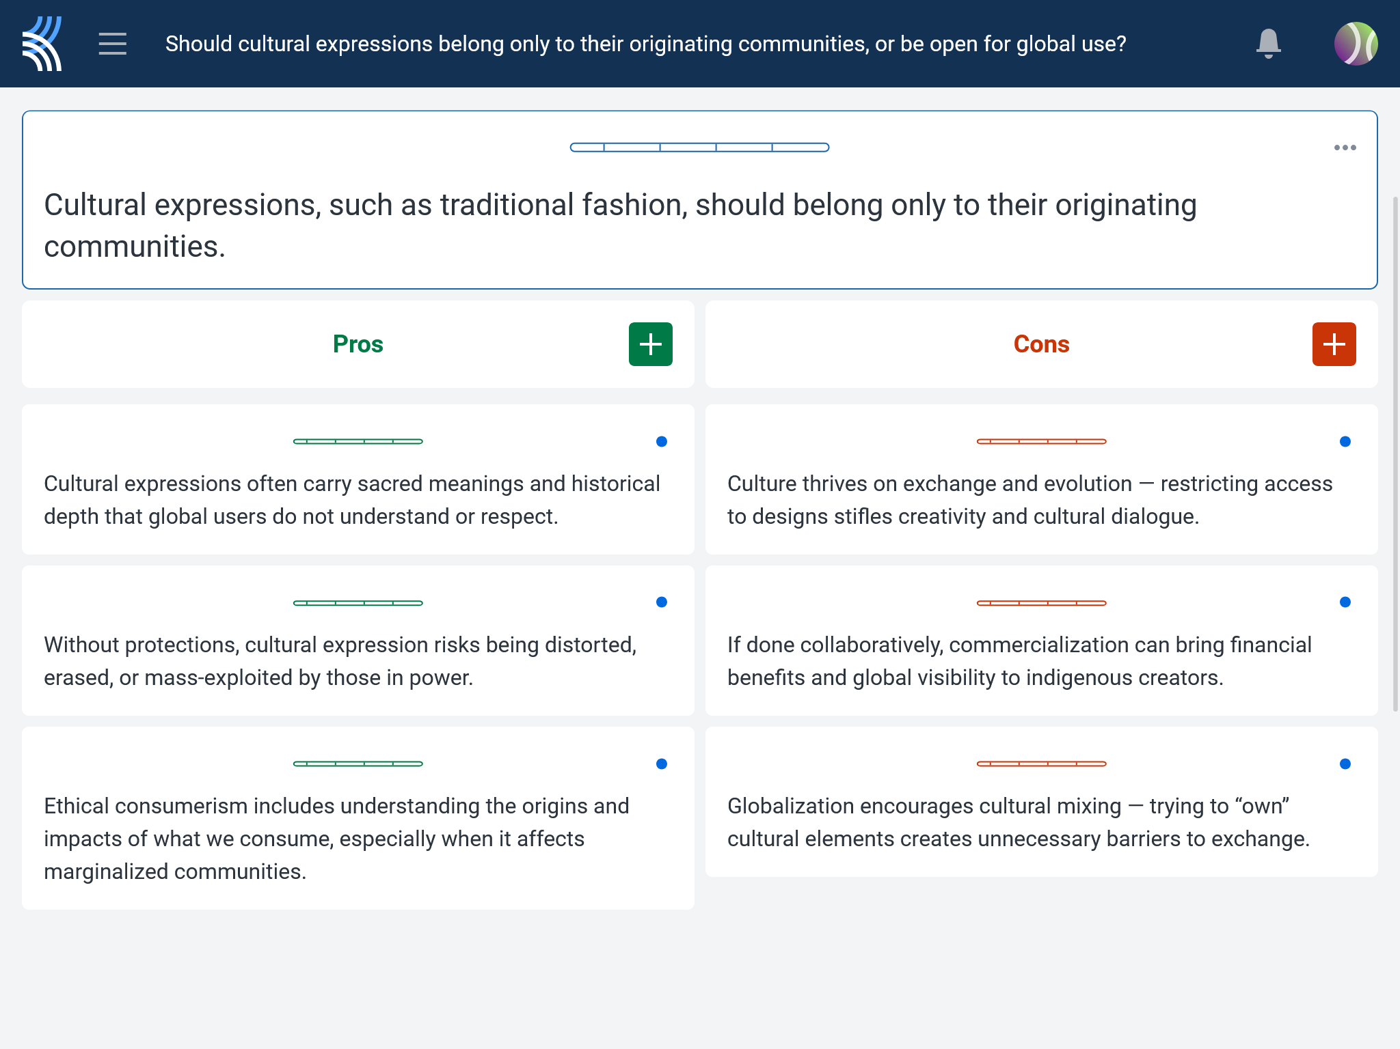
Kialo Discussion: Should cultural expressions belong only to their originating communities, or be open for global use?
Now that you’ve had chance to discuss your initial thoughts, you are going to add your ideas to a Kialo discussion.
Let’s learn more about having an in-depth discussion on Kialo.

Slide 13
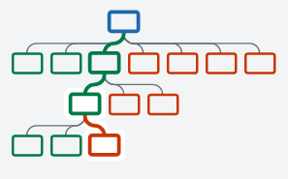

Kialo Discussion: The Argument Tree
On Kialo, the discussion is represented by an argument tree.
The pros are green and the cons are red.
Here are two Kialo argument trees.
Which one represents a more in-depth discussion?

Slide 14
Kialo Discussion: The Argument Tree
In this discussion, everyone has added their own perspective on the thesis.
Some perspectives might be repeated.
Students have not engaged with their peers’ perspectives.
This is unlikely to be an in-depth discussion!
In this discussion, students have added their perspective on the thesis, developed their arguments, and responded to other perspectives.
This results in a more in-depth discussion!

Slide 15

Kialo Discussion: Should cultural expressions belong only to their originating communities, or be open for global use?
Let’s apply this to a discussion!
Building Arguments
Step 1: Choose the starter claim you most agree with.
Step 2: Develop this claim by adding at least two pros.
Step 3: Add at least two cons to represent an alternative perspective.
Step 4: Repeat this for at least two other starter claims.
Step 5: Your peers will also add claims to the discussion. Try to respond to at least three of these.
Check the argument tree: How deep is the discussion?

Slide 16
Reflection Task: Ownership of Indigenous Fashion
Who has the authority to decide whether cultural knowledge should be protected, shared, or commercialized?
Is the debate over cultural appropriation primarily about ethics, economics, or power?
How do social, historical, and political contexts shape our understanding of “ownership” in culture?

Slide 17
Exit Ticket Task: Ownership of Indigenous Fashion
Can the use of Indigenous designs by non-Indigenous brands ever be truly respectful — or is it always extractive?
How do your own cultural background and values influence the way you see this issue?
What responsibilities do individuals and institutions have when engaging with knowledge rooted in marginalized cultures?

Slide 18
Lesson Objectives: Recap
Explore diverse perspectives on intellectual property, cultural appropriation, and the ownership of traditional knowledge.
Recognize the tension between creative freedom and the protection of Indigenous cultural heritage.
Introduce the concepts of ownership and power in relation to cultural knowledge.

