Slide 1
How do we develop a strong argument in a TOK essay?
Knowledge and the Knower:
Personal Memory or Shared Memory
Lesson 4: Writing a TOK Essay

Slide 2

Lesson Objectives
Write a fully developed TOK essay claim using the TOK essay structure.
Apply real-world examples and counterclaims to support arguments.
Engage critically with TOK concepts (e.g., perspectives, bias, power, justification).
Practice structured writing for the TOK essay assessment.

Slide 3

TOK Concepts
Perspectives: How do we sort through diverse viewpoints to decide what “really” happened?
Power: Who decides on the “official” version of events?
Justification: What counts as evidence for reliability?
Today’s lesson links to these TOK concepts.
By completing the activities, you will build knowledge that can help with your assessments.

Slide 4
Introduction: The TOK Essay
Today’s lesson is about applying your learning to practice writing a section of the TOK essay.
Step 1
Learn about the structure of the TOK essay.
Step 2
Plan and write your own section of the TOK essay, using what you’ve learnt on power, bias, and knowledge.
Step 3
Peer-review your writing, and revise it based on feedback.

Slide 5

Introduction: The TOK Essay
How do we develop a strong argument in a TOK essay?

Slide 6

Class Discussion: What makes a TOK essay unique?
A TOK essay should:
Focus on knowledge (not merely opinions).
Use real-world examples drawn from multiple Areas of Knowledge (AOKs).
Include counterclaims.
Refer to TOK concepts (e.g., perspectives, bias, power, justification).
Reflect on the implications and limitations of the argument.

Slide 7
Structuring a TOK Essay: AOK 1
Introduction
Assume a position.
Define key topic-specific terms.
Introduce chosen AOKs.
Explain the aspects of the topic you will explore.
{
Knowledge claim (AOK 1), including real-life example
Make a claim that links this AOK with the PT.
Explain how the example supports your claim.
Try to make links to your other subjects.
Lesson Focus
Counterclaim (AOK 1)
Evaluate a contrasting perspective in relation to your main claim.
Explain how the example, if used, supports your claim.
Try to make links to your other subjects.

Slide 8
Structuring a TOK Essay: AOK 2
Knowledge claim (AOK 2), including real-life example
Make a claim that links this AOK with the PT.
Explain how the example supports your claim.
Try to make links to your other subjects.
Counterclaim (AOK 2)
Evaluate a contrasting perspective in relation to your main claim.
Explain how the example, if used, supports your claim.
Try to make links to your other subjects.
Conclusion
Integrate the different AOKs and perspectives.
Explain your insights and their implications.
Refer to any limitations or unresolved questions.

Slide 9
Deconstructing a TOK Essay
Your teacher will provide you with a section of a TOK essay.
You should annotate the features listed below.
Claim: The stance or argument addressing the TOK prompt.
Example: A real-world situation supporting or illustrating the claim.
Counterclaim: A contrasting perspective that challenges the claim and may include a further real-world example.
TOK links: Explicit connection to TOK concepts (e.g., perspectives, bias, power, justification) and reflection on how knowledge is produced or validated.

Slide 10

Deconstructing a TOK Essay
Discussion Questions
How does the example strengthen the claim?
Which Ways of Knowing (WOKs) or Areas of Knowledge (AOKs) are relevant here?
Does the counterclaim effectively challenge the claim, encouraging deeper exploration?

Slide 11
Application: TOK Essay Prescribed Titles
How do these prompts apply to the topics we’ve covered?
Can you identify any other prompts that link?
Do the ever-improving tools of an area of knowledge always result in improved knowledge?
(May 2025)
Do historians and human scientists have an ethical obligation to follow the directive: “Do not ignore contradictory evidence?”
(May 2025)
Does our responsibility to acquire knowledge vary according to the area of knowledge?
(Nov 2024)
Is subjectivity overly celebrated in the arts but unfairly condemned in history?
(May 2024)

Slide 12
Writing a TOK Essay
Step 1
Select an essay prompt from the list your teacher provides.
Step 2
Plan your claim and real-life example.
You could use one of the examples from this unit.
Step 3
Plan your counterclaim, using another real-life example if possible.
Step 4
Use your plan to write your essay section.
It should be clear and coherent, with a TOK focus.

Slide 13
Writing a TOK Essay: Example Structure
Claim: Deliberate censorship by those in power often leads to significant gaps in recorded history, shaping what future generations perceive as ‘truth.’
Example: Governments restricting access to war archives, creating skewed accounts of victories and suppressing evidence of atrocities (e.g., classified WWII documents withheld for decades).
Counterclaim: Even in the absence of direct censorship, historians’ cultural and personal biases can subtly color narratives, indicating that distortion isn’t exclusive to official suppression.
TOK Link: Historical knowledge critically depends on who controls the evidence and how it is curated. Within the AOK of History, corroboration and acknowledgment of bias are essential to mitigate the effects of censorship and partial accounts.
AOKs: Ensure students reference relevant AOKs (e.g., how the Sciences interpret discoveries and assign credits and contributions).

Slide 14
Writing a TOK Essay
You can use a blank Kialo discussion to plan out your essay section.
Step 1
Add your prescribed title to a Kialo discussion as the Discussion Name.
Step 2
Create a multi-thesis discussion.
Use the AOKs as your theses.
Step 3
Add your main claim under your first thesis.
Add pros to support this based on your examples and evaluation.
Step 4
Add a contrasting perspective using a con.
Break your examples and evidence down into single claims to help you build a logical line of reasoning.

Slide 15
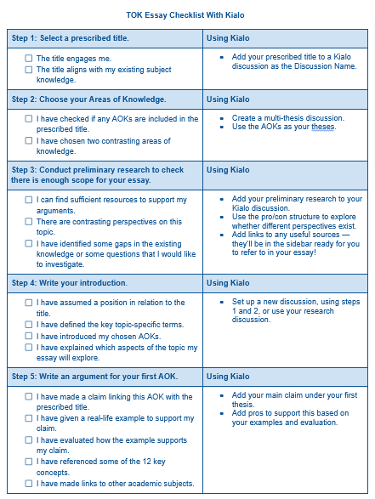

Peer Review: TOK Essay Checklist
Exchange your writing with your peers.
Use the relevant sections of the checklist to evaluate your peers’ work.
Revise your work based on their feedback.

Slide 16
Peer Review: Developing Feedback
Discussion Points
Claim: Is it clearly stated, and does it tie back to the prompt?
Example: Is it concrete, relevant, and well-explained?
Counterclaim: Is it meaningfully different or just a weaker version of the claim?
TOK link: Does it show awareness of how knowledge is justified, constructed, or challenged?
Language and clarity: Are there any vague statements or unclear references?

Slide 17
Reflection Task: TOK Essay Writing
What was the most challenging part of writing this essay section?
How do different perspectives influence debates on power and bias?
How will this practice help you prepare for the TOK essay assessment?

Slide 18
Extension/Homework Activities: TOK Essay
Option A: Expand the paragraph by adding another real-world example or a deeper analysis of the counterclaim.
Option B: Research a different context (another region or era) to see if the claim holds universally or changes with cultural/political conditions.
Option C: Draft an introductory or concluding paragraph linking the argument to a broader TOK theme.

Slide 19
Lesson Objectives: Recap
Write a fully developed TOK essay claim using the TOK essay structure.
Apply real-world examples and counterclaims to support arguments.
Engage critically with TOK concepts (e.g., perspectives, bias, power, justification).
Practice structured writing for the TOK essay assessment.

