Slide 1
How power and bias influence historical narratives
Knowledge and the Knower: Personal Memory or Shared Memory
Lesson 3: Listening Task

Slide 2


How does Kialo work?
If you’re new to Kialo, watch this video to discover how the platform works. Otherwise, let’s get started!

Slide 3

Lesson Objectives
Analyze how history is revised over time and what factors drive these revisions.
Evaluate the role of power, bias, and perspective in shaping historical knowledge.

Slide 4

TOK Concepts
Perspectives: Who benefits from historical revision?
Bias: Can we ever write a fully “objective” history?
Power: How do power structures determine which historical narratives survive?
Today’s lesson links to these TOK concepts.
By completing the activities, you will build knowledge that can help with your assessments.

Slide 5
Introduction: Historical Narratives
Today’s lesson is about listening to a discussion on why historical narratives change over time and evaluating the strength of arguments.
Step 1
Share your own perspectives on why historical narratives change over time.
Step 2
Listen to a discussion on the topic. Take notes on the main arguments and counterarguments, analyzing their strengths and weaknesses.
Step 3
Use your notes to add the strongest arguments and counterarguments to a Kialo discussion.

Slide 6

Introduction: Historical Narratives
Class Discussion
Why do historical narratives change over time?
Does this mean history is unreliable?

Slide 7
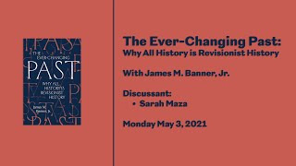
Listening Task: Historical Narratives
As you watch the video, take notes on the key arguments and counterarguments.
Analyze the strengths and weaknesses of each argument.
Find other sources to support your analysis.
You will need your notes for today’s Kialo discussion!

Slide 8
Kialo Discussion: Why do historical narratives change over time?
You will now use your research in a Kialo discussion.
Your teacher will tell you whether to create your own discussion or use a ready-made version.
Step 1
If you have created your own discussion, add your theses.
These are the main points you wish to argue for or against.
Step 2
Add the strongest arguments (pros) under each thesis, based on your notes and previous research.
Be sure to reference power, bias, and perspective.
Step 3
Follow the same approach to add counterarguments (cons) to each branch.
Step 4
Include examples and evidence to support your arguments and counterarguments.

Slide 9
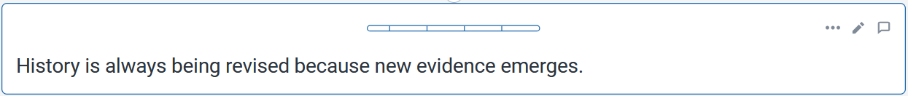


Kialo Discussion: Example Claims
History is a dynamic field where new discoveries can change historical understanding.
Some revisions are based on interpretation rather than evidence.
For example, the discovery of the Dead Sea Scrolls added to our knowledge of early religious texts.
This means they may reflect current political or ideological trends rather than objective truth.

Slide 10
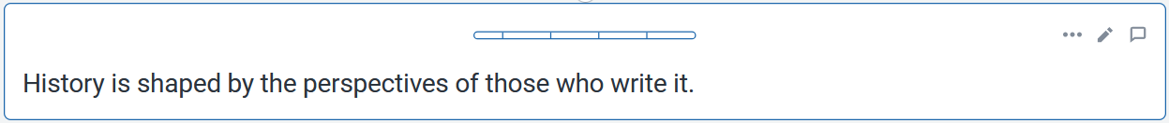
Kialo Discussion: Example Claims
Historians interpret events based on their own cultural and social backgrounds.
While perspectives influence history, historians follow rigorous methods to minimize bias.
This can lead to bias in how history is recorded.
These methods include archival research and peer review.

Slide 11
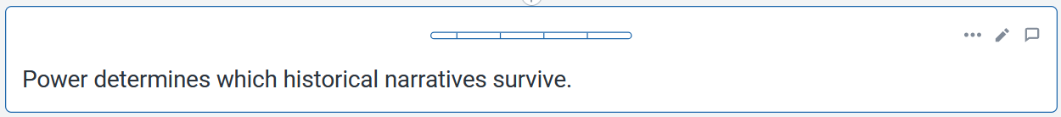
Kialo Discussion: Example Claims
Those in power control historical narratives by deciding which events are recorded, erased, or emphasized.
There are ways for alternative histories to be preserved.
For example, some governments have rewritten history textbooks.
Examples include oral traditions, independent research, and social activism.

Slide 12
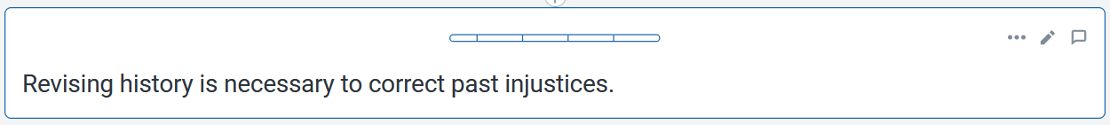
Kialo Discussion: Example Claims
Historical revisionism can bring justice to marginalized communities by uncovering hidden or suppressed histories.
Some revisions might be politically motivated rather than fact-based.
An example is the recognition of the Tulsa Race Massacre in U.S. history, which was ignored for decades.
This can create new biases instead of correcting old ones.

Slide 13
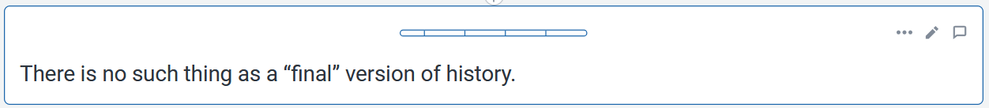
Kialo Discussion: Example Claims
History is an ongoing conversation, not a fixed record.
Some core historical facts are well-documented and should not be rewritten.
Each generation reinterprets past events in light of new values and knowledge.
For example, Holocaust denial is dangerous and not a valid “revision” of history.

Slide 14
Reflection Task: Why do historical narratives change over time?
What factors cause historical revision?
Does revising history mean previous knowledge was false?
Who benefits from historical revision?
Who loses?

Slide 15
Lesson Objectives: Recap
Analyze how history is revised over time and what factors drive these revisions.
Evaluate the role of power, bias, and perspective in shaping historical knowledge.

