Slide 1
Which is more reliable: personal memory or shared memory?
Knowledge and the Knower:
Personal Memory or Shared Memory
Lesson 1: Opening Debate

Slide 2


How does Kialo work?
If you’re new to Kialo, watch this video to discover how the platform works. Otherwise, let’s get started!

Slide 3

Lesson Objective
Explore different perspectives on the reliability of memory and history, with attention to power, bias, and subjectivity.
Analyze how commonly held memories differ from documented historical facts.
Determine whether there are circumstances under which intentionally omitting certain memories from historical narratives can be justified.

Slide 4

TOK Concepts
Perspectives: How do commonly held memories differ from documented historical facts, and what implications does this have for our understanding of history?
Power: In what ways do power structures shape the "official" narratives of historical events, and how does this affect collective memory?
Justification: Are there circumstances under which intentionally omitting certain memories from historical narratives can be justified?
Today’s lesson links to these TOK concepts.
By completing the activities, you will build knowledge that can help with your assessments.

Slide 5
Introduction: Personal Memory vs. Official History
Today’s lesson is about sharing your existing knowledge and perspectives on the concept of personal and shared memory, in the form of historical records.
Step 1
Discuss the class’s initial response to the question.
Step 2
Share your existing knowledge and perspectives and respond to those of your peers in an in-depth Kialo discussion.
Step 3
Reflect on the reliability of personal memory and official history.

Slide 6

Introduction: Personal Memory vs. Official History
Class Discussion
Which is more reliable: personal memory or official history?

Slide 7
Introduction: Personal Memory vs. Official History
History Textbook
Family Memory
In 1975, the town council, facing pressure to cut costs, voted to close Jackson Elementary School, intending to redirect funds toward a new stadium project.
A small group of about fifty residents held a modest protest outside the council meeting. They accused the council of prioritizing capital projects over the needs of the community's children.
The council defended their decision, claiming the stadium would ultimately benefit the town as a whole.
I remember the protests in 1975 when the council decided to close the school. My daughter, Jenny, had just started kindergarten there.
We all gathered outside the council meeting, determined not to let this happen. We’d spent days making signs saying things like, “Save our school!”
We thought there’d just be a few parents, but more and more people joined. You should have heard the noise! Our chants were so loud that they called the police, but we stood our ground. We weren’t going to let them close our school!

Slide 8
Discussion Points
History is always written by the victors.
Does this mean personal memory is more authentic, since it’s free from official spin?
If a memory is shared by enough people, it becomes history.
Is there a difference between commonly held memories and documented historical fact?
All personal memory is too subjective to trust, while history is based on objective research.
But historians can also be subjective.

Slide 9
Discussion Points
Official history is just a collectively agreed-upon memory — no more valid than personal recollections.
Do official archives, historical methods, and cross-verification make history inherently stronger?
Forgetting is essential to national unity — some parts of history must be left out.
Should certain memories (genocides, atrocities, colonial abuses) ever be intentionally omitted?

Slide 10
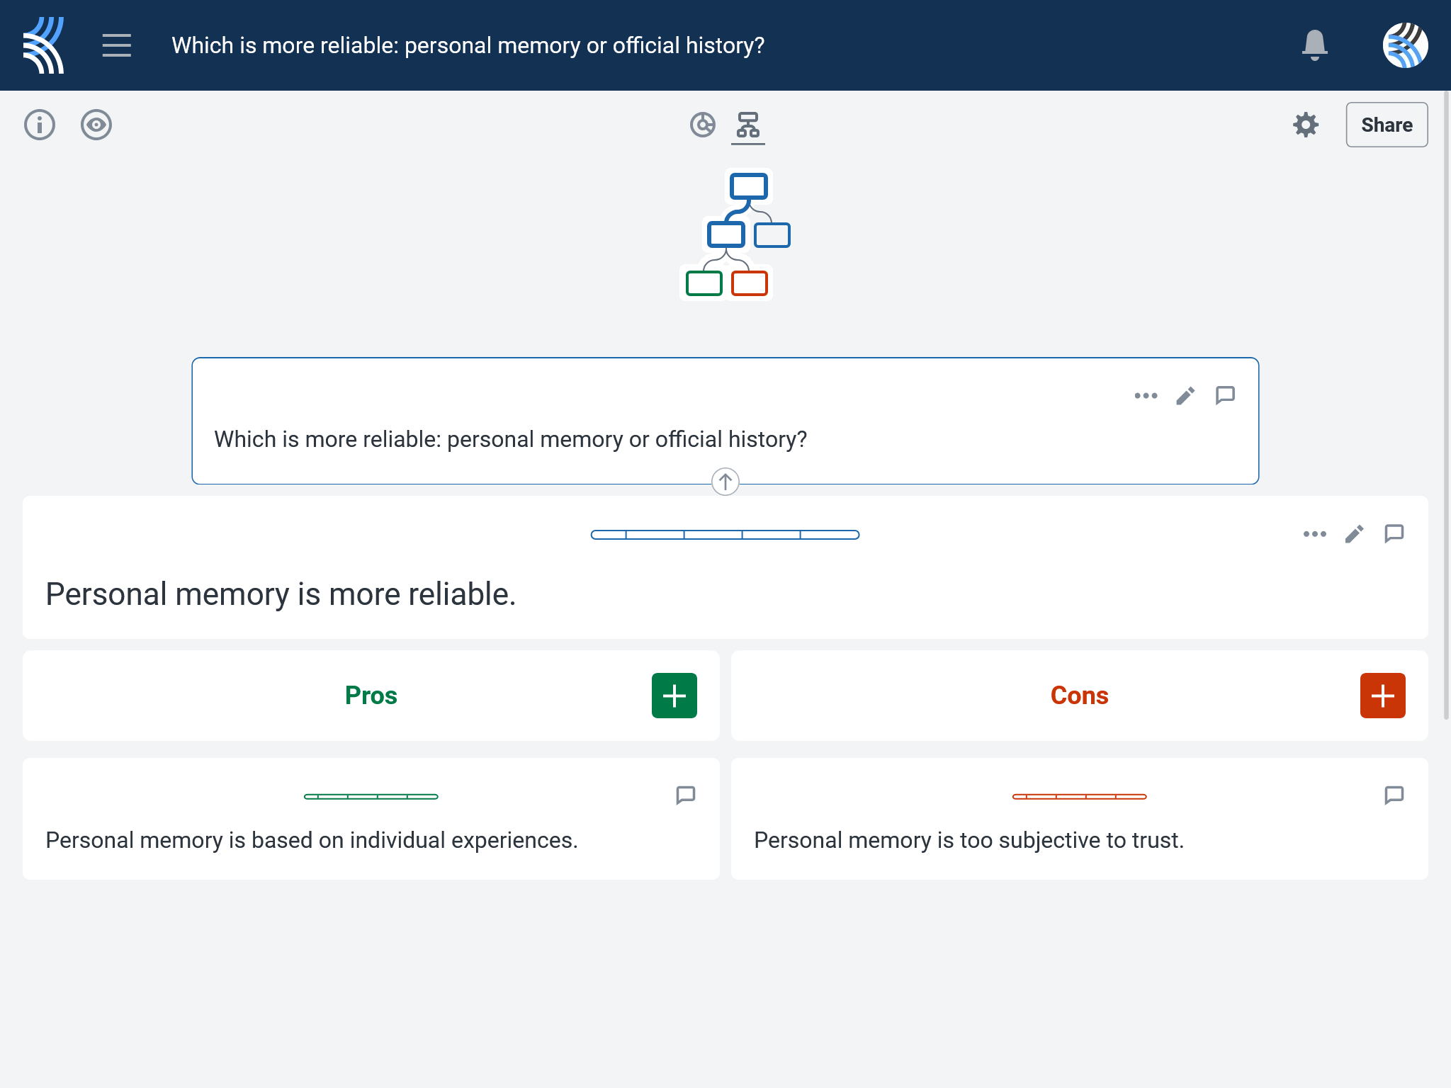
Kialo Discussion: Which is more reliable: personal memory or official history?
Now that you’ve had chance to discuss your initial thoughts, you are going to add your ideas to a Kialo discussion.
Let’s learn more about having an in-depth discussion on Kialo.

Slide 11
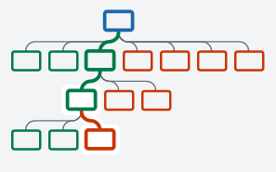

Kialo Discussion: The Argument Tree
On Kialo, the discussion is represented by an argument tree.
The pros are green and the cons are red.
Here are two Kialo argument trees.
Which one represents a more in-depth discussion?

Slide 12
Kialo Discussion: The Argument Tree
In this discussion, everyone has added their own perspective on the thesis.
Some perspectives might be repeated.
Students have not engaged with their peers’ perspectives.
This is unlikely to be an in-depth discussion!
In this discussion, students have added their perspective on the thesis, developed their arguments, and responded to other perspectives.
This results in a more in-depth discussion!

Slide 13

Kialo Discussion: Which is more reliable: personal memory or official history?
Let’s apply this to a discussion!
Presenting Your Perspective
Step 1: Choose the thesis you most agree with.
Step 2: Write at least 2 pros to explain why you agree.
Step 3: Develop your argument by adding another pro under each of these.
Step 4: Think about how someone might argue against this thesis.
Step 5: Repeat steps 2 and 3 with counterarguments (cons).

Slide 14
Kialo Discussion: Which is more reliable: personal memory or official history?
Engaging With Other Perspectives
Step 1: Choose the other thesis and read your peers’ claims.
Step 2: Respond to at least 2 of these by adding your own pros and cons underneath.
Step 3: Revisit the first thesis to see how your peers have responded to your claims.
Step 4: Try to respond with further pros and cons!
Check the argument tree: How deep is the discussion?

Slide 15
Reflection Task: Personal Memory vs. Official History
What factors make personal memory convincing or unconvincing as a source of knowledge?
How might historians’ methods challenge or support personal recollections?
In what ways could power or authority shape both memory and history?

Slide 16
Lesson Objective: Recap
Explore different perspectives on the reliability of memory and history, with attention to power, bias, and subjectivity.
Analyze how commonly held memories differ from documented historical facts.
Determine whether there are circumstances under which intentionally omitting certain memories from historical narratives can be justified.

