Slide 1
How do real-world cases highlight the tensions between memory and history?
Core Theme: Knowledge and the Knower: Personal Memory or Shared Memory
Lesson 2: Fact-Finding Exercise

Slide 2


How does Kialo work?
If you’re new to Kialo, watch this video to discover how the platform works. Otherwise, let’s get started!

Slide 3

Lesson Objective
Analyze real-world examples where personal memory and shared historical records conflict or align.
Explore how different societies remember the same events differently.
Deepen student understanding of reliability, power, and bias.

Slide 4

TOK Concepts
Perspectives: What factors contribute to the differing interpretations and memories of the same historical event among various societies?
Bias: How do cultural, political, or ideological biases impact the formation and preservation of both personal and collective memories?
Power: How do dominant groups shape history through textbooks, laws, and media representations?
Justification: Should all historical narratives be preserved in their entirety, or are there some that warrant reconsideration and potential revision?
Today’s lesson links to these TOK concepts.
By completing the activities, you will build knowledge that can help with your assessments.

Slide 5
Introduction: Personal Memory vs. Official History
Today’s lesson is about using case studies to expand your knowledge on the tensions between memory and history.
Step 1
Discuss the class’s initial response to the question.
Step 2 (inc. homework)
Conduct in-depth research into a specific case, present your findings, and refine your arguments in your Kialo discussions.
Step 3
Reflect on how society should handle conflicting narratives.

Slide 6

Introduction: Personal Memory vs. Official History
Class Discussion
What makes memory reliable or unreliable?
How do power structures influence history?

Slide 7
Case Studies: Personal Memory vs. Official History
The Partition of India (1947):
Focus: Personal memories of displacement and trauma vs. official historical narratives in textbooks from India and Pakistan.
Task: Analyze how political agendas shape historical narratives and whose memories are prioritized.
Holocaust Denial and Memory Preservation:
Focus: Survivor testimonies vs. historical revisionism.
Task: Assess how firsthand memories serve as evidence to counteract biased historical revisionism.
Removal of Confederate Statues in the U.S.:
Focus: Public memory and heritage vs. the erasure or reinterpretation of history.
Task: Debate whether removing statues erases history or reclaims collective memory.
Australia’s “Stolen Generations”:
Focus: Indigenous personal testimonies vs. government records.
Task: Explore how memory and history are used to demand justice and reconciliation.
Mandela Effect (False Collective Memory):
Focus: Cases of shared false memories (e.g., Nelson Mandela's "death" in the 1980s).
Task: Investigate how and why collective false memories emerge and their implications for shared knowledge.

Slide 8

Case Studies: Personal Memory vs. Official History
You teacher will assign you a case study for homework.
Key Questions
What is the memory or history being examined?
Who controls the dominant narrative, and why?
How do power structures, cultural values, or political goals shape the knowledge in this case?
Is one perspective (memory or history) more reliable than the other in this instance? Why?

Slide 9
Case Studies: Personal Memory vs. Official History
You will need to give a short presentation to the class on your case study.
Presentation
Your presentation should focus on:
The conflict or alignment between memory and history.
Examples of power and bias at play.
Key takeaways about reliability and justification.

Slide 10
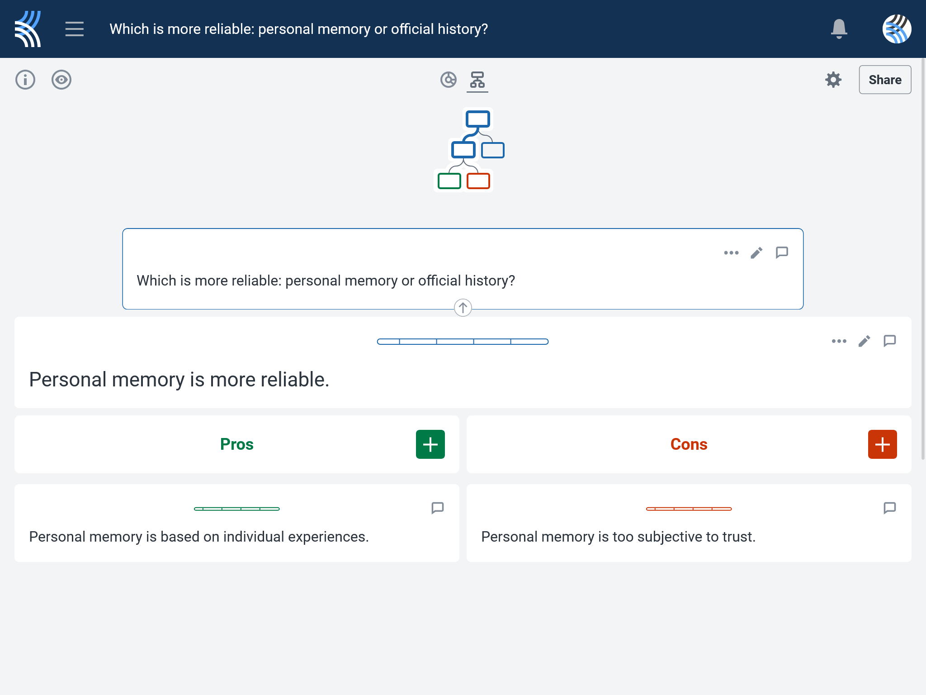
Kialo Discussion: Which is more reliable: personal memory or official history?
Use your case study and any other research to support, challenge, or refine your initial arguments in your Kialo discussion!

Slide 11
Reflection Task: Personal Memory vs. Official History
How does this case shape your understanding of the reliability of memory and history?
Are certain types of knowledge (e.g., personal memory or official history) always more trustworthy?
How should societies handle conflicting narratives?

Slide 12
Lesson Objective: Recap
Analyze real-world examples where personal memory and shared historical records conflict or align.
Explore how different societies remember the same events differently.
Deepen student understanding of reliability, power, and bias.

